Slide 1
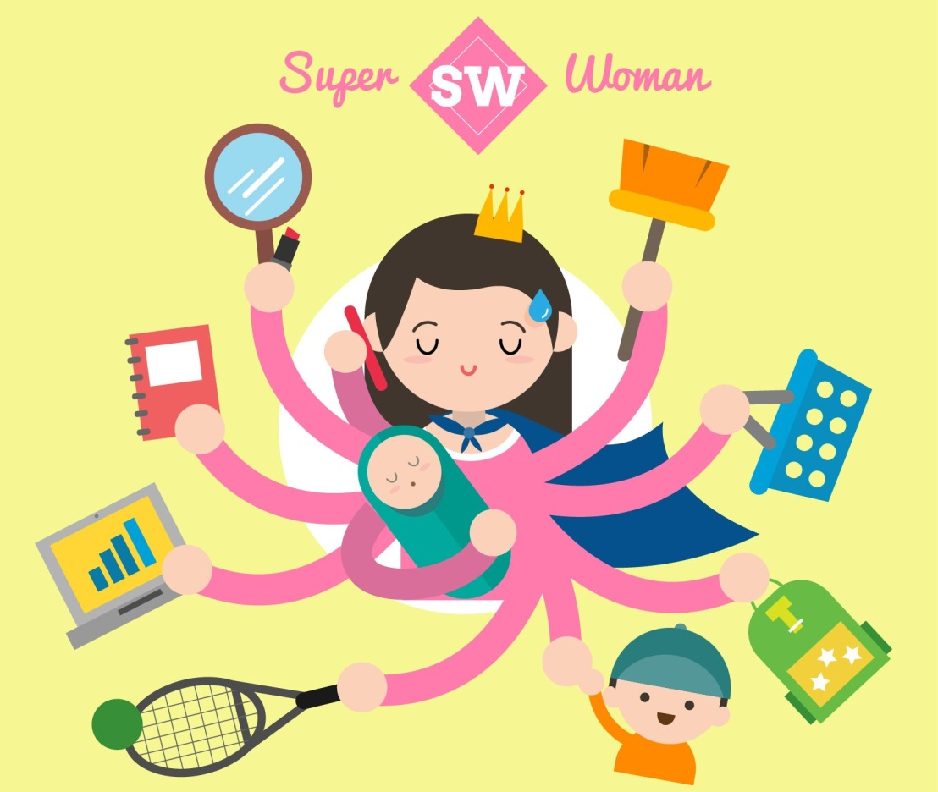
Woman stress & PTDS
prof. dr. rabea m. ali

Slide 2
What is stress?
Stress is the body’s response to the daily events that occur in the life. Everyone experiences stress. Stress can be positive and motivate women to achieve notable goals. But stress can also be negative and destructive, taking its toll in many life areas.

Slide 3
What are the symptoms of stress?
Physical: Headaches, difficulty sleeping, tiredness, pain (most commonly in the back and neck), less interest in sex/other things used to enjoy.
Emotional. Anxiety, depression, anger, unhappiness
Mental: worry, can’t make decisions, negative thinking, lack of focus.

Slide 4
Occupational. poor concentration, unfulfilling job.
Social. Less intimacy, isolation, family problems.

Slide 5
What causes some of the stress seen in women?
In today’s society, women’s roles often include family obligations, caregiving for children and/or elderly parent (statistically more likely to be a woman) and work responsibilities as well as other roles.

Slide 6
As demands increase to fulfill these roles, women can feel overwhelmed with time pressures and unmet obligations. They may feel a sense of failure in not being able to meet expectations for themselves and others. Oftentimes women spend more time meeting the needs of others rather than nurturing their own needs. If functioning at high stress levels, women may not even recognize what their needs are.

Slide 7
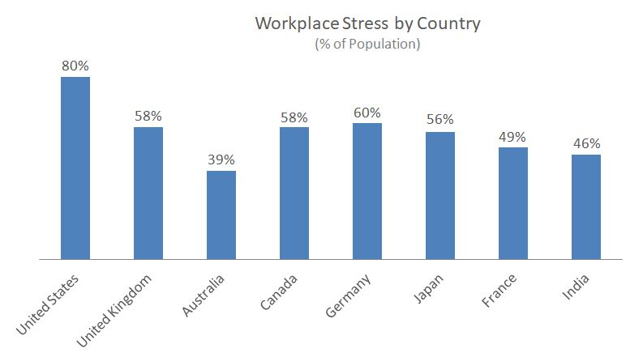

Slide 8
Type of stress
Physical stress: trauma (injury, infection, surgery), intense physical labor/over-exertion, environmental pollution , illness (viral, bacterial, or fungal agents), fatigue, inadequate oxygen supply, hypoglycemia I(low blood sugar), hormonal and/or biochemical imbalances, dietary stress etc..
Psychological stress: emotional stress, cognitive stress relationship/marriage difficulties ,lack of social support.

Slide 9
Behavioral: Avoidance of tasks; sleep problems; difficulty in completing work assignments; tremors; strained face; clenching fists; crying; changes in drinking, eating, or smoking behaviors.
Social: Some people in stressful times tend to seek out others to be with. Other people withdraw under stress. Also, the quality of relationships can change when a person is under stress

Slide 10
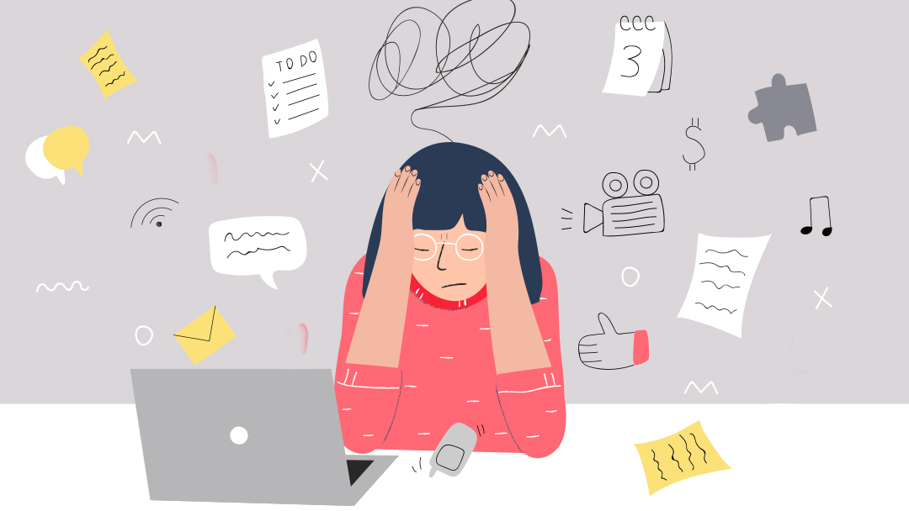

Slide 11
How does stress affect a woman’s health?
Depression and anxiety:
Heart problems. Stress increases blood pressure and heart rate.
Headaches and migraines. Tension headaches are more common in women than men.

Slide 12
Obesity. Women are more prone to stress-related weight gain than men.
Bowel problems. Stress can lead to such bowel problems as irritable bowel syndrome.
Pregnancy issues. Women with higher stress levels have a more difficult time becoming pregnant than women with lower stress levels.
Menstrual problems. Premenstrual syndrome is more severe with increasing stress levels.

Slide 13
How can women better manage stress?
Physical. Exercise, practice relaxation techniques (yoga, meditation, listen to relaxing music), eat healthy (for example, follow the Mediterranean diet), schedule leisure time, get enough sleep (7 to 9 hours/night).
Emotional. Express emotions, repeat positive emotions, work toward a healthy self-esteem.
Mental. Have a positive outlook, realistic thinking, be creative.

Slide 14
Occupational. Establish doable goals, identify home-work balance, set limits.
Social. Strive to maintain loving relationships, establish healthy boundaries, stay connected with friends.
Spiritual. Find the meaning/purpose, focus on gratitude, stay in the present moment

Slide 15
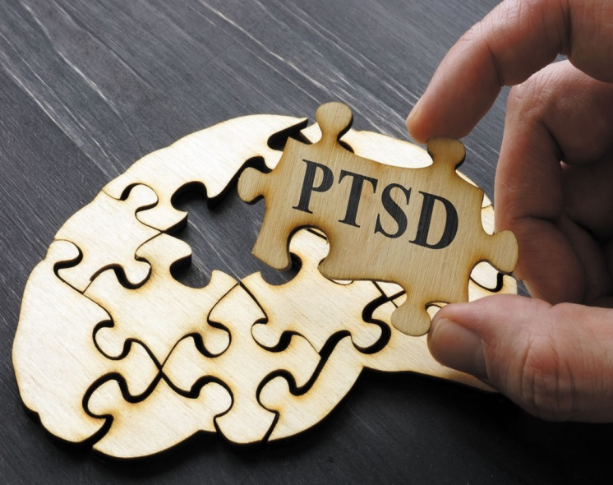
PTSD, or posttraumatic stress disorder: is a set of reactions that can occur after someone has been through a traumatic event. The chance of developing PTSD depends on the type of event experienced, but about 5 to 10% of Australians will suffer from PTSD at some point in their lives.

Slide 16
The main symptoms of PTSD are:
Re-living the traumatic event through distressing, unwanted memories, vivid nightmares and/or flashbacks. This can also include feeling very upset or having intense physical reactions such as heart palpitations or being unable to breathe when reminded of the traumatic event.

Slide 17
Avoiding reminders of the traumatic event, including activities, places, people, thoughts or feelings that bring back memories of the trauma.
Negative thoughts and feelings such as fear, anger, guilt, or feeling flat or numb a lot of the time. A person might blame themselves or others for what happened during or after the traumatic event, feel cut-off from friends and family, or lose interest in day-to-day activities.

Slide 18
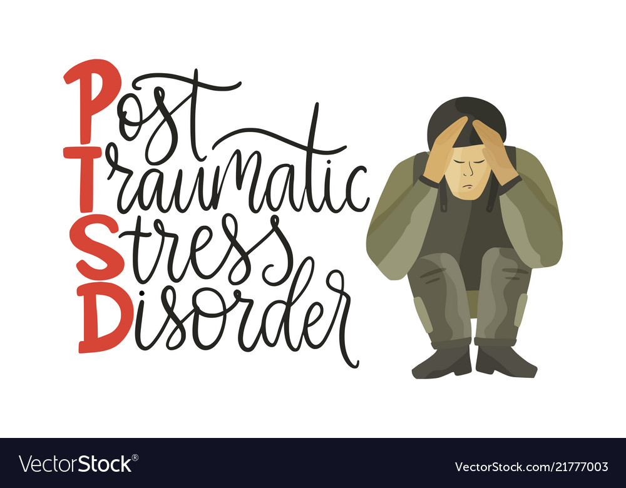
Feeling wound-up. This might mean having trouble sleeping or concentrating, feeling angry or irritable, taking risks, being easily startled, and/or being constantly on the lookout for danger.

Slide 19
Changes in physical and emotional reactions
Being easily startled or frightened
Always being on guard for danger
Self-destructive behavior, such as drinking too much or driving too fast
Trouble sleeping
Trouble concentrating
Irritability, angry outbursts or aggressive behavior
Overwhelming guilt or shame`

Slide 20
Causes
Stressful experiences, including the amount and severity of trauma have gone through life
Inherited mental health risks, such as a family history of anxiety and depression
Inherited features of the personality — often called the temperament
The way the brain regulates the chemicals and hormones that body releases in response to stress

Slide 21
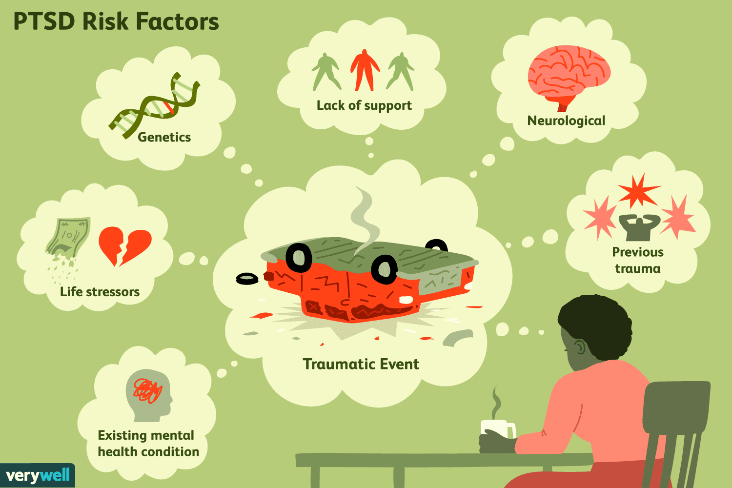

Slide 22
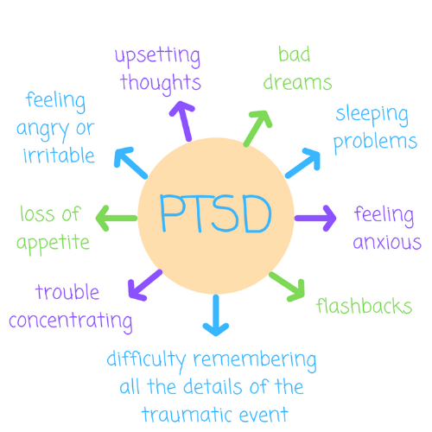

Slide 23
Risk factors:
Experiencing intense or long-lasting trauma
Having experienced other trauma earlier in life, such as childhood abuse
Having a job that increases the risk of being exposed to traumatic events, such as military personnel and first responders

Slide 24
Having other mental health problems, such as anxiety or depression
Having problems with substance misuse, such as excess drinking or drug use
Lacking a good support system of family and friends
Having blood relatives with mental health problems, including anxiety or depression

Slide 25
To diagnose post-traumatic stress disorder, the doctor will likely:
Perform a physical exam to check for medical problems that may be causing the symptoms
Do a psychological evaluation that includes a discussion of the signs and symptoms and the event or events that led up to them
Use the criteria in the Diagnostic and Statistical Manual of Mental Disorders (DSM-5), published by the American Psychiatric Association

Slide 26
Treatment
Psychotherapy(Cognitive therapy, behavioral therapy ,
Medications( antidepressant, antianxiety)

Slide 27
