Slide 1
Reproductive Health
By: Asst. Prof. Dr.Hawraa Hussein Ghafel
MCH Departement

Slide 2
Content of the lecture
Reproductive Health Definition and Indicators
Components of Reproductive Health
Maternal Health
Family Planning
Sexually Transmitted Infections
Abortion
Violence Against Women

Slide 3
Definition of Reproductive health
Reproductive health is defined as” A state of complete physical, mental, and social well being and not merely the absence of disease or infirmity, in all matters related to the reproductive system and to its functions and process”.

Slide 4
Components of Reproductive Health
1.Quality family planning services
2. Promoting safe motherhood: prenatal, safe
delivery and post natal care, including breast
feeding
3. Prevention and treatment of infertility
4. Prevention and management of complications of
unsafe abortion
5.Safe abortion services
6.Treatment of reproductive tract infections
including sexually transmitted infections;

Slide 5
Components of reproductive health
7. Information and counseling on human sexuality,
responsible parenthood and sexual and
reproductive health
8. Active discouragement of harmful practices, such
as female genital mutilation and violence related
to sexuality and reproduction

Slide 6
Reproductive Health indicators
1. Total Fertility Rate: Total number of children a woman would have by the end of her reproductive period, if she experienced the
currently prevailing age-specific fertility rates
throughout her childbearing life. TFR is one of
the most widely used fertility measures to assess the impact of family planning programmes.

Slide 7
Reproductive Health indicators
2.Contraceptive Prevalence (any method):
Percentage of women of reproductive age who
are using (or whose partner is using) a
contraceptive method at a particular point in
time.

Slide 8
Reproductive Health indicators
3. Maternal Mortality Ratio: The number of
maternal deaths per 100 000 live births from
causes associated with pregnancy and child
birth.
4. Antenatal Care Coverage: Percentage of
women attended, at least once during
pregnancy, by skilled health personnel for
reasons relating to pregnancy.

Slide 9
Reproductive Health indicators
5. Births Attended by Skilled Health Personnel:
Percentage of births attended by skilled health
personnel. This doesn’t include births attended
by traditional birth attendants.
6. Availability of Basic Essential Obstetric Care:
Number of facilities with functioning basic
essential obstetric care per 500 000 population.
Essential obstetric care includes, Parenteral
antibiotics, Parenteral oxytocic drugs, Parenteral
sedatives for eclampsia, Manual removal of
placenta, Manual removal of retained products,
Assisted vaginal delivery. These services can be
given at a health center level.

Slide 10
Reproductive Health indicators
7. Availability of Comprehensive Essential
obstetric care: Number of facilities with
functioning comprehensive essential obstetric
care per 500 000 population. It incorporates
obstetric surgery, anesthesia and blood
transfusion facilities.
8. Perinatal Mortality Rate: Number of Perinatal
Deaths (deaths occurring during late pregnancy,
during childbirth and up to seven completed days
of life) per 1000 total births. Deaths which occur
starting from the stage of viability till completion
of the first week after birth (22 weeks of gestation
up to end of first week after birth, WHO). Total birth means live birth plus IUFD born after fetus
reached stage of viability.

Slide 11
Reproductive Health indicators
9. Low birth Weight Prevalence: Percentage of
live births that weigh less than 2500 g.
10. Positive Syphilis Serology Prevalence in
Pregnant Women: Percentage of pregnant
women (15–24) attending antenatal clinics,
whose blood has been screened for syphilis, with positive serology for syphilis.

Slide 12
Reproductive Health indicators
11. Prevalence of Anemia in Women: Percentage
of women of reproductive age (15–49) screened
for haemoglobin levels with levels below 110 g/l
for pregnant women and below 120 g/l for nonpregnant women.
12. Percentage of Obstetric and Gynaecological
Admissions Owing to Abortion: Percentage of
all cases admitted to service delivery points
providing in-patient obstetric and gynaecological
services, which are due to abortion (spontaneous
and induced, but excluding planned termination
of pregnancy)

Slide 13
Reproductive Health indicators
13.Reported Prevalence of Women with FGM:
Percentage of women interviewed in acommunity survey, reporting to have undergone
FGM.
14. Prevalence of Infertility in Women: Percentage of women of reproductive age (15–49) at risk of pregnancy (not pregnant, sexually active, noncontraception and non-lactating) who report trying for a pregnancy for two years or more

Slide 14
Reproductive Health indicators
15. Reported Incidence of Urethritis in Men:
Percentage of men (15–49) interviewed in a
community survey, reporting at least one episode of urethritis in the last 12 months.
16. HIV Prevalence in Pregnant Women:
Percentage of pregnant women (15–24)
attending antenatal clinics, whose blood has
been screened for HIV, who are sero-positive for
HIV.

Slide 15
Reproductive Health indicators
17.Knowledge of HIV-Related Prevention
Practices: The percentage of all respondents
who correctly identify all three major ways of
Reproductive Health preventing the sexual transmission of HIV and who reject three major misconceptions about HIV transmission or prevention

Slide 16
Maternal Health
Motherhood should be a time of expectation and joy for
a woman, her family, and her community. For women in
developing countries, however, the reality of
motherhood is often grim. For those women,
motherhood is often marred by unforeseen
complications of pregnancy and childbirth. Some die in
the prime period of their lives and in great distress: from
hemorrhage, convulsions, obstructed labor, or severe
infection after delivery or unsafe abortion.

Slide 17
Safe Motherhood
The strategies adopted to make motherhood safe vary among countries and include:
Providing family planning services.
Providing post abortion care.
Promoting antenatal care.
Ensuring skilled assistance during childbirth
Improving essential obstetric care.
Addressing the reproductive health needs of adolescents.

Slide 18
Essential Services for Safe Motherhood
Safe motherhood can be achieved by providing high quality maternal health services to all women. These services for safe motherhood should be readily available through a network of linked community health care providers, clinics and hospitals. These services could be provided at different levels including home and health
institutions.

Slide 19
Essential Services include:
1. Community education on safe motherhood
2. Prenatal care and counseling, including the
promotion of maternal nutrition
3. Skilled assistance during childbirth
4. Care for obstetric complications, including
emergencies
5. Postpartum care

Slide 20
Essential Services include:
6. Post-abortion care and, where abortion is not
against the law, safe services for the termination
of pregnancy
7. Family planning counseling, information and
services
8. Reproductive health education and services for
adolescents

Slide 21
Maternal Mortality
Definition : maternal death as the death of a woman while pregnant or within 42 days of termination of pregnancy, irrespective of the duration and site of the pregnancy, from any cause related to or aggravated by the pregnancy or its management, but not from accidental or incidental causes.

Slide 22
Maternal Morbidity
Definition : Any deviation, subjective or objective, from a state of physiological or psychological well being of women.

Slide 23
Causes of Maternal Mortality and Morbidity
1.Direct Obstetric Deaths : are those that result from
obstetric complications of the pregnancy state from interventions, omissions, incorrect treatment or from chain of events.
Examples: Abortion, Ectopic pregnancy, pre-eclampsia, Eclampsia, Obstructed labor, infection, etc.

Slide 24
Causes of Maternal Mortality and Morbidity
Commonest Direct Obstetric Cause:
A. Hemorrhage: Includes antepartum, postpartum, abortion, and ectopic pregnancy.
B. Unsafe Abortion: It is claimed as the
commonest cause of maternal death in our
country accounting for 20 –40% of deaths.
C. Hypertensive disorders of pregnancy: This
includes pre-eclampsia, eclampsia, etc.
Preclampsia and eclampsia account for 10-
12% of maternal deaths.

Slide 25
Causes of Maternal Mortality and Morbidity
Commonest Direct Obstetric Cause:
D. Obstructed Labor and uterine rupture: The
prevalence of obstructed labor is said to be 47
% in Ethiopia. It accounts for 9% of the total
maternal death.
E. Infection: The introduction and multiplication
of microbial agents in the pelvic organs and
other systems having an effect on the health of
the mother and newborn. It includes infection
of the uterus, tubes, urinary system and fetal
infection. It accounts for 10% of maternal
deaths.

Slide 26
Causes of Maternal Mortality and Morbidity
Indirect Obstetric Death: Deaths resulting from previous existing diseases or diseases that developed during pregnancy
Anemia: This is the commonest indirect cause of maternal death in our country, since malaria is endemic and iron supplementation is low
B. Other indirect causes include, heart disease,
diabetes mellitus, HIV/AIDS, TB, Malnutrition,
etc. The indirect obstetric death:

Slide 27
Maternal Mortality in Context: The Three D’s (Delays)
1. Delay in deciding to seek care
Failure to recognize signs of complications
Failure to perceive severity of illness
Cost consideration
Previous negative experience with the health
system
Transportation

Slide 28
Maternal Mortality in Context: The Three D’s (Delays)
2. Delay in reaching care
Lengthy distance to a facility
Conditions of roads
Lack of available transportation

Slide 29
Maternal Mortality in Context: The Three D’s (Delays)
3. Delay in receiving appropriate care
Uncaring attitudes of providers
Shortages of supplies and basic
equipment
Non-availability of health personnel
Poor skills of health providers

Slide 30
Causes of Maternal Morbidity
Maternal morbidity is difficult to measure due to variation in the definition and criteria to diagnose. The risk factors for maternal morbidity include prolonged labor, hemorrhage, infection,
preclampsia, etc.

Slide 31
Factors affecting women health
1.Socio-cultural factors: Like early marriage, early childbirth, harmful traditional practices including female genital mutilation, etc.

Slide 32
Factors affecting women health
2. Economy: Socio economic status affects the
women’s status by affecting their decision making roles in the community, educational status, health coverage, level of sexual abuse, etc.

Slide 33
Factors affecting women health
3. Inadequate Health Service Coverage: Most
mothers do not get care during pregnancy and most deliveries are unattended. This is due to lack of transportation, distance from health facilities, small number of health facilities, etc

Slide 34
Factors affecting women health
4. Psychological factors: For instance, after sexual
abuse women are at great risk of depression.
5.Health and nutrition services: The health status of
women who are not getting adequate amount of
nutrients and proper reproductive health services
could be affected.

Slide 35
Factors affecting women health
6. Interaction with providers: Some health care
providers are, unsympathetic and uncaring as they
do not respect women's cultural preferences. E.g.
privacy, birth position, or treatment by women
providers.
7.Gender Discrimination: E.g. lack of women
empowerment, giving more attention to a male child.

Slide 36
Family planning
Definition:
Family Planning involves planning the number, frequency and timing of pregnancy. In other words it is a program to regulate the number and spacing of children in a family through the practice of contraception or other methods of birth control

Slide 37
Benefits of family planning to women’s health
1. Avoiding pregnancy at the extremes of
maternal age
2. Decreasing risks by decreasing parity: If all
women had five births or fewer, the number of
maternal deaths could drop by 26 %
worldwide.
3. Preventing high-risk pregnancies: decrease
maternal deaths by quarter
4. Prevention of unwanted pregnancy: reduces
unnecessary risks of pregnancy, childbirth and
risks of induced abortion
5. Improving health through non-contraceptive
benefits including prevention of STIs and
reproductive cancers

Slide 38
Types of Family Planning

Slide 39
Types of Family Planning
1.Hormonal contraceptive methods :
include oral contraceptives pills, injectables, and implants. They all prevent pregnancy mainly by stopping a woman’s ovaries from releasing eggs. Hormonal methods contain either one or two female sex hormones that are similar to the hormones naturally produced by a woman’s body.

Slide 40
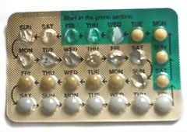
Types of Family Planning
2.Oral contraceptive pills:
should be taken one pill every day. They are most effective when no pills are missed, the pill is taken at the same time every day,and each new pack of pills is started without a delay.

Slide 41
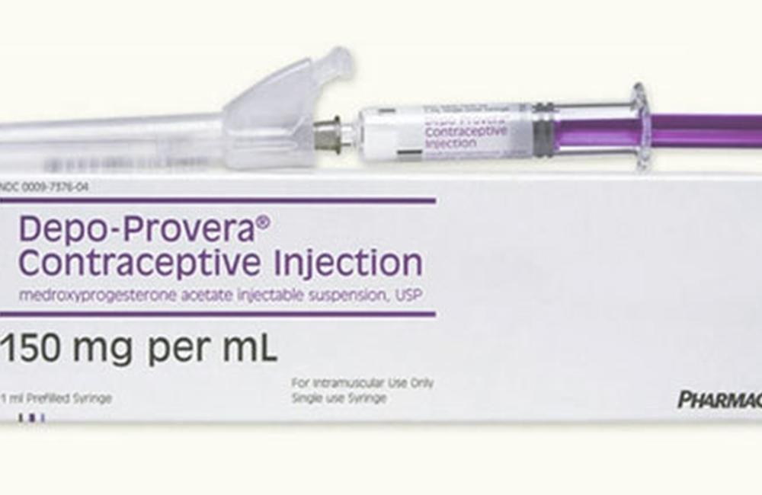
Types of Family Planning
3.Injectable contraceptives:
are given by injection into a woman’s arm or buttocks once every 1, 2, or 3 months, depending on the type of injectable. Injectables are most effective when women remember to come back for re-injection on time.

Slide 42
There are 3 different varieties of Injectable Contraceptives available
1. Monthly Injectable – Cyclofem/ Cycloprovera and Mesigyna/ Norigynon.
2.Bi-monthly Injectable – Noristerat and Norethindrone Enanthate – NET-EN
3. Quarterly Injectable – DMPA (Depo medroxy progesterone acetate)

Slide 43
Types of Family Planning
4.Contraceptive implants:
are inserted under the skin of a woman’s upper arm and provide continuous, highly effective pregnancy protection for 3 to 5 years, depending on the type of implant. When this time is
over, new implants can be inserted during the same visit that the old set is removed.

Slide 44
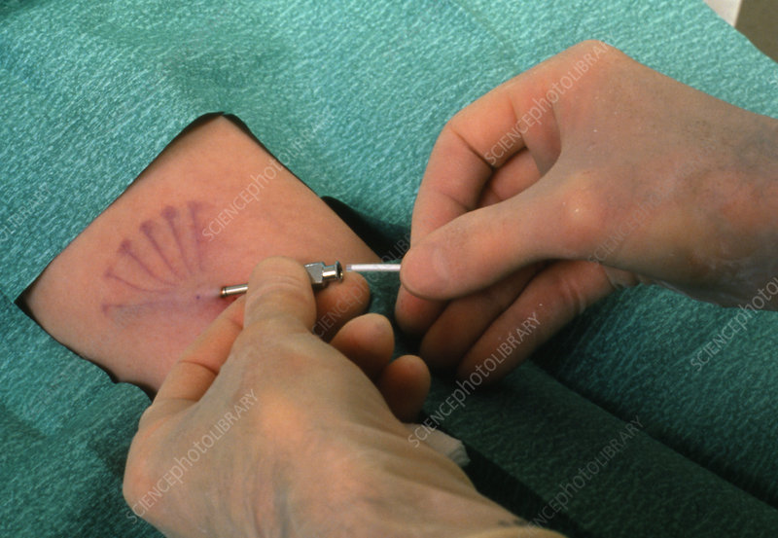
Contraceptive Implants

Slide 45
Types of Family Planning
5.Emergency contraceptive pills (ECPs):
can help prevent pregnancy if taken within 5 days after unprotected sex. The sooner they are taken, the more effective they are. They are NOT meant to be used for ongoing contraception, in place of a regular method.

Slide 46
Emergency contraceptive pills
Pills can be taken after unplanned, unprotected coitus as emergency contraceptive after consulting the doctor . A dose of 4 tablets of a low dose pill within 72 hours of un protected intercourse followed by 4 more tablets 12 hours later.

Slide 47
Types of Family Planning
6.Intrauterine contraceptive devices (IUDs or IUCDs):
are small, flexible plastic devices that are inserted
into the woman’s uterus. The most common IUDs
contain copper, and they work by preventing sperm
from reaching an egg. Depending on the type, IUDs
can provide protection for 5 to 12 years

Slide 49
Intrauterine contraceptive devices (IUDs or IUCDs):

Slide 50
Types of Family Planning
7.Barrier methods are either devices (male and female condoms):
that physically block sperm from reaching
an egg, or chemicals (spermicides) that kill or
damage the sperm in the vagina. The effectiveness of barrier methods greatly depends on people’s ability to use them correctly every time they have sex.

Slide 51
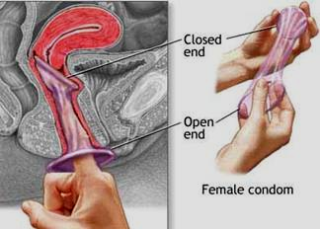
male and female condoms

Slide 52
Types of Family Planning
8.Fertility awareness methods:
require a couple to know the fertile days of the woman’s menstrual cycle — the
days when pregnancy is most likely to occur. During these fertile days the couple must avoid sex or use abarrier method to prevent pregnancy.

Slide 53
Fertility awareness methods

Slide 54
Types of Family Planning
9.Breastfeeding provides contraceptive: protection for the first 6 months after delivery if certain conditions are met. This approach is called the Lactational Amenorrhea Method or LAM.

Slide 55
Types of Family Planning
11. Female and male sterilization:
are permanent methods of contraception. Sterilization involves a relatively simple surgical procedure that provides life-long protection against pregnancy. Sterilization is appropriate for men and women who are certain they do not want more children.

Slide 57
Types of Family Planning
10.Withdrawal:
involves a man withdrawing his penis
during sex and releasing his ejaculate, which
contains sperm, outside the woman’s vagina. For most people withdrawal is one of the least effective contraceptive methods.

Slide 58
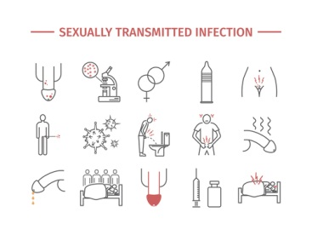
Sexually Transmitted Infections
Reproductive tract infections (RTIs) are infections of the genital tract of women and men

Slide 59
Types of STIs
1. Sexually transmitted infections (STIs)
Infections caused by organisms that are
passed through sexual activity with an infected
partner. More than 40 have been identified, including Chlamydia, gonorrhea, hepatitis B and C, herpes, HPV, syphilis, trichomoniasis, and HIV.

Slide 60
Types of STIs
2. Endogenous infections
– Infections that result from an overgrowth of
organisms normally present in the vagina.
– These infections are not usually sexually
transmitted, and include bacterial vaginosis and
candidiasis.

Slide 61
Types of STIs
3. Iatrogenic infections
– Infections introduced into the reproductive tract
by a medical procedure such as menstrual
regulation, induced abortion, IUD insertion, or
childbirth.
– This can happen if surgical instruments used in
the procedure are not properly sterilized, or if an
infection already present in the lower
reproductive tract is pushed through the cervix
into the upper reproductive tract.

Slide 62
Main STI Pathogens
More than 30 pathogens are transmissible through
sexual intercourse-oral, anal, or vaginal. The main
sexually transmitted bacteria are:
Neisseria gonorrhoeae (causes gonorrhoea)
Chlamydia trachomatis (chlamydial infections)
Treponema pallidum (causes syphilis)
Haemophilus ducreyi (causes chancroid)

Slide 63
Main sexually transmitted viruses
Human immunodeficiency virus (causes
AIDS)
Herpes simplex virus (causes genital herpes)
Human papilloma virus (causes genitalwarts).
Hepatitis B virus
Cytomegalovirus

Slide 64
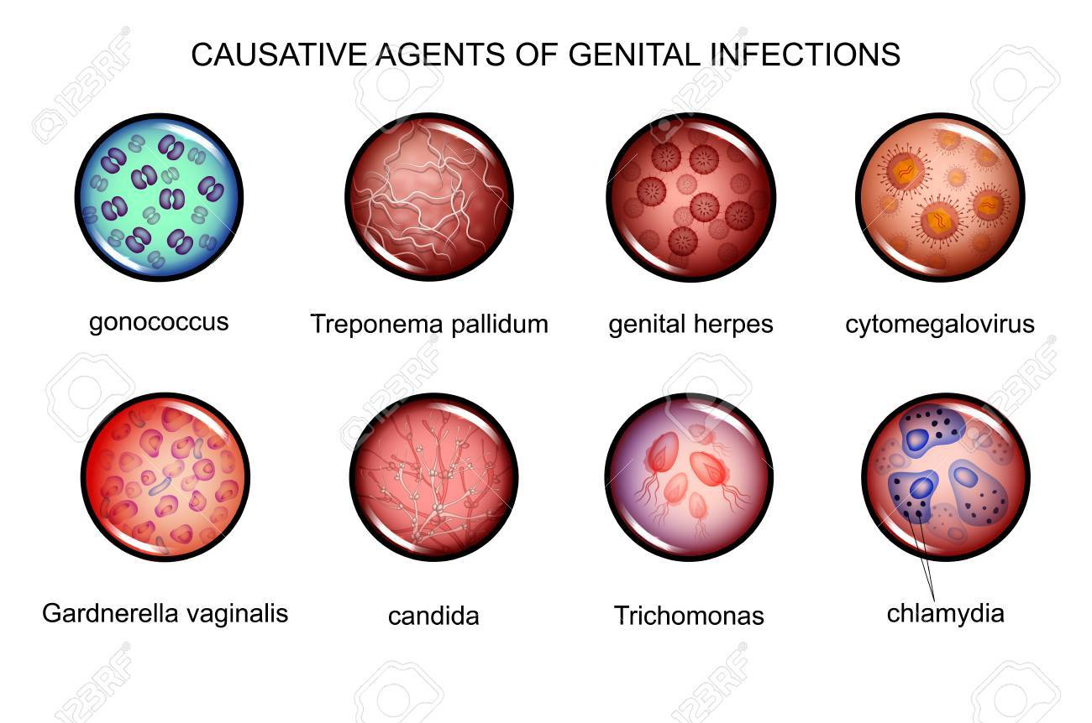
Main parasitic organisms
Trichomonas vaginalis (causes vaginal
trichomoniasis)

Slide 65
Classification of STIs
1. Diseases characterized by genital ulcer
• Chancroid, Genital herpes simplex virus,
Granuloma inguinale (Donovanosis),
Lymphogranuloma Venarum, Syphilis

Slide 66
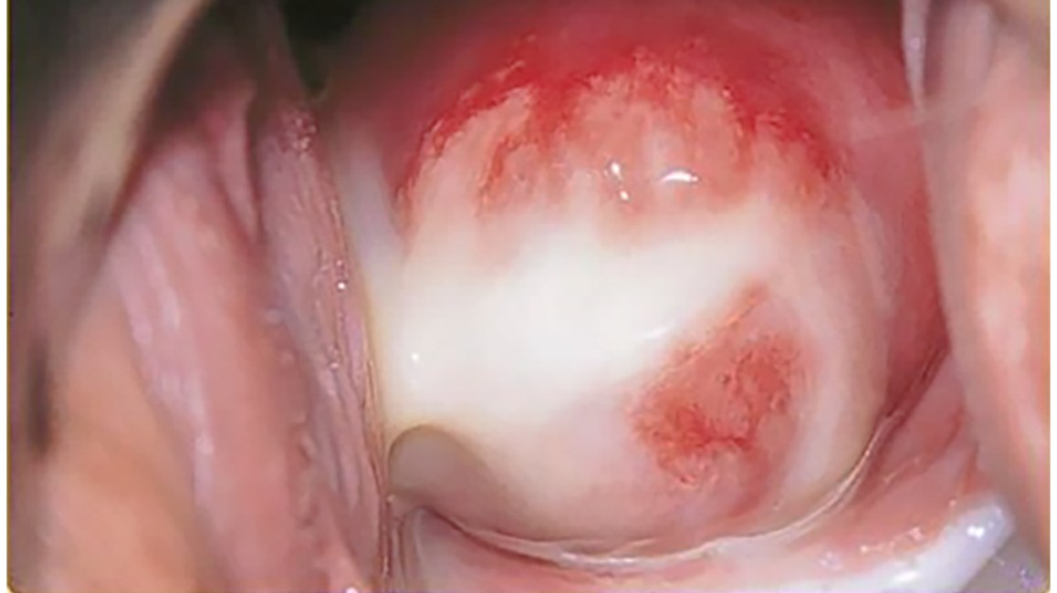
Classification of STIs
2. Diseases characterized by urethritis and cervicitis
• Chlamydial infection, Gonorrhea

Slide 67
Classification of STIs
3. Diseases characterized by vaginal discharge
• Bacterial vaginosis, trichomoniasis, Vulvovaginal candidiasis

Slide 68
Classification of STIs
4. Pelvic Inflammatory Disease (PID)
5. Epididymitis
6. Human papilomavirus infection (Genital wart)
7. Vaccine preventable STDs
• Hepatitis A, Hepatitis B
8. Proctitis, Proctocolitis and enteritis
9. Ectoparasitic Infections
• Pediculosis Pubis, Scabies

Slide 69
Main STI syndromes
Genital ulcer
Inguinal bubo
Scrotal swelling
Vaginal discharge
Lower abdominal pain
Neonatal conjunctivitis

Slide 70
STI Control Strategies
Prevention by promoting safer sexual behaviors
2. General access to quality condoms at affordable
prices
3. Promotion of early recourse to health services by
people suffering from STIs and by their partners
4. Inclusion of STI treatment in basic health services
5. Specific services for populations with frequent or
unplanned high-risk sexual behaviors

Slide 71
STI Control Strategies
6. Proper treatment of STIs, i.e. use of correct and
effective medicines; treatment of sexual partners;
education and advice; reliable supply of condoms;
7. Screening of clinically asymptomatic patients;
8. Provision for counseling and voluntary testing for
HIV infection;
9. Prevention and care of congenital syphilis and
neonatal conjunctivitis;
10. Involvement community, in prevention
of STIs and prompt contact with health services for
those requiring care.

Slide 72
ABORTION
Abortion is the termination or initiation of termination of pregnancy before reaching viability (before 20weeks or <500grams according to WHO.
WHO characterizes unsafe abortion by the lack of skilled providers, safe techniques, and/or sanitary facilities.

Slide 73
Introduction
It could be induced or spontaneous.
Three consecutive abortions would be
termed; habitual abortion.
The frequency of spontaneous abortions is
12 to 15%.
The frequency of habitual abortion is about
0.4 to 0.8%.
75% of spontaneous abortions occur
before the 16th week of gestation and 62%
before 12 weeks.

Slide 74
Abortion-related morbidities and mortalities
Unsafe abortion is a global problem. Millions of women around the world risk their lives and health to end an unwanted pregnancy. Every day, 55, 000 unsafe abortions take place–95 % of them in developing countries-and lead to the deaths of more than 200 women daily. Globally, one unsafe abortion takes place for every seven births.

Slide 75
Acute Complications of unsafe abortion
Incomplete abortion
Sepsis
Hemorrhage
Uterine Perforation
Bowel injury

Slide 76
Long term Complications of unsafe abortion
Chronic pelvic pain
Pelvic inflammatory disease
Tubal blockage and secondary infertility
Ectopic pregnancy
Increased risk of spontaneous abortion or premature delivery in subsequent pregnancies.

Slide 77
Types of abortion

Slide 78
PREVENTION of Abortion
Progesterone: R M Oates Cochrane, 14
trials, 1988 women; progestogens and
placebo with similar outcome.
• Bed rest: A Aleman (2005) 2 studies of 84
women, placebo and bed rest similar,
hospital and home bed rest similar, HCG
reduced miscarriage more than bed rest.

Slide 79
Treatment of Threatened abortion
The most frequent indication of cerclage is
prophylaxis, around the 15th week of
gestation; Mac Donald (1963) and
Shirodkar (1955).

Slide 80
post-abortion care
1. Treatment of incomplete and unsafe abortion
2. Counseling
3. Family planning services
4. Links to comprehensive reproductive health services and Community
5. Service provider partnerships.

Slide 81
Violence Against Women
Globally, at least one in three women has experienced
some form of gender-based abuse during her lifetime.
Violence against women is any act of gender-based
violence that results in, or is likely to result in, physical,
sexual, psychological harm or suffering to women,
including threats of such acts, coercion or arbitrary
deprivations of liberty, whether occurring in public or
private life. A

Slide 82
Violence Against Women
Women with a history of physical or sexual abuse are also at increased risk for unintended pregnancy, sexually transmitted infections, and adverse pregnancy outcomes. Females of all ages are victims of violence, in part because of
their limited social and economic power compared with men.

Slide 83
Impact of violence on Health
1.Physical: injuries, bruises, chronic pain
syndromes, disability, fractures, GI disorders,
irritable bowel syndrome, reduced physical
functioning
 2.Sexual and reproductive health: gynecological
disorders, infertility, PID, pregnancy
complications/miscarriage, sexual dysfunction,
STIs including HIV/AIDS, unsafe abortion and
unwanted pregnancy

Slide 84
Impact of violence on health
4.Psychological and behavioral: alcohol and
drug abuse, depression and anxiety, poor selfesteem, psychosomatic disorders, unsafe sexual
5.behavior, phobias and panic disorder
 Fatal health consequences: AIDS-related
mortality, maternal mortality, homicide, and
suicide

Slide 85
Supporting Women Who Disclose Abuse
 Assess for immediate danger
 Provide appropriate care
 Document women’s condition
 Develop a safety plan
 Inform women of their rights
 Refer women to community resources
Community health promotion
Communication campaigns

Slide 86
Prevention strategies also need to focus on
 Empowering women and raising their status
 Combating norms of violence
 Reducing poverty and alcohol consumption

Slide 87
References
Reproductive health for health science students. university of Gondar.2008.available at https://www.cartercenter.org/resources/pdfs/health/ephti/library/lecture_notes/health_science_students/RH_HSS_final.pdf
A guide to family planning for community health workers and their clients. WHO available at https://apps.who.int/iris/handle/10665/44882
Facts for family planning :family planning methods.ch7. available at https://www.fphandbook.org/factsforfamilyplanning
• WHO. Prevention and Control of STIs: draft global strategy. May 2006
• WHO. Sexually transmitted and other
reproductive tract infections. 2005
• WHO. Training modules for the syndromic management of STIs. 2nd edition
https://www.researchgate.net/publication/279258832_family_planing/link/5591420408ae15962d8d4f2f/download

