Slide 1
Pre pregnancy competency and family planning

Slide 2
Introduction:
Competencies in this category are about health assessment of the woman and fetus, promotion of health and well-being, detection of complications during pregnancy and care of women with an unintended pregnancy.

Slide 3
A. Provide pre-pregnancy care
• Anatomy and physiology of female and male related to reproduction and sexual development
• Socio-cultural aspects of human sexuality
• Evidence based screening for cancer of reproductive organs
and other health problems such as diabetes, hypertension, thyroid conditions, and chronic infections that impact pregnancy

Slide 4
• Identify and assist in reducing barriers related to accessing and using sexual and reproductive health services
• Assess nutritional status, current immunization status, health behaviors such as smoking, existing medical conditions, and exposure to known teratogens
• Carry out screening procedures for sexually transmitted and other infections, HIV, cervical cancer
• Provide counseling about nutritional supplements such as folic acid, dietary intake, exercise, updating immunizations as needed.
modifying risk behaviors.
and prevention of sexually transmitted infections.

Slide 5
B .Determine health status of woman
• Confirm pregnancy and estimate gestational age from history, physical exam, laboratory test and/or ultrasound
• Obtain comprehensive health history
• Perform a complete physical examination
• Obtain biologic samples for laboratory tests (e.g. venipuncture, urine samples, and vaginal swabs)
• Provide information about conditions that may be detected by screening
• Assess status of immunizations, and update as indicated
• Discuss findings and potential implications with woman and mutually determine plan of care

Slide 6
C. Promote and support health behaviors that improve well being
• Impact of adverse social, environmental, and economic conditions on maternal -fetal health
• Effects of inadequate nutrition and heavy physical work
• Effects of tobacco use and exposure to second-hand smoke, use of alcohol and addictive drugs
• Effects of prescribed medications on fetus
• Community resources for income support, food access, and programs to minimize risks of substance abuse
• Strategies to prevent or reduce risks of mother-to-child disease transmission including infant feeding options for HIV infection

Slide 7
• Provide emotional support to women to encourage change in health behavior
• Provide information to woman and family about impact on mother and fetus of risk conditions.
• Counsel women about and offer referral to appropriate persons or agencies for assistance and treatment
• Respect women’s decisions about participating in treatments and programs
• Make recommendations and identify resources for smoking reduction/cessation in Pregnancy

Slide 9
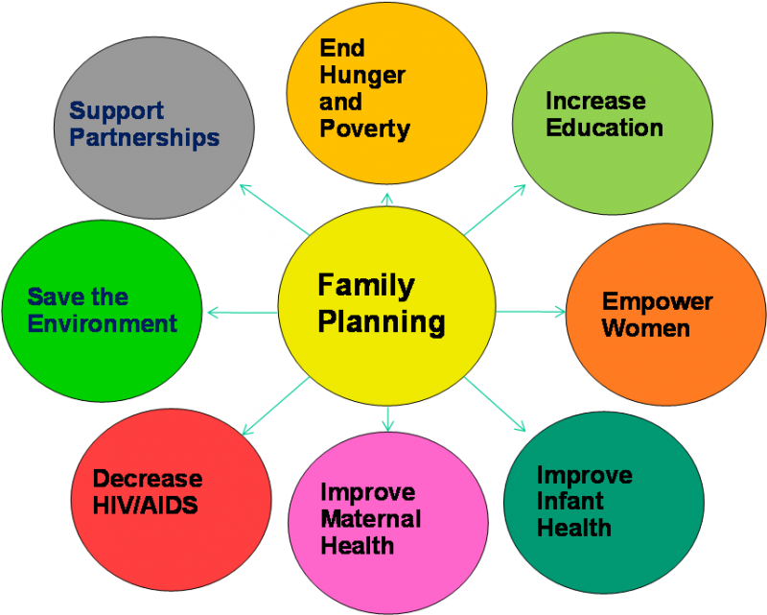

Slide 10
Benefits of family planning / contraception
Promotion of family planning – and ensuring access to preferred contraceptive methods for women and couples – is essential to securing the well-being and autonomy of women, while supporting the health and development of communities.

Slide 11
Preventing pregnancy-related health risks in women
1-Reducing infant mortality
2-Helping to prevent HIV/AIDS
3-Empowering people and enhancing education
4-Reducing adolescent pregnancies
5-Slowing population growth

Slide 12
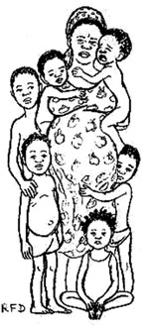

Slide 13
Benefits of birth spacing:
For maximum protection, women after childbirth should not wait until the return of monthly bleeding to start a contraceptive method, but start as soon as safe guidance for her chosen method allows

Slide 14
Appropriate birth spacing lowers the risk of:
Maternal mortality
Fetal death (miscarriage or stillbirth), neonatal mortality
Anemia in the mother during subsequent pregnancies
Postpartum inflammation of the endometrium lining the uterus
Premature rupture of the amniotic membranes surrounding the fetus
Premature birth
Intrauterine growth retardation and a low birth-weight baby
Malnutrition of newborns and infants due to insufficient breast milk.

