Slide 1
Nursing care of women and family experience Postpartum Complications
باشراف
ا.م.د. حوراء حسين

Slide 2
Common postpartum complications
Postpartum hemorrhage
Hypertensive disorders
Infection
Venous disorders
Postpartum mood disorders
Amniotic fluid embolism

Slide 3
Postpartum hemorrhage
Definition:
Blood loss >500cc within 24 hrs of delivery (vaginal delivery)
Blood loss >1000cc within 24 hrs of delivery (Cesarean delivery)
A change in postpartum hemoglobin concentration
Blood loss requiring transfusion

Slide 4
Types of postpartum hemorrhage
Primary or early postpartum hemorrhage
Occurs within 24 hrs after delivery
Secondary or delayed postpartum hemorrhage
Occurs 24hrs to 12 wks after delivery
More commonly due to placental site sub involution and retained placental parts
May be associated with von Willebrand’s disease

Slide 5
of postpartum hemorrhage causes
Uterine atony
Lacerations of the upper or lower genitourinary tracts
Retained products of conception
Invasive placental implantation
Uterine inversion or rupture
Coagulation disorders
Infection
Placental site subinvolution

Slide 6
Risk factors
Precipitous or prolonged 1st or 2nd stage of labor or both
Overstretching of the uterus
Drugs
Birth trauma
Previous postpartum hemorrhage, uterine rupture or uterine surgery
Past placenta accreta, increta or percreta
Current diagnosis of placenta previa

Slide 7
Risk factors (cont
Uterine malformation or fibroids
Coagulation disorders
Maternal exhaustion, malnutrition, anemia or PIH
Grand multiparity
Uterine infection

Slide 8
Assessment
Symptoms:
Dizziness, lightheadedness, fainting
Tachycardia, tachypnea, weak pulse, decreasing bp
Oliguria, profound hypotension and signs of shock
Altered loc
Uterine atony
Lacerations
Hematoma
DIC (disseminted intervascular )

Slide 9
Intervention
Immediate postpartum period
Prompt response
Medical orders
Exam for lacerations
Removal of retained products of conception
Uterine tamponade
Arterial embolization
Surgery

Slide 10
Intervention (cont
After initial post delivery period
Uterine assessment
Lochia assessment
Vital signs
Guard against inaccurate assessment
Notify physician

Slide 11
After stabilization
Encourage rest
Nutritional and fluid support
Vitamins and iron supplements
Assist and encourage mild activity
Antibiotics as ordered

Slide 12
Hypertensive disorders
Five classifications of hypertension in pregnancy
Gestational hypertension
Preeclampsia
Eclampsia
Chronic hypertension
Preeclampsia superimposed on chronic hypertension

Slide 13
Postpartum management of hypertension
30% of cases of eclampsia and HELLP syndrome occur after delivery
Magnesium sulfate continued postpartum as ordered or per policy
Facilitate family bonding
Discharge teaching

Slide 14
Postpartum management of hypertension (cont)
Monitor for signs and symptoms of preeclampsia
Strict bp measurement
Monitor renal function, liver function tests, platelet count and coagulation profile
Medications
Labetolol
Hydralazine
Nifedipine
Continue treatment for 2-3 wks postpartum and then reevaluate

Slide 15
Infection
Definition
An oral temp > 100.4F on any two of the first ten days postpartum
Temp 101.6F or higher during the first 24 hrs post delivery taken at least four times a day

Slide 16
Types of infections
Endometritis
Cesarean section wound infection
Perineal wound infection
Urinary tract infection
Breast infection
other ( upper respiratory infection or appendicitis or other viral infections)

Slide 17
Risk factors
Cesarean birth
Young age
Low socioeconomic status
Prolonged labor
Multiple vaginal exams during labor
Severe anemia or diabetes
Traumatic delivery

Slide 18
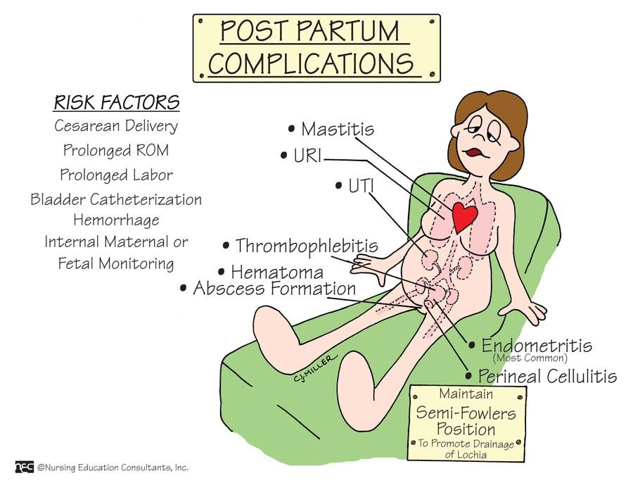

Slide 19
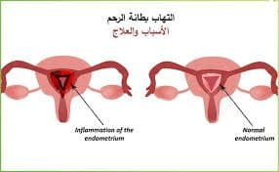

Slide 20
Risk factors
Postpartum hemorrhage
Malnutrition
Pre-existing infection
Hematoma
Foley catheter in place > 24 hrs
Perineal lacerations
Internal monitoring

Slide 21
Assessment
Genital tract
Urinary tract
Breasts
Wound
Psychosocial

Slide 22
Interventions
IV antibiotics
Cultures
Prevention
Education

Slide 23
Venous disorders
Definition:
Variety of terms (superficial phlebitis, DVT (deep vein thrombophlebitis ), thrombophlebitis)
Inflammation or infection of the wall of a vessel in which a clot attaches to a vessel wall with possible thrombus formation
Incidence
Decreased with early ambulation
Dvt-more common in antepartum period
Pe-more common in postpartum period
Can occur up to the 20th day postpartum

Slide 24
Types of venous disorder
Superficial phlebitis
Deep vein thrombosis
Septic pelvic thrombophlebitis

Slide 25
Causes of venous disorder
Vessel wall damage
Venous stasis
Altered coagulation state

Slide 26
assessment
Reports of pain in leg or groin
Nonspecific back pain or right lower quadrant pain
Tenderness to palpation
Increased temperature of limb
Coolness of limb with edema and pain
Erythema or discoloration of the extremity
Fever
Pulmonary embolism
Homans sign

Slide 27
Diagnostics
D-dimer
Ultrasound or MRI
Complete blood count
Blood cultures
Screening for clotting disorders

Slide 28
Interventions
Bedrest
Elevation
Analgesics
Compression therapy
Anticoagulants
Heparin
Coumadin
Lovenox

Slide 29
Intervention
Oxygen as needed
Frequent rest periods
Vital signs
Emotional support

Slide 30
Postpartum mood disorders
Baby blues
Postpartum depression
Postpartum psychosis

Slide 31
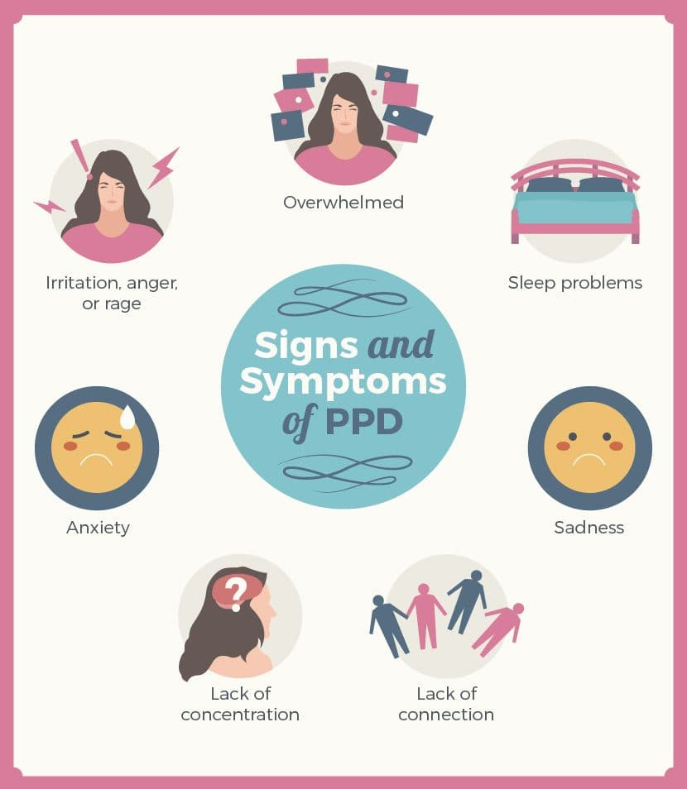

Slide 32
Postpartum mood disorders
Baby blues
Mildest form of pp mood disorder
Occurs on the 3rd to 8th pp day
Incidence of 60-80% of all pp women
Symptoms disappear spontaneously by the second postpartum week with support and adequate rest
May progress to postpartum depression

Slide 33
Postpartum mood disorders
Postpartum depression
Major mood disorder the onset of which occurs within the first 4 weeks after delivery
Incidence 10-20% of all postpartum women
Depressed mood or decreased interest or pleasure in activities, most of the day nearly every day for 2 weeks or more
Disabling and can last for prolonged period

Slide 34
Postpartum mood disorders
Postpartum psychosis
Symptoms include hallucinations, bizarre behavior, delusions, extreme disorganizations of thought and phobias
Incidence of 0.1% pr 1/1000 postpartum women
Onset usually occurs within the first 2 weeks after delivery
Women with postpartum psychosis should not be left alone with their infants

Slide 35
Assessment
Risk factors
Symptoms
Physical findings
Psychosocial findings
Diagnostics

Slide 36
intervention
Data collection
Request psych evaluation
Confirm correct use of antidepressant medications
Support coping mechanisms
Facilitate family interactions and care
Explain changes that occur during postpartum period
Assist with home risk identification

Slide 37
Amniotic fluid emboliss
Also called anaphylactoid syndrome of pregnancy
It is thought that the entry of amniotic fluid and fetal cells into the maternal circulation in certain patients causes an anaphylactiod reaction
Causes acute onset of maternal dyspnea and hypotension, followed by cardiopulmonary collapse

Slide 38
Amniotic fluid embolism
40% develop, left-sided heart failure, and multisystem failure
Mortality rate as high as 80%
Those who survive 85-92% have permanent neurologic impairment

Slide 39
Assessment
physical finding
Acute respiratory distress
Acute circulatory collapse
Acute onset of coagulopathy
Psychosocial findings
Diagnostic possibilities

Slide 40
Intervention
Recognition
Oxygen and IV therapy
CPR
Assist with intubation
Administer crystalloid solutions
Monitor vital signs, pulse oximetry and color
Have emergency medications at hand

Slide 41
Intervention (cont
Obtain chest x-ray and ekg
Observe for signs and symptoms of shock
Observe for signs and symptoms of coagulopathy
Obtain lab work
Assist with central line placement
Prevent hypothermia
Keep family informed

Slide 42
Reference
http://www.9news.com/story/news/health/2014/11/19 /amniotic-fluid-embolism-denver-mother/19250207/
Su, L, Chong, Y, Samuel, M. Carbetocin for preventing postpartum haemorrhage, Cochrane Database Syst Rev (Issue 4): DOI: 10.1002/14651858.CD005457.pub4. Chichester, UK: John Wiley & Sons; 2012.
Tuncalp, O, Hofmeyr, GJ, Gülmezoglu, AM. Prostaglandins for preventing postpartum haemorrhage, Cochrane Database Syst Rev (Issue 8):DOI: 10.1002/14651858.CD000494.pub4. Chichester, UK: John Wiley & Sons; 2012.
Begley, CM, Gyte, GM, Devane, D, et al. Active versus expectant management for women in the third stage of labour, Cochrane Database Syst Rev (Issue 11): DOI: 10.1002/14651858.CD007412.pub3. Chichester, UK: John Wiley & Sons; 2011.

