Slide 1
Monitoring Labor Using Partograph Prof. Dr. Rabea M. Ali

Slide 2
Stages of Labor
First Stage of Labor: This stage starts with true labor pains and ends with a full dilatation of the cervix. This stage does not usually last more than 12 hours.
Second Stage of Labor: This stage begins with a full dilatation of the cervix and ends with delivery of the neonate. Under normal circumstances it lasts for 1-2 hours or less.

Slide 3
Stages of Labor
Third Stage of Labor: This stage ends with the delivery of the placenta and fetal membranes. It normally takes 15-30 minutes or less.
Fourth Stage of Labor: This stage occurs during the first two hours after completing the delivery of the fetus and placenta. This is when myometrial contractions and reactions take place along with blood vessel thrombosis to control postpartum hemorrhage (a major killer of young women).

Slide 4
THE PARTOGRAPH
“An Early Warning System”
Definition:
A partograph is a graphical record of progress during labor. Progress is measured by cervical dilatation against time in hours, and a record is made of the important conditions of the mother and fetus that may arise during the labor process.

Slide 5
Purpose of the partograph:
To detect abnormal progress of labor as early as possible
To prevent prolonged labor
To recognize CPD long before obstructed labor
To assist in early decision on augmentation or termination of labor
To increase the quality and regularity of all observations of mother and fetus.
To recognize maternal or fetal problems as early as possible

Slide 6
Components Of The Partograph
Part I: Assessment of Fetal condition.
Part II: Progress of labor.
Part III: Assessment of Maternal condition.
Part IV: Outcome of labor

Slide 7
Part I; Assessment of Fetal Condition
1.Fetal Heart Rate
>160 beats/min = Tachycardia
<120 beats/min = Bradycardia
<100 beats/min = Severe bradycardia

Slide 8
2. Membranes and Liquor
Intact membranes I
Ruptured membranes + Clear liquor C
Ruptured membranes + Meconium stained liquor M
Ruptured membranes + Blood-stained liquor B
Ruptured membranes + Absent liquor A

Slide 9
3. Molding the Fetal Skull Bones
Molding is an important indication of how adequately the pelvis can accommodate the fetal head
Separated bones, sutures felt easily 0
Bones just touching each other +
Overlapping bones (reducible) ++
Severely overlapping bones (non-reducible) +++

Slide 10
Part II; Progress of Labor
Cervical dilation against time: Cervical dilation is divided into Latent & Active Phase
Latent and Active Phases
Latent phase:
Starts from onset of labor until the cervix reaches 3 cm dilation.
Once 3 cm dilation is reached, labor enters the active phase.
Lasts 8 hours or less.
Contractions at least 2/10 min. each lasting ≥ 20 seconds.

Slide 11
Latent and Active Phases (Cont.)
Active phase:
Starts when the cervix reaches 3 cm dilation.
Contractions at least 3/10 min. each lasting ≥ 40 seconds.
The cervix should dilate at a rate of 1 cm/hour or faster.

Slide 12
2. Cervical Dilation
Cervical dilation is the most important information and the surest way to assess progress of labor, even though other findings discovered on vaginal examination are also important. When progress of labor is normal and satisfactory, plotting of cervical dilation remains on the Alert Line or to left of it.

Slide 13
2. Cervical Dilation
The Alert Line ( Health Facility Line):
The Alert line drawn from 3 cm to 10 cm dilation represent the rate of dilation of 1 cm/hr.
Action Line (Hospital Line):
The Action Line is drawn four hours to the right of the alert Line and parallel to it. This is the critical line at which specific management decision must be made.

Slide 14
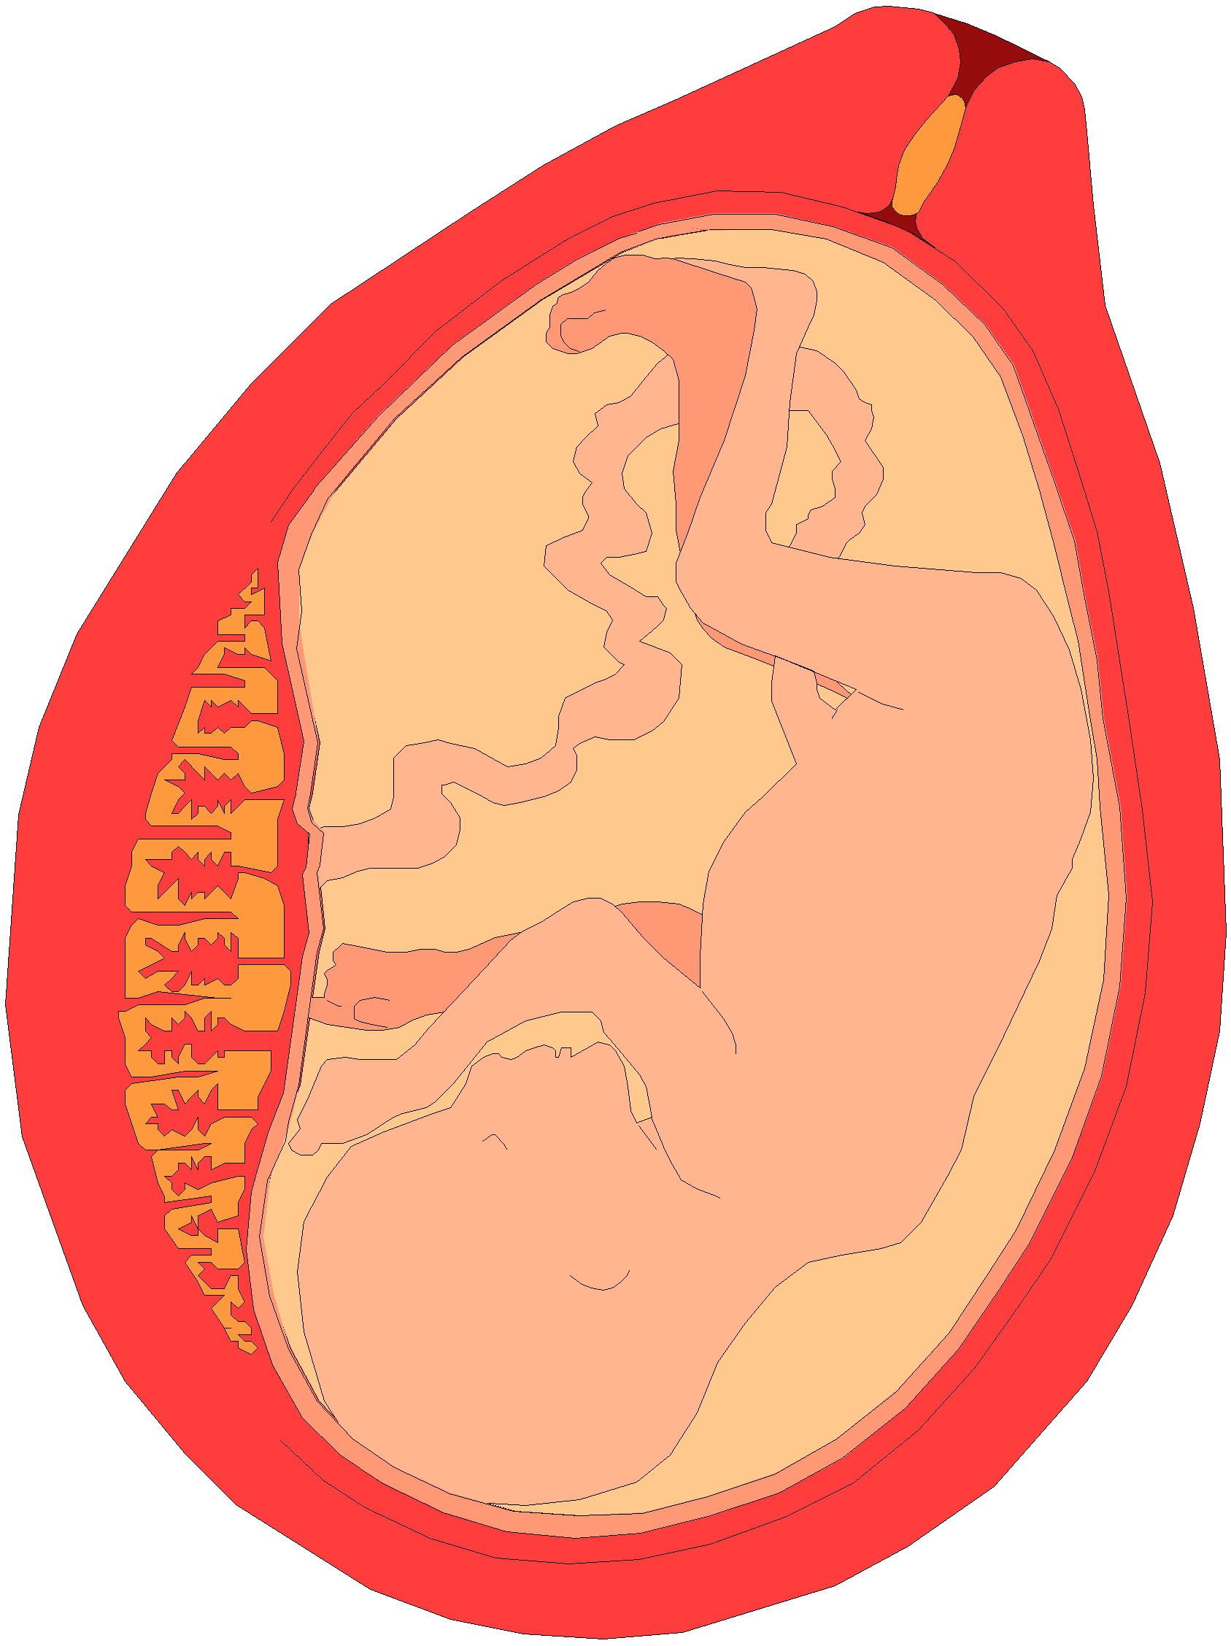
3. Descent of the Fetal Head
Descent of the fetal head should be assessed by abdominal examination immediately before doing a vaginal examination, using the Rule of Fifths to assess engagement.

Slide 15
Descent of head as assessed by abdominal examination
Head accommodates full width of 5 fingers above the brim
Head is mobile above brim – 5/5
Head accommodates 2 fingers above the brim
Head is engaged – 2/5

Slide 16
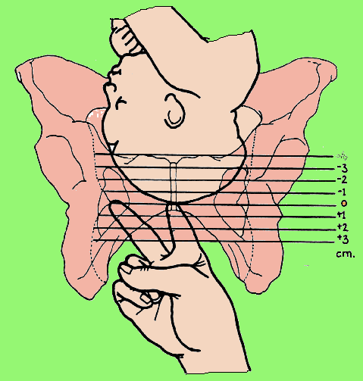
Assessing the Descent of the Fetal Head by Vaginal Examination

Slide 17
Uterine Contractions
Observations of the contractions are made every hour in the latent phase and every half-hour in the active phase.
Each square represents one contraction.

Slide 18
Uterine Contractions
Frequency of contraction is assessed by the number of contractions in a 10 minute period.
Duration:
is measured in seconds from the time the contraction is first felt abdominally, to the time the contraction phase off.

Slide 19
Part III;
Assessment of Maternal Condition
Assess the maternal condition regularly by monitoring:
Pulse every 30 minutes.
Blood pressure every 4 hours
Temperature every 2 hours
Urine volume, analysis for protein & acetone
Drugs, IV fluids, and oxytocin, if labor is augmented.

Slide 20
Points to Remember
A partograph chart must only be started when a woman is in labor; be sure that she is contracting enough to start a partograph.
If progress of labor is satisfactory, the plotting of cervical dilation will remain on or to the left of the Alert Line.
When labor progresses well, the dilation should not move to the right of the Alert Line.

Slide 21
Points to Remember (Cont.)
The latent phase, 0-3 cm dilation, is accompanied by gradual shortening of the cervix. Normally, the latent phase should not last more than 8 hours.
The active phase, 3-10 cm dilation, should progress at the rate of at least 1 cm/hour.
When admission takes place in the active phase, the admission dilation is immediately plotted on the Alert Line.

Slide 22
Points to Remember (Cont.)
When labor goes from latent to active phase, plotting of the dilation is immediately transferred from the latent phase area to the Alert Line.
Dilation of the cervix is plotted (recorded) with an X, descent of the fetal head is plotted with an O, and uterine contractions are plotted with differential shading.

Slide 23
Points to Remember (Cont.)
Descent of the head should always be assessed by abdominal examination (by Rule of Fifths felt above the pelvic brim) immediately before doing a vaginal examination.
When the woman arrives in the latent phase, time of admission is 0 time.

Slide 24
Points to Remember (Cont.)
A woman whose cervical dilation moves to the right of the Alert Line must be transferred and managed in an institution with adequate facilities for obstetric interventions, unless delivery is near.
When a woman’s partograph reaches the Action Line, she must be carefully reassessed to determine why there is lack of progress, and a decision must be made on further management (usually by an obstetrician or resident).

Slide 25
Points to Remember (Cont.)
When a woman in labor passes the latent phase in less than 8 hours, i.e., transfers from latent to active phase, the most important feature is to transfer plotting of cervical dilation to the Alert Line using the letters TR, leaving the area between the transferred recording blank. The broken transfer line is not part of the process of labor.
Do not forget to transfer all other findings vertically.

Slide 26
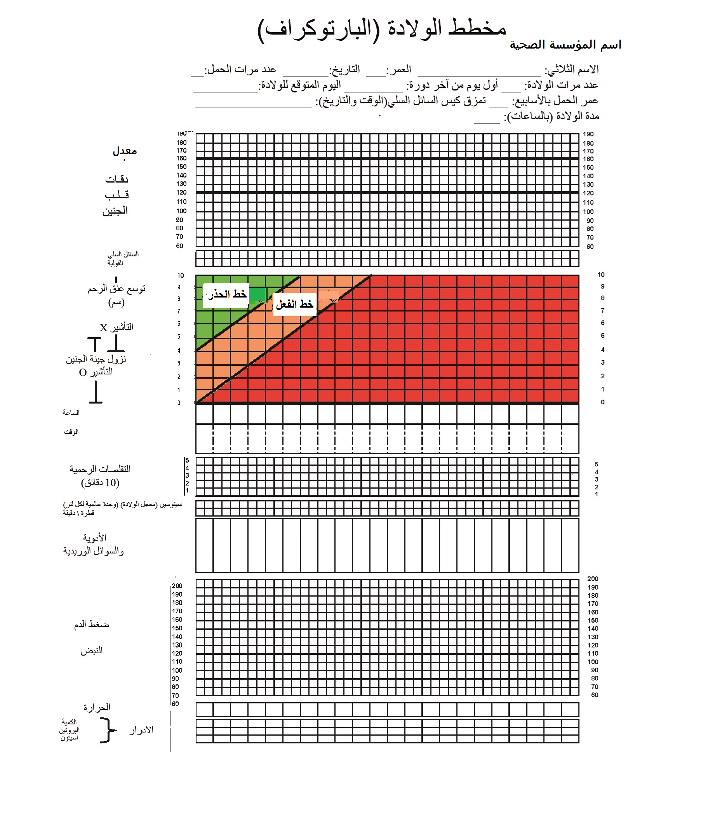

Slide 27
