Slide 1
NEW TRENDS OF FERTILITY
Prof. Dr. Rabea M Ali

Slide 2
INFERTILITY
The inability to create a desired pregnancy that culminates in the birth of a child is likely to create a life crisis for women and their partners. Women seeking fertility treatment look to nurses for care, counsel and health teaching.

Slide 3
Primary infertility:
The inability to conceive after 1 year of unprotected intercourse for a woman younger than 35, or after 6 months of unprotected intercourse for a woman 35 or older.
Secondary infertility:
The inability of a woman to conceive who previously was able to do so .

Slide 4
Factors Influencing the Use of Fertility Services
- Increased education and career opportunities for women
- Increased number of providers and centers offering fertility services
- Increased public awareness of infertility and treatment options

Slide 5
Evaluation of the Woman
Primary evaluation components:
Male factor
Ovarian factor
Cervical factor
Tubal factor
Uterine factor

Slide 6
Infertility Treatment: Goals
To ensure patient safety
To help a couple experience a healthy pregnancy and birth or an alternative way to build a family
To use as little of a couple’s resources as necessary

Slide 7
Infertility Treatment: Options
Correct ovulatory dysfunction
Correct tubal or uterine abnormalities
Overcome sub fertile sperm parameters
ART

Slide 8
Ovulation Induction: Clomiphene Citrate (Clomid, Serophene)
The “first line” of fertility therapy
Used to treat mildly disordered ovulation and luteal-phase insufficiency
Establish tubal patency and sperm adequacy before use.
In appropriately selected patients, 80 percent ovulate and 40 percent conceive with clomiphene.
Cumulative conception rate is 60 percent to 75 percent
Multiples rate is about 10 percent
After 6 months, women should move on to more aggressive therapy.

Slide 9
Ovulation Induction: Injectable Gonadotropins
Used:
When women exhibit resistance to clomiphene
When multiple oocytes are desirable to ovulate
With IVF and creation of donor oocytes and embryos
With ovulation induction (OI)
Multiple rates as high as 40 percent.

Slide 10
Ovulation Induction: Pulsatile Gonadotropin-Releasing Hormone
Anovulation may be due to the failure of the hypothalamus to provide sufficient stimulation to the pituitary gland.
Gonadotropin-releasing hormone (GnRH) can be directly administered via a small medication pump to induce ovulation.
The ideal patient is the hypo-gonadotropic woman.

Slide 11
(DHEA) Dehydro- Epiandro- Sterone
Also known as Androstenelone is an endogenous steroid hormone produced by adrenal glands in the brain, it functions as metabolic intermediate in the biosynthesis of androgen and estrogen sex steroids both in the gonads and ovaries and in other various tissues so replaces this hormone with in the body.
INOSITOLاينوزيتول
Dose 2-4 G
Improves several of the hormonal disturbance of PCOS

Slide 12
Artificial Insemination
Used to treat:
Male-factor infertility
Retrograde ejaculation
Neurologic impotence
Sexual dysfunction
Sperm used for insemination may be the male partner’s or donated.

Slide 13
Artificial Insemination
Methods of insemination
Intra-cervical insemination (ICI)
Intrauterine insemination (IUI)
Success rates vary from 6 percent to 24 percent per cycle

Slide 14
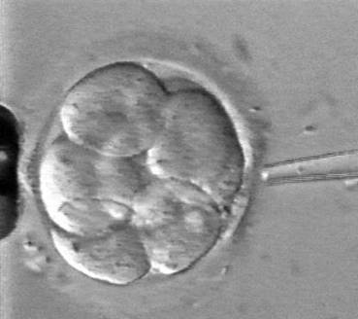
Assisted Reproduction

Slide 15
Assisted Reproduction
Indications for ART:
Tubal disease
Male-factor infertility
Endometriosis
Premature ovarian failure
Polycystic ovarian syndrome
Immunologic infertility
Unexplained infertility

Slide 16
Assisted Reproduction
IVF: Placing the gametes and subsequent embryo into the uterus
ZIFT (zygote intra-fallopian transfer): Placing the gametes and subsequent embryo into the fallopian tubes
GIFT (gamete intra fallopian transfer): Placing the unfertilized oocyte and sperm into the fallopian tube

Slide 17
Assisted Reproduction
Stimulation type, dosage and duration depends on patient characteristics, diagnoses and the fertility center.
Monitoring is usually by serial TVUS, usually over four to five visits.

Slide 18
Assisted Reproduction
Cleavage انقسامof the embryos and other subjective indicators of embryo health help the clinician decide timing and number of embryos to transfer.
The usual timing of transfer of embryos is on day 3, 4 or 5 after retrieval.

Slide 19
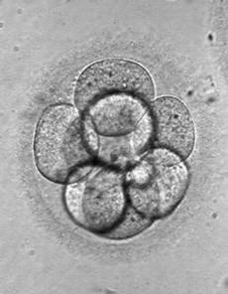
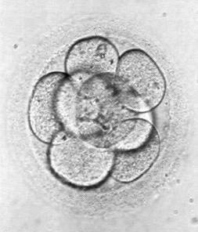
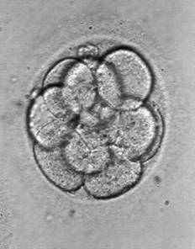
Assisted Reproduction
Multicellular embryos

Slide 20
Assisted Reproduction: Cryopreservation
Freezing, thawing and using:
Sperm
Embryos
Oocytes

Slide 21
Cryopreservation :is the proses that preserve organelles, cells, tissues or any other biological constructs by cooling the samples to very low temperatures
Embryo cryopreservation used to storage embryonic IVF
Ovarian tissue cryopreservation or women in case of hematological malignancies or ca Breast

Slide 22
Oocyte cryopreservation :where t he women's eggs(oocyte) are extracted ,frozen, and stored later when she is ready to become pregnant the eggs can be thawed, fertilized ,and transferred to the uterus
Semen cryopreservation :used in case of treatment that compromised their fertility such as chemotherapy or radiation or surgery

Slide 23
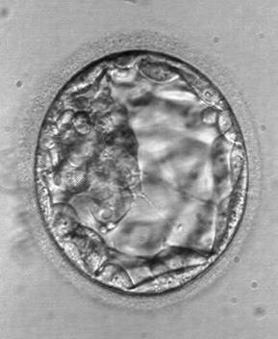
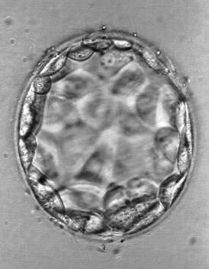
Assisted Reproduction: Cryopreservation
Expanded blastocystsتمدد الكيسات الاريمية

Slide 24
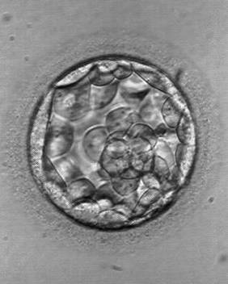
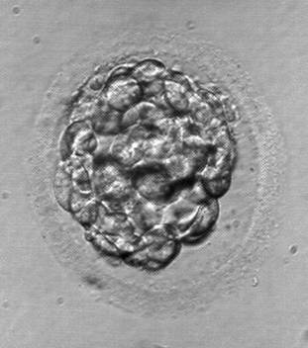
Assisted Reproduction: Cryopreservation
Cryopreserved blastocysts

Slide 25
Pre-implantation Genetic Diagnosis (PGD)
Used only with IVF
One or two cells removed from the embryo and analyzed for defects before transfer to the uterus

Slide 26
PGD (Continued)
May be helpful for:
Women older than 35 years
Couples who have experienced recurrent pregnancy loss
Couples with one partner known to carry a balanced chromosomal translocation
Up to 85 percent accurate for detecting the most common chromosomal abnormalities

Slide 27
Third-party Reproduction
Donor : Sperm ( by intrauterine insemination (IUI) or intra-cervical insemination, ICI form donor either from sperm bank or known donor.
Donor EGG( an ovum is taken from donor ).
Surrogacy :women with no egg or un healthy eggs might also want to consider surrogacy is a women who agree to become pregnant using mans sperm and her own egg.
Gestational carrier: Carries other people’s oocyte and sperm(NOT BIOLOGICAL MOTHER )
Traditional surrogate: Inseminated with the male partner’s sperm(BIOLOGICAL MOTHER)

Slide 28
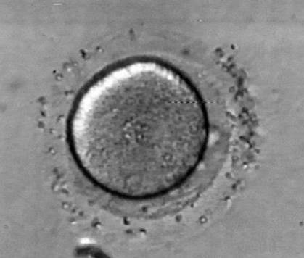
Third-party Reproduction (Continued)
Fertilized oocyte

Slide 29
ART Risks and Complications
Ovarian hyper stimulation syndrome (OHHS)
Multiple gestation:
More than 43 percent of the rise in multiple births is linked to ART, with 25 percent to 38 percent of treatments leading to multiple births

Slide 30
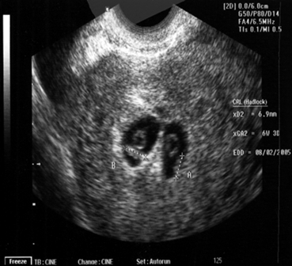
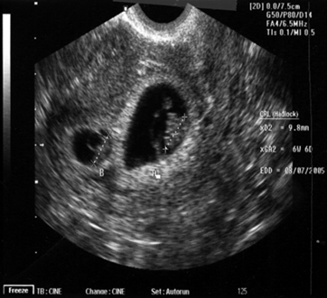
ART Risks and Complications (Continued)
Twin intrauterine pregnancy

Slide 31
Male-factor Infertility
ART may help men with:
Sperm counts between 1 and 10 million with poor motility and morphology scores
Failed previous inseminations
Obstructive or non obstructive azoo-spermia where sperm can be successfully extracted from the epididymis or testes

Slide 32
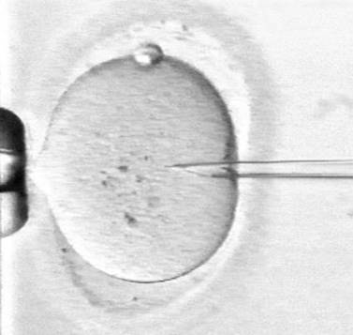
Male-factor Infertility (Continued)
Intracyto-plasmic sperm injection (ICSI)

Slide 33
Advanced Reproductive Age
Risks
Pregnancy loss at all stages of gestation
Down syndrome
Multiple births
Hypertension and gestational diabetes
Low birth weight (LBW)
Difficult labor
Cesarean birth
Risks associated with older childbearing are manageable. Most women can expect positive outcomes.
Nurses should counsel women in their early 30s about fertility.

Slide 34
Using acupuncture for fertility
Acupuncture used to boost تعزيز their fertility thus improve intrauterine blood circulation ,regular ovulation and increase sperm count
Low level laser therapy (LLLT):used to treat in case of advanced maternal age and poor ovarian function .
Solography :help to direct visualization to diagnoses infertility.
Hysteroscopy :also direct visualization to pelvic and uterus and ovaries

Slide 35
Special Role of Nursing
To help reduce a woman’s anxiety, increase her knowledge and validate the significance of her experience throughout evaluation and treatment
To guide the woman through grief that follows unsuccessful treatment and help her determine when it is time to stop treatment
Giving anticipatory guidance
Providing a quiet, private place for consultation
Allowing adequate time for questions and discussion

Slide 36
Giving patient-specific instructions
Giving therapeutic touch, when appropriate
Maintaining personal contact during and after treatment cycles
Recognizing the need for grief work
Expressing positive and negative feelings
Providing easy access to nursing care
Follow up to discuss options and emotional status

