Slide 1
Maternal and neonatal nursing (specialties) nursing care of high risk newborn & their families
بأشراف : ا.م.د. حوراء حسين

Slide 2
High risk newborns
any baby exposed to any condition that make the survival rate of the neonate at danger

Slide 3
Factors that contribute to have a high risk newborn:
1)High risk pregnancies: e.g. : toxemias
2)Medical illness of the mother : e.g. :Diabetes
mellitus
3)Complication of labor :e.g premature rupture of membrane (prom) ,obstructed labor, or C.S).)ceasarian section
4) Neonatal factors: e.g Neonatal asphyxia .

Slide 4
Identification of some high-risk newborn.
1)premature birth .
2) low birth weight
3)Hypothermia and hyperthermia
4)Hypoglycemia
5)respiratory disorder.
6) Hyperbilirubinemia
7) RH Incompatibility
8) Congenital anomaly .
9) intrauterine growth retardation. (IUGR)

Slide 5
1-Premature birth
Also known as preterm birth is the birth of a
baby at a fewer than 37 weeks gestation age
Symptoms:
of preterm birth include four or more uterine contractions in one hour. Cerebral palsy ,delays in development ,hearing and sight problems .these risks are greater the earlier a baby is born.

Slide 6
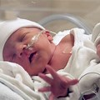

Slide 7
2-Low birth weight :
IS any live born baby weighting 2500 gram or less at birth .very low birth weight(VLBW ):less than 1500 gm., extremely low birth weight (ELBW): less than 1000 gm.
Causes: by preterm birth ( that’s alow gestational age at birth ) or the infant begin small for gestation age ( that’s a slow prenatal growth rate ) or combination of both.
the risk factors in the mother include: young age, multiple pregnancy ,previous LBW,poor nutrition .environment risk factor such as smoking .

Slide 8
Nursing care for preterm, low birth weight and their families
1-care at neonatal intensive care unit
2-maintenance of nutrition and hydration
3- maintenance of breathing
4-maintenance of stable body temperature
5-gently early stimulation
6-prevention, early detection and promote management of complication
7-family support discharge, follow-up and hom care

Slide 9
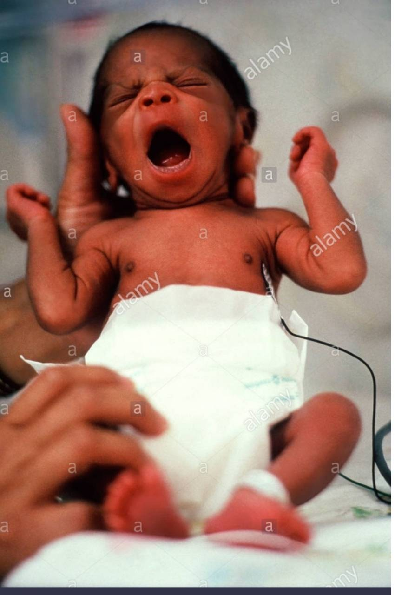

Slide 10
3-Hypothermia and hyperthermia
Hypothermia : its acondition characterized temperature less than 36C .
hypothermia classified according to causes and severity. according to causes(primary hypothermia :immediately associated with delivery and secondary hypothermia this occurs due to factors).according to severity (mild Temp less than 36C ,moderate Temp less than 35.5C and severity hypothermia Temp less than 35C).

Slide 11
Hyperthermia :its acondition characterized by elevation body temp more than 37C.
Nursing care for newborn with Hypo-hyperthermia and their families.
1-newborn should be warmed quickly by wrapping In a warm towel.
2-if the infant in incubator ,increase the temperature.
3- avoid exposure to direct source of air drafts.
4-check body temperature and give antibiotics if infection is present.
5-if in hyperthermia ,undress the newborn
6-reduction of incubator temp.
7-increase fluid intake to prevent dehydration
8- family health education . .

Slide 12
4-Hypoglycemia: is the most common metabolic disorder. Small gestational age (SGA) newborn. the plasma glucose concentration at or below 40mgl clinical manifestation include (tremor ,poorly feeding ,cyanotic spells .poor reflexes)
nursing care for newborn and their familiy with hypoglycemia .
1)Ensure airway, breathing, circulation( ABC).
2)newborn should be start breast feeding or artificial milk.
3)moniter glucose level pre and post feeding
4) if the newborn high risk and unable to feeding give IV fluid .
5)mother education and give her information about hypoglycemia

Slide 13
Infant of Diabetic mother

Slide 14
5-Respiratory disorder : is a medical term that encompasses pathological condition affecting the organs and tissues that include respiratory distress syndrome (hyaline membrane) disease:
Transient tachypnea newborn ,meconiuma aspiration syndrom and apnea .
Nursing care for newborn and their
Families.
1)maintain adequate respiratory status
2)maintain adequate of hydration and nutritional status .
3) avoidance of breast –feeding
4) basic support include thermal regulation and medication (antibiotics).
family 5) support and educate

Slide 15
6-Hyperbilirubinemia:(pathologic jaundice): condition characterized by bilirubin level that exceed 6mg/dl within the first 24 hr after delivery and remains elevated beyond 7days in a full-term neonate and 10days in a premature neonate, bilirubin level that rise by more than 5mg/dl/ day, a level that greater than12mg/dl in premature. .

Slide 16
Nursing care for newborn with hyperbilirubinemia .
1) put the newborn in incubator with phototherapy and cover eyes to prevent retinal damage .
2)newborn should be start breast feeding 3)monitor test (TSB).
4) administration Iv fluid and medication as order.
5)educated and give information about it

Slide 17
7-Rh incompatibility: it occurs when an Rh –negative mother carries an Rh –positive fetus .leakage of fetal Rh antigens commonly occur during delivery ,at the time of placenta separation ,maternal antibodies are produced in response ,in asubsequent pregnancy with an Rh-positive fetus ,maternal antibody enter the fetal circulation transplacentally, causes erthroblastosis .
Nursing care for newborn and their family
1) make the blood groub and Rh test as order .
2)give anti D to the mother as order.
3) give information about disorder to the parents

Slide 18
8-Congenital anomaly :
Congenital anomaly (CA) : is an anomaly that affects a body part or physiologic function and is present at birth .it causes by the abnormal ontogenetic development of the fetus ,the process is affected by genetic, environment or by both factors .the most commom congenital anomaly are ( spinal bifida ,,down syndrome ,hydrocephalus , cleft lip and palate ,congental heart disease )

Slide 20
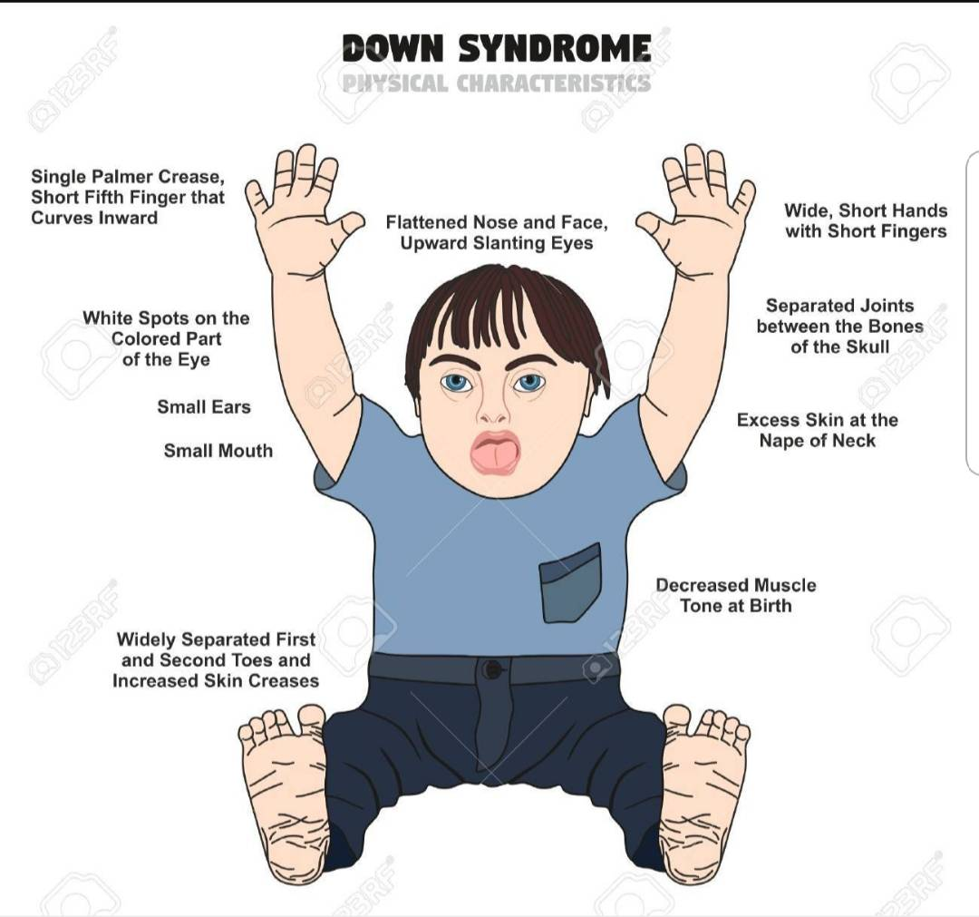

Slide 21
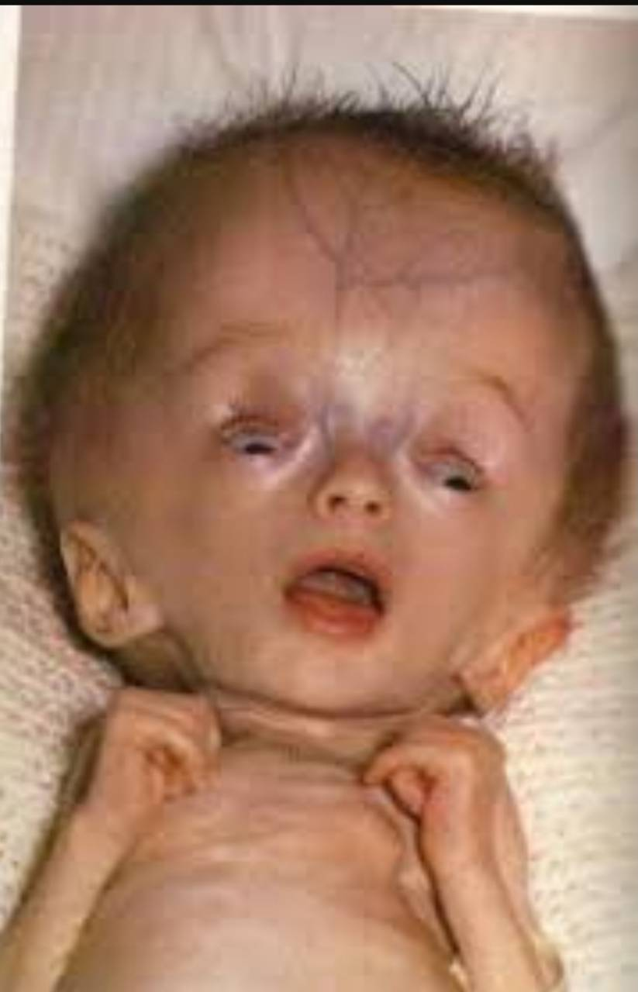

Slide 22
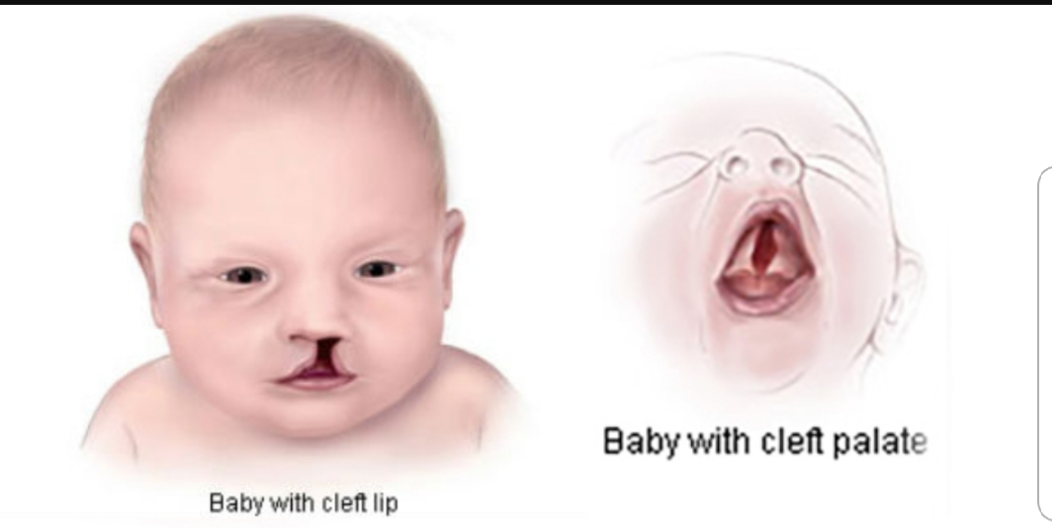

Slide 23
9-IUGR:
IUGR: refers to poor growth of afetus while in the mothers womb during pregnancy .
Many causes that include Maternal (pre-pregnancy weight and nutrition status, anemia,alcohol,smoking). Uteroplacental (preeclampsia ,multiple gestation ,uterine malformation). Fetal (chromosomal abnormalities) .
there are 2 major categories of IUGR symmetrical and asymmetrical growth restriction.the goals of management is to deliver the most mature fetus in the best physiological condition possible .

Slide 24
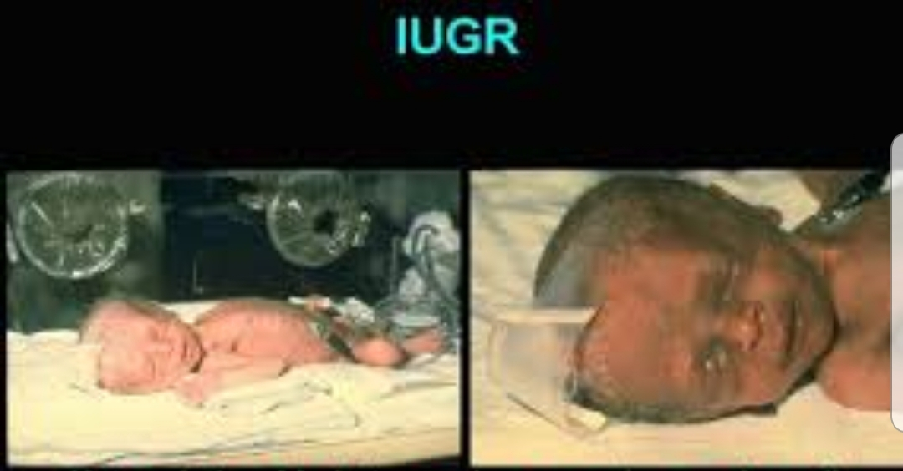

Slide 25
References
1-Bobak,I.Maternity and Gynecologic Care : The nurse and the Family ,4th ed. St.
2-Louis:Mosby-Year Book,Inc.1988.
3-Wilkerson,N.Acomprehensive Look at Hyperbilirubinemia ,MCN13(5):360-
4-64,September /October 1988.
5-P07-Disorder related to short gestation and low birth weight in ICD-10
6-“Labor and delivery –Low Birth Weight “ Umm.edu .2008-10-22.
http//www.Vrozene-Vady.cz/-7

