Slide 1
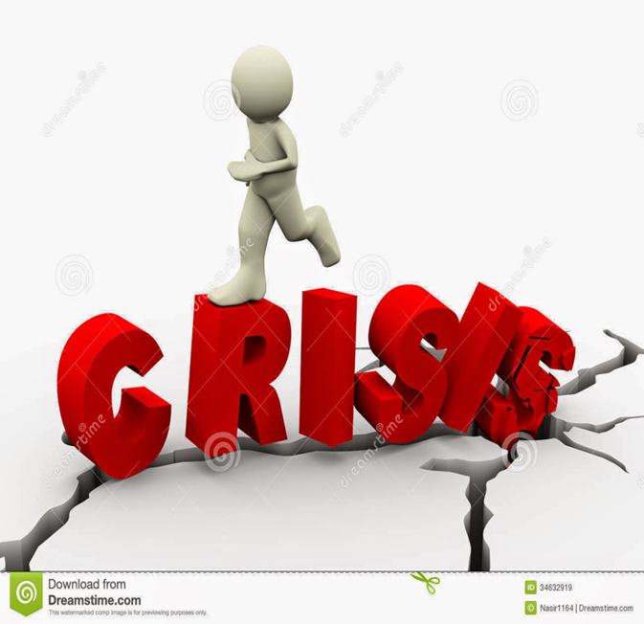
Care of the Family With Crisis
Prof. Dr. Rabea M. Ali

Slide 2
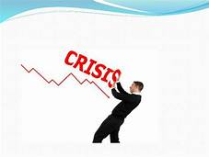
Introduction
Crisis is any event that is expected to lead to, an unstable and dangerous situation affecting an individual, group, community or whole society

Slide 3
Family Crisis
is a situation that upsets the normal functioning of the family and requires a new set of responses to the stressor
Or: The experience of an event or stressor that is beyond the family’s ability to cope.

Slide 4
Causes that can lead to a crisis:
Social pressure
Job stress
Family problems
Defensive mechanisms
Disaster
Crucial time or event that changes a person’s life
Devastation

Slide 5
Three factors which help determine whether a situation is overwhelming enough to be a crisis:
Hardship: such as a house fire, natural disaster or unnatural), Incarceration, Divorce
Resources:sach as Loss of Job, Reduced Income, Failed Business, Job Relocation, Reduced Income
Mental Attitude :such as
Excessive anxiety
Prolonged depression or apathy
Marked changes in eating or sleeping patterns
Thinking or talking about suicide

Slide 6
Types of Crisis in the community
1.Financial Crisis
2. Technological Crisis
3. Malevolence of Crisis of
4.Natural Crisis
5. Deception of Crisis
6. Workplace Violence

Slide 7
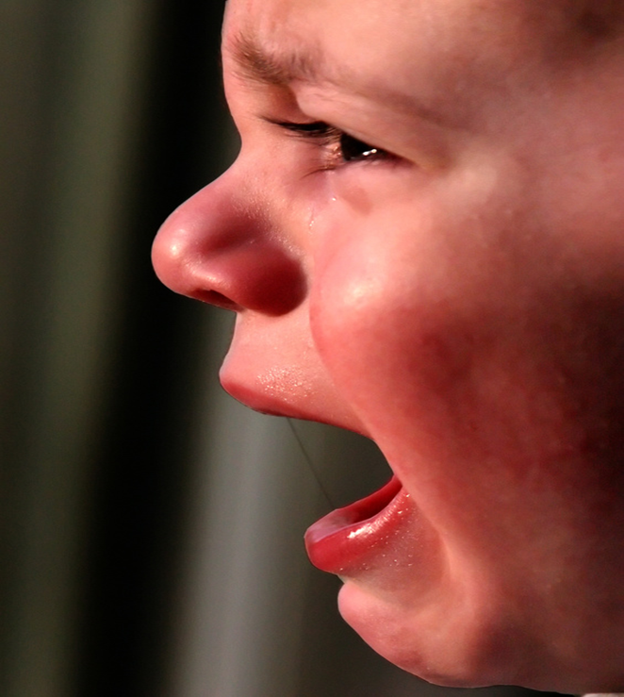
Types of Crisis in Families
Addictions: drugs / alcohol
Loss of job
Relocation
Compulsive gambling
Suicide
Criminal attack
Violent behavior in families
Missing / Runaway children
Community and national crisis
10.Separation or divorce
Special Needs Individuals

Slide 8
Types of Crisis in the community
1.Financial Crisis
2. Technological Crisis
3. Malevolence of Crisis
4.Natural Crisis
5. Deception of Crisis
6. Workplace Violence

Slide 9
Common features of Crisis
1. Situation materialises unexpectedly
2. Decisions are required urgently.
3. Time is short. Urgent demands for information are received.
4. There is sense of loss of control.
5.Pressures build over time.
6.Routine business become increasingly difficult.
7.Reputation suffers.

Slide 11
Stages of Family Crisis
Stage 1 or Onset: is the start of the crisis and the increasing realization that a crisis has occurred.
Stage 2 Disorganization: is a time when shock and disbelief may make it impossible to function or think .
Stage 3 Reorganization: is when the family members take action. The family reorganizes at a new level.

Slide 12
Effect crisis of the family
Effects on family life
2.Financial effects
3.Emotional effects
4.Drug Abuse (Alcohol, Prescription And Illegal Drugs),
5.Child Abuse
6. Domestic Violence.
7.Critical And Hostile
8.Blame Each Other
9. Disagree About Family Goals And How To Reach Them

Slide 13
10.Experience Stressed-out Symptoms Including:
Sleeplessness
Lack Of Appetite
Disorientation
Memory Lapses
Depression And Anxiety

Slide 14
Lack Cohesiveness And Closeness Among Members
Lack Family Activities And Quality Time Together
Lack Open And Safe Communication. When Families Do Not Communicate Well, They Have More Misunderstandings.
Lack Positive Conflict-management Skills
Lack Shared Values, Rules And Roles. In Poorly Functioning Families, Members Are Rigid and will
lack time and positive interaction between the parents

Slide 15
16.When a family is experiencing a crisis, all the members are affected -- including the children. Sometimes adults believe that children do not really feel stress, but they do.
Some signs that child may be stressed are:
A. child is misbehaving more than usual
B. child is more quiet than usual
C. child develops some school problems, such as fighting at school or not paying attention
D. child is having trouble sleeping
E. child often tells he is worried and concerned about the family problem

Slide 16
F. Increases crime
G. Reduces confidence
H. Multiplies developmental gaps
I. Increases absenteeism

Slide 17
Reaction to a Crisis
Crisis
Stage 1 Impact
Stage 2 Withdrawal and Confusion
Stage 3 Focus
Stage 4 Adaptation

Slide 18
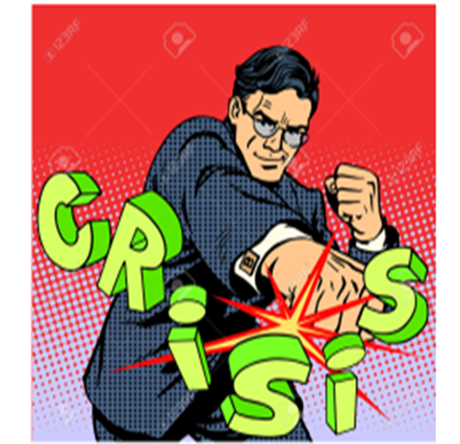
Factors Associated with Meeting a Crisis Creatively
A positive outlook
Spiritual values
Support groups
Adaptability
Informal social support

Slide 19
according to each case Crisis Management
1. Addictions: drugs / alcohol
The first step in treatment is for the individual to accept that substance abuse or dependence is a treatable disease.
These are steps showing a general approach to the management of substance users.
2. Loss of job
Financial decisions related to unemployment
Assessing obligations
Making a budget
Talking to creditors for payment plan

Slide 20
3. Relocation
Feelings of vulnerability
Uncertainty of the future
Hesitation leaving familiar surroundings
Moving is difficult for children – let them help with finding and decorating a new home
4.Compulsive gambling
Potential losses are high for the whole family
Gambler goes through family savings
Threatens family relationships and jeopardizes educational and career opportunities

Slide 21
5. Suicide
It is important to assess family interactions and to recognize disturbed relationships. The most effective approach is recognition of susceptible adolescents during the early stages of family distress so that family counseling can be started. Prevention must be directed toward improving childrearing practices through support and education of parents and changing societal conditions that generate defeat, despair, and maladaptive behavior.
6. Criminal attack
• Anyone is vulnerable
• Take precautions
• Can take place anywhere
• Practice situational awareness

Slide 22
Violent behavior in families
Action plan to prevent violence :
Create and implement school based curriculum
Public awareness campaign – explain.
Scale up media campaign
Implement alcohol reduction strategies.
Restrict access to drugs.
Minimize violence prevention programs as women gain skills.
Parent training for fatherhood

Slide 23
8.Missing / Runaway children
There are 1.5 million children are reported each year. Causes are:
Children leave home because of abuse
Communication breakdown
Divorce / remarriage of parents
Abductions take place by parents in divorces
Children are lured by acquaintances or people they do not regard as strangers
9. Community and national crisis
Local terrorist incident
Natural disaster – earthquake, flood, severe weather or fire
Preparation – being ready for crisis that could occur (situational awareness

Slide 24
10. Separation or divorce
Tell children the truth
Reassure the children that it is not their fault
Parents should reinforce their love for their children
Professional counseling may be helpful
11. Special Needs Individuals
Adult Protective Services (APS) is responsible for investigating abuse, neglect and exploitation of clients receiving services in state operated and / or contracted settings that serve adults and children with mental illness or intellectual and developmental disabilities.

Slide 25
