Slide 1
New Issues In Breast Feeding
Supervisor By:
أ.م.د. حوراء حسين

Slide 2


Slide 3
Breast feeding: is the feeding of an infant or young child with breast milk directly from female human breasts (i.e., via lactation) not from a baby bottle or other container.
-Breast milk alone contains all the nutrients,
antibodies, hormones and antioxidants an infant
needs to thrive.
-Breast milk protects babies from diarrhea and
acute respiratory infections, stimulates their
immune systems and response to vaccination.
-Continued breastfeeding to two years, accompanied
by appropriate complementary feeding, maintains
good nutritional status and continues to help
prevent diarrhea.

Slide 4
Physiology of lactation
The physiological basis of lactation is divided into four phases:
1-Preparation of breasts (gamogenesis).
2-Synthesis and secretion from the breast alveoli (lactogenesis).
3-Ejection of milk (galactokinesis).
4-Maintenance of lactation (galactopoiesis).

Slide 5
Montgomery gland: To soften the nipple (prepare the nipple for breastfeed))
The milk ejection the Prolactin Reflex:
1- (Long arrow) Nerve impulses from sucking go to the brain.
2- (Short arrow) The pituitary gland releases prolactin into the blood.
3- (Breast) This causes the alveolar cells to secrete milk and swells alveoli.

Slide 6
The let-down reflex
How body responds to baby’s suckling:
*Infant suckling stimulates the nerve endings in the nipple and areola, which signal the pituitary gland in the brain to release two hormones, prolactin and oxytocin.
How Breast Responds to Baby’s Suckling:
* Prolactin causes alveoli to take nutrients (proteins, sugars) from blood supply and turn them into breast milk.
* Oxytocin causes the cells around the alveoli to contract and eject milk down the milk ducts. This passing of the milk down the ducts is called the “let-down” (milk ejection) reflex.
Let-down is experienced in numerous ways including:
1– Infant begins to actively suck and swallow.
2 – Milk may drip from the opposite breast.
3 – Mother may feel a tingling or a full sensation (after the first week of breastfeeding) in breasts or uterine cramping.
4– May feel thirsty.

Slide 7
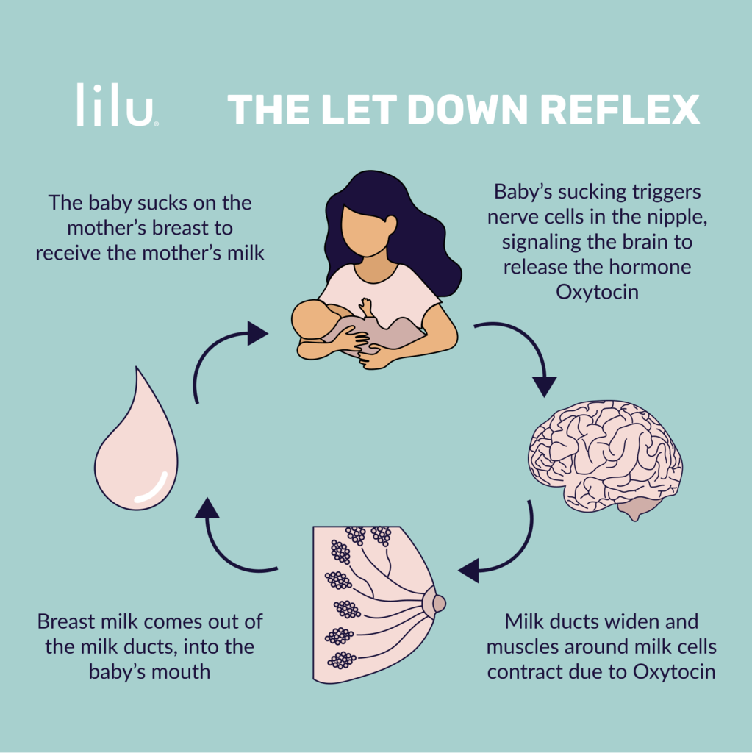

Slide 8
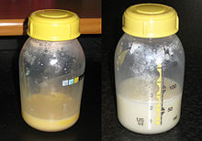
Colostrum
The initial milk produced is referred to as colostrum, which is high in the immunoglobulin IgA, which coats the gastrointestinal tract. This helps to protect the newborn until its own immune system is functioning properly. It also creates a mild laxative effect, expelling meconium and helping to prevent the build-up of bilirubin (a contributory factor in jaundice

Slide 9
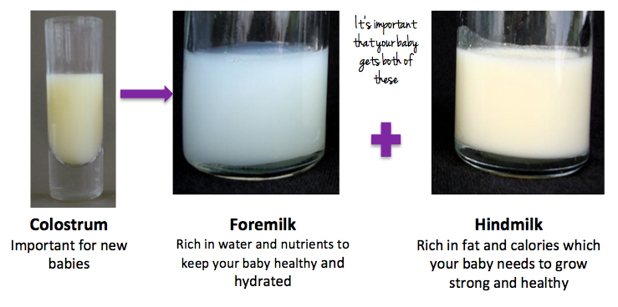
Breasts begin producing mature milk around the third or fourth day after birth. Early in a nursing session, the breasts produce foremilk, a thinner milk containing many proteins and vitamins. If the baby keeps nursing, then hind milk is produced. Hind milk has a creamier color and texture because it contains more
fat.

Slide 10
Breast Milk Contents
Lysozyme is an enzyme that protects the infant against E.
’Fats
• It is necessary for brain development, absorption of fat-soluble vitamins, and is a primary calorie source.
’Vitamins
• The amount and types of vitamins in breast milk is directly related to the mother’s vitamin intake. Fat-soluble vitamins, including vitamins A, D, E, and K,
Carbohydrates
• Lactose is the primary carbohydrate found in human milk.. Lactose helps to decrease the amount of unhealthy bacteria in the stomach,

Slide 11
Positions of Breastfeeding
1-Side lying position
2-Football hold position
3-Cradle hold position
4-Cross cradle hold position
5-Saddle Hold
6-Twin Football Hold
7-supine position

Slide 12
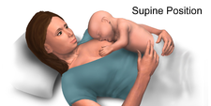
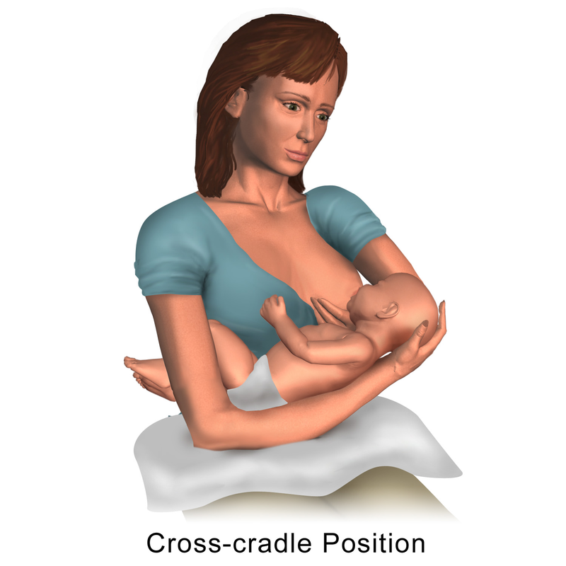






Slide 13
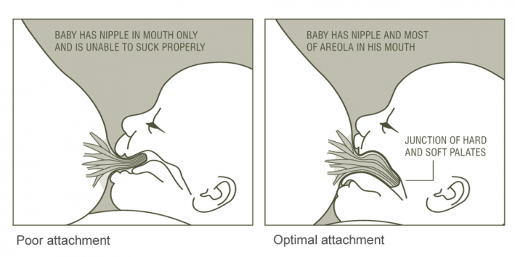
Proper Latch-on | Dis latch Baby After Breastfeeding latch
1. Baby open the mouth wider. 2. The chin touching the breast 3. The lip are flanged out. 4. The breast looked full and round 5- Can hear the sound suck and swallow. 6-The nipple looked long and round after breastfeed | • Used little finger press on the gum to open the baby mouth to dis latch from the nipple.

Slide 14
Complications
-Sore nipples
-Low milk supply
- Over supply of milk
-Strong let-down reflex
-Engorgement
-Plugged ducts
-Breast infection (mastitis)
- Fungal infections
-Inverted, flat, or very large nipples

Slide 15
Sore nipples
are a common complaint among women. It is most common in mothers who are breastfeeding their infants—80 percent experience nipple pain .Typically, it is due to the baby being unable to latch on properly during breastfeeding.
Other causes of sore nipples include wearing the wrong size bra, exercising without a proper sports bra, an injury on the chest area and excessive dry skin that causes cracks on the nipples.
It can also occur due to hormonal changes associated with pregnancy or premenstrual

Slide 16
Low milk supply
Many moms worry about low milk supply:
Various factors can cause a low milk supply during breast-feeding, such as waiting too long to start breast-feeding, not breast-feeding often enough, supplementing breastfeeding, an ineffective latch and use of certain medications. Sometimes previous breast surgery affects milk production.
Other factors that can affect milk production include:
Premature birth
Maternal obesity
Pregnancy-induced high blood pressure
Poorly controlled insulin-dependent diabetes

Slide 17
Over supply of milk
How over supply happens
At first, milk production is driven by high hormone levels. Later on, the rate at which a breast makes milk is mainly determined by how much milk remains in the breast between feeds and a mother and baby’s joint nursing behavior. Frequently drained breasts make milk faster.

Slide 19
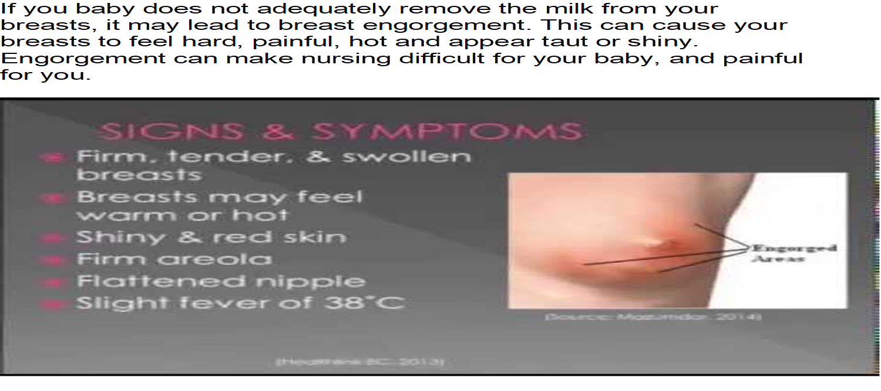

Slide 20
What is mastitis in breast?
Mastitis is inflammation (swelling) in the breast, which is usually caused by an infection. It most commonly affects women who are breastfeeding, but it can affect other women as well. A clogged milk duct, not fully draining milk from the breast, or breaks in the skin of the nipple can lead to infection.

Slide 21
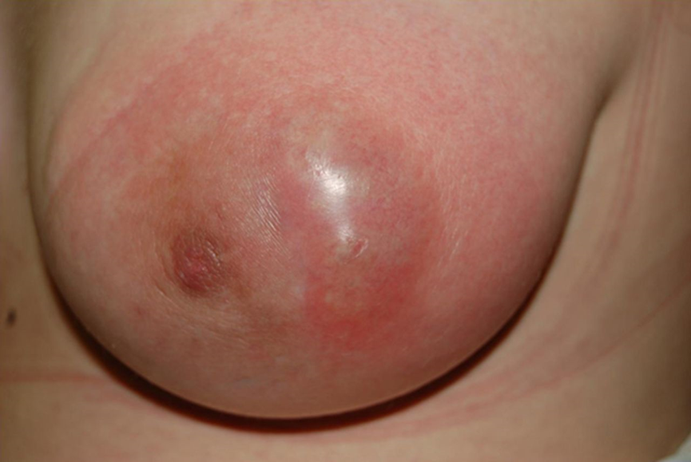
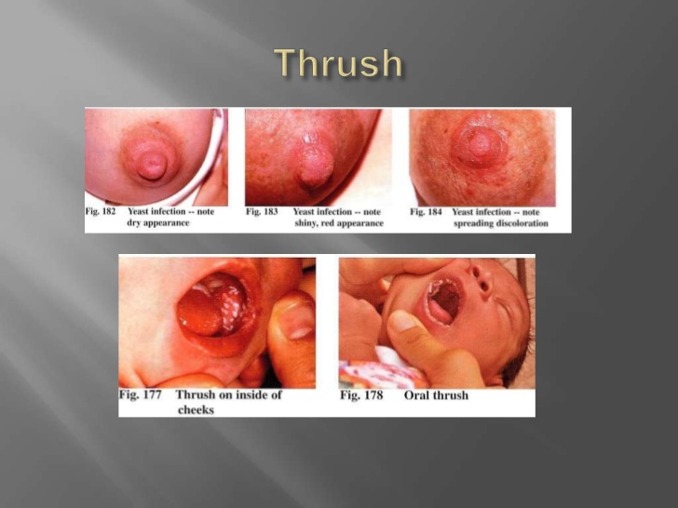
Mastitis
Notes:
Mastitis

Slide 22
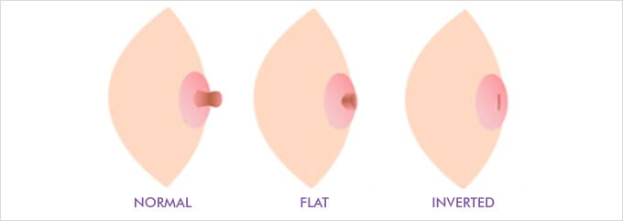
Inverted or flat nipples

Slide 23
Nursing Role
1-Educate all pregnant women about the benefits and management of breastfeeding.
2-Helping women initiate breastfeeding within half an hour after birth.
3-Assisting mothers to breastfeed and maintain lactation even if they should be separated from their infant.
4-Not giving newborns food or drink other than breast milk unless medically indicated, so they are hungry to breastfeed.

Slide 24
5-Educate the mothers almost all drugs pass into breast milk, a breastfeeding mothers must be certain not to take any medication without contacting her primary care provider.
6-Encourage and help the mother to have skin-to-skin contact with her baby as much as possible during the first days after delivery·
7-Discourage the use of pacifiers and bottles during the establishment of lactation when the baby is learning to breastfeed. When some babies are fed with an artificial teat they develop a preference for it and this can reduce their enthusiasm for the breast.
8-Encourage the mother to practice different feeding positions from time to time. Horizontal positions allow her to rest or even sleep while breastfeeding

Slide 25
REFRENCES
1-“WHO | Exclusive breastfeeding". Who.int. 2011-01-15. Retrieved 2011-10-26.
2-"The World Health Organization's infant feeding
recommendation“
3- "Breastfeeding and diet". NHS Choices. NHS. 26 March 2018. Archived from the original on 7 August 2016.
4-ww.euro.who.int/__data/assets/pdf_file/0019/118414/E57592.pdf
5-Maternal and child health nursing,chapter19 page 491·

Slide 26


