Slide 1
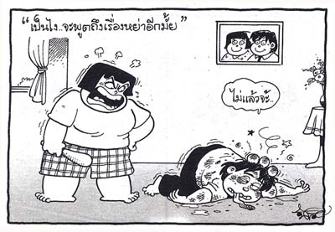
Women's Violence
Prof. Dr. Rabea M. Ali

Slide 2
Women’s Violence
The United Nations defines violence against women as "any act of gender-based violence that results in, or is likely to result in, physical, sexual or mental harm or suffering to women, including threats of such acts, coercion or arbitrary deprivation of liberty, whether occurring in public or in private life."

Slide 3
WHAT IS DOMESTIC VIOLENCE
Domestic violence is defined in the law as certain criminal acts committed between persons of opposite sex who live together in the same household or who have lived together in the past; or persons who have a child in common or are expecting a child (regardless of whether they have resided in the same household); or persons related to one another in the following ways: spouse(husband) , former spouse ,child, grandparent,, brother, grandchild, parent, sister

Slide 4
The criminal acts specifically defined in the law are:
1-Assault
2- Criminal damage
3- Custodial interference
4- Endangerment
5-Imprisonment
6- Intimidation
7- Kid-napping
8- Trespass
9- Disorderly conduct (by fighting, unreasonable noise, abuse language)
10- Reckless display or discharge of a deadly weapon or dangerous instrument

Slide 5
Types of Violence
Physical: pushing, grabbing, slapping,
kicking, biting or hitting with an object, suffocate use of knife or gun, acid throwing, burning.
Verbal: shouting, making threats, calling
names, humiliating remarks (gestures).
Sexual: forcing intercourse, making her
to do sexual things against her will.
Exercising control: Isolating her from
her family/ friends checking on her, using
the children, economic control.

Slide 6
Various forms of Violence against Women
Rape/Sexual Violence in Refugee camps
Forced sexual initiation or abuse
Sex-selective abortion
honor killing (dowry related deaths)
Undue virginity examination
Forced caesarian section deliveries
Trafficking in women and Girls

Slide 7
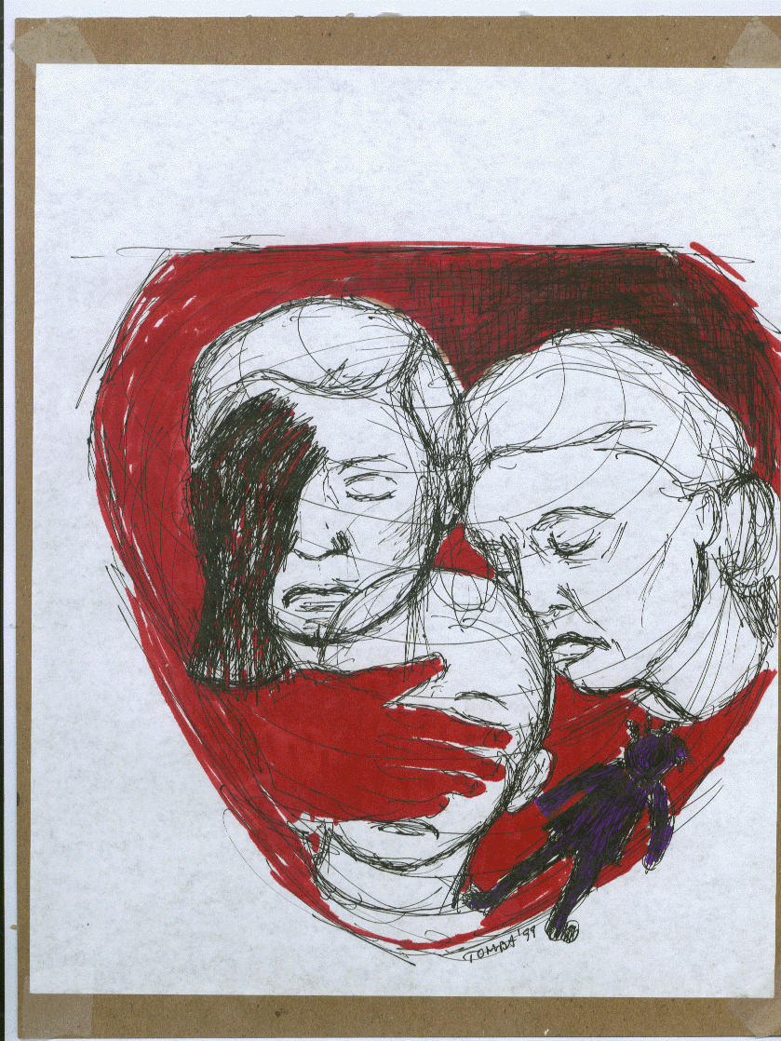
Victimization of Women so Common
Physically weak.
Dependency status.
Social tolerance of victimization.
Little whom they associate with.
Limited mobility

Slide 8
Effects of Domestic Violence
Anxiety
Chronic depression
Chronic pain
Death
Dehydration
Dissociative states
Drug and alcohol dependence
Eating disorders
Emotional "over-reactions" to stimuli
General emotional numbing
Health problems
Malnutrition

Slide 9
Panic attacks
Poor adherence to medical recommendations
Repeated self-injury
Self neglect
Sexual dysfunction
Sleep disorders
Somatization disorders
Tension family relationships
Suicide attempts
Inability to adequately respond to the needs of their children

Slide 10
WHO response
1-Building the evidence base on the size and nature of violence against women in different settings and supporting countries' efforts to document and measure this violence and its consequences, including improving the methods for measuring violence against women. This is central to understanding the size and nature of the problem at a global level and to initiating action in countries.
2-Strengthening research and research capacity to assess interventions to address partner violence.

Slide 11
3-Undertaking interventions research to test and identify effective health sector interventions to address violence against women.
4-Developing technical guidance for evidence-based intimate partner and sexual violence prevention and for strengthening the health sector responses to such violence.

Slide 12
5-Generalization of information and supporting national efforts to advance women's health and rights and the prevention of and response to violence against women.
6-Supporting countries’ to strengthen the health sector response to violence against women.
7-Collaborating with international agencies and organizations to reduce and eliminate violence globally.

Slide 13
Intimate partner violence
Refers to behavior by an intimate partner that causes physical, sexual or psychological harm, including physical aggression, sexual coercion, psychological abuse and controlling behaviors.

Slide 14
Sexual violence
is "any sexual act, attempt to obtain a sexual act, or other act directed against a person’s sexuality using coercion, by any person regardless of their relationship to the victim, in any setting. It includes rape, defined as the physically forced or otherwise coerced penetration of the vulva or anus with a penis, other body part or object."

Slide 15
Risk factors
Factors associated with intimate partner and sexual violence occur at individual, family, community and wider society levels. Some factors are associated with being a criminal of violence, some are associated with experiencing violence and some are associated with both.

Slide 16
Risk factors for both intimate partner and sexual violence include:
Lower levels of education (sexual violence and experience of sexual violence);
Exposure to child maltreatment
Witnessing family violence
Antisocial personality disorder .
Harmful use of alcohol .
Having multiple partners or suspected by their partners of infidelity.
Attitudes that are accepting of violence and gender inequality .

Slide 17
Factors specifically associated with intimate
partner violence include:
past history of violence;
marital disagreement and dissatisfaction;
difficulties in communicating between partners.

Slide 18
Factors specifically associated with sexual
violence perpetration include:
beliefs in family honor and sexual purity
ideologies of male sexual entitlement
weak legal sanctions for sexual violence.

Slide 19
Health consequence
1-Violence against women can have fatal outcomes like homicide or suicide.
2-Intimate partner violence and sexual violence can lead to unintended pregnancies, induced abortions, gynaecological problems, and sexually transmitted infections, including HIV.

Slide 20
3-Intimate partner violence in pregnancy also increases the likelihood of miscarriage, stillbirth, pre-term delivery and low birth weight babies.
4-These forms of violence can lead to depression, post-traumatic stress and other anxiety disorders, sleep difficulties, eating disorders, and suicide attempts.

Slide 21
5-Health effects can also include headaches, back pain, abdominal pain, fibromyalgia, gastrointestinal disorders, limited mobility and poor overall health.
6-Sexual violence, particularly during childhood, can lead to increased smoking, drug and alcohol misuse, and risky sexual behaviors in later life. It is also associated with perpetration of violence (for males) and being a victim of violence (for females).

Slide 22
Impact on children
Children who grow up in families where there is violence may suffer a range of behavioral and emotional disturbances. These can also be associated with perpetrating or experiencing violence later in life.
Intimate partner violence has also been associated with higher rates of infant and child mortality and morbidity (e.g. diarrheal disease, malnutrition).

Slide 23
References
United Nations, 2014. Guidelines for Producing Statistics on Violence against Women‐ Statistical Surveys.
FRA (European Union Agency for Fundamental Rights), 2014. Violence against women: an EU‐wide survey.

Slide 24
Thank you

