Slide 1
Provision Of Care For Women During The Postpartum Period
بأشراف:
أ. د. ربيعة محسن علي

Slide 2
Goals Of Postpartum Care
The main goals in postpartum care are to:
assist and support the women's recovery to the prepregnant state and deviations.
Educate the mother about her own self-care, newborn feeding, and newborn care.
Promote bonding between the newborn and family.
During the 1st to 2nd postpartum hours (the fourth stage of labor)

Slide 3
What Are The Best Practices For Postnatal Care?
Best Practices Postnatal Care for All Mothers and Newborns :
Provide postnatal care in the first 24 hours to all mothers and babies─ regardless of where the birth occurs.
A full clinical examination should be done around 1 hour after birth, when the baby has had his/her first breastfeed.

Slide 4
Postpartum Period
begins immediately after the birth of a child as the mother's body, including hormone levels and uterus size, returns to a non-pregnant state.
The terms puerperium or puerperal period, or immediate postpartum period are commonly used to refer to the (first six weeks) following childbirth.

Slide 5
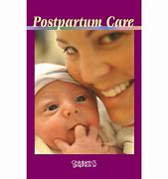

Slide 6
There Are Three Stages Of The Postpartum Period
1-Acute Phase
The first 6 to 12 hours after childbirth is the initial or acute phase of the postpartum period. During this time the mother is typically monitored by nurses or midwives as complications can arise.
The greatest health risk in the acute phase is postpartum bleeding

Slide 7
Postpartum Hemorrhage
Postpartum hemorrhage is described as a life-threatening event that is characterized by a loss of more than 500 mL of blood after a vaginal birth and 1000 mL blood loss after a cesarean birth.
There are three major causes of postpartum hemorrhage: uterine atony, lacerations, and retained placental tissue.

Slide 9
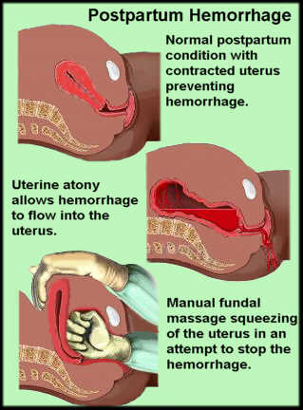

Slide 10
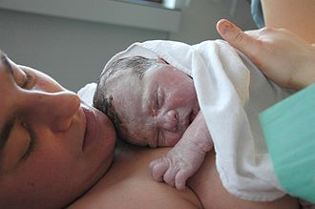
Infant placed directly on the chest following childbirth

Slide 11
Postpartum uterine massage helps the uterus to contract after the placenta has been expelled in the acute phase

Slide 12
2-Subacute Postpartum Period
The subacute postpartum starts after the acute postpartum
the subacute stage, would range from the second day after delivery to 6 weeks later.
During this phase of the puerperium, the annoying but necessary afterbirth pains begin to take place, a type of uterine contraction whose mission is to make the uterus go back to its original size, after having increased its capacity to be able to house the baby inside during pregnancy.

Slide 13
3. Delayed Postpartum Period
It could last up to 6 months if the mother chooses to breastfeed her baby. During this stage, prolactin (which is the hormone responsible for promoting milk production) prevents the restoration of the hormonal balance needed to give rise to ovulation, and for the body to resume its normal functioning.
It will be from the end of breastfeeding when the fourth stage of the puerperium or postpartum is considered to be over, which is why some health experts speak of the delayed postpartum period as a phase that can be extended up to 12 months.

Slide 14
Postpartum physiological changes
Postpartum physiological changes may be different for women delivering by cesarean section. Other postpartum changes, may indicate developing complications such as, postpartum bleeding, engorged breasts, postpartum infections.

Slide 15
Uterus
Immediately after delivery, the fundus of the uterus begins to contract. This is to deliver the placenta which can take up to 30 minutes.
The uterus changes in size from one kilogram to 60 -80 grams in the space of six weeks. After birth, the fundus contracts downward into the pelvis one centimeter each day. After two weeks the uterus will have contracted and return into the pelvis. The sensation and strength of postpartum uterine contractions can be stronger in women who have previously delivered a child or children.

Slide 17
Cervix, vagina and perineum
The cervix remains soft after birth. The vagina contracts and begins to return to the size before pregnancy. For four to six weeks of the postpartum period the vagina will discharge lochia, a discharge containing blood, mucus, and uterine tissue.

Slide 18
Breasts and lactation
The breasts change during pregnancy to prepare for lactation
more changes occur immediately after the birth. Progesterone is the hormone that influences the growth of breast tissue before the birth. Afterwards, the endocrine system shifts from producing hormones that prevent lactation to ones that trigger milk production.
The first secretions are known as colostrum and are rich in substances that help the newborn adjust to life outside the womb. About two to five days after the birth the breasts begin to produce milk. This sometimes is described as "the milk coming in".

Slide 19
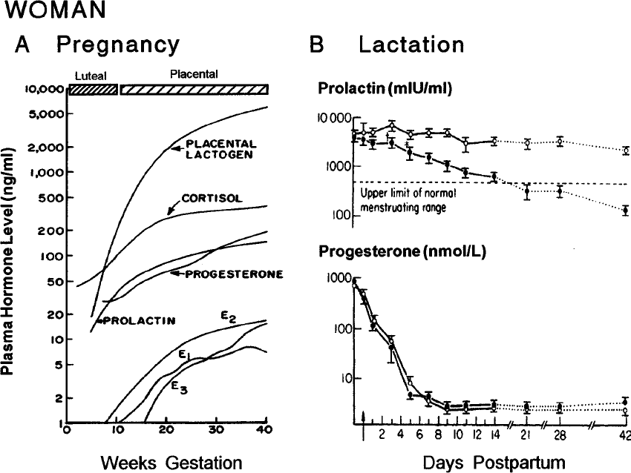

Slide 20
Management
Immediately after the birth, on going assessments are identified that vital signs of blood pressure, and pulse, uterine position.
bleeding should be assessed every 15 minutes for the first two hours after birth.The temperature is then measured twice, four hours and eight hours after birth. This is to guard against postpartum infections, previously known as childbed fever or puerperal sepsis, one of the main causes of maternal mortality.

Slide 21
Infection of the Perineum
If a woman has a suture line on her perineum from an episiotomy or a laceration repair, a portal of entry exists for bacterial invasion.

Slide 22
Care Of The Mother
1-clean perineum & apply sterile pad
2-make her comfortable & allow her to rest
3-give her a cup of tea and something light to eat
4-record vital sign(4 times daily for the 1st &2nd day)then twice daily if elevated as doctor ordered
5-chek for any bleeding
6-keep the mother and baby togther
7-never leave the women and newborn alone
8-feel uterus if hard and round

Slide 23
References
1-Template: Cite journal
2- maternity nursing : an introductoire text /gloria leifer- eleventh
4-Davidson, Michele (2014). Fast facts for the antepartum and postpartum nurse : a nursing orientation and care guide in a nutshell. New York, NY: Springer Publishing Company, LLC. ISBN 978-0-8261-6887-0
1-Henry, Norma (2016). RN maternal newborn nursing : review module. Stilwell, KS: Assessment Technologies Institute. ISBN 9781565335691
7-Lyon, Deborrah S. (2009). "Postpartum Care". The Global Library of Women's Medicine. doi:10.3843/GLOWM.10143. ISSN 1756-2228
6-Henry, Norma (2016). RN maternal newborn nursing : review module. Stilwell, KS: Assessment Technologies Institute. ISBN 9781565335691
9-Flores-Quijano, M. E., et al. (2008). Risk for postpartum depression, breastfeeding practices, and mammary gland permeability. Journal of Human Lactation, 24(1), 50–57.
.

