Slide 1
Preparing a family for childbirth and parenting
اشراف
ا.م.د. حوراء حسين

Slide 2
Preparing child birth and parenting
They provide accurate information about normal labour and delivery.
So it supplys information not only on how to prepare for childbirth but also on how to
parent.

Slide 3
Three of the most importent decisions they need to make involve:-
Choice of birth attendant
Setting and how much
What type of analgesic they want to use in labor

Slide 4
Preparing child birth and parenting
For example,
a woman may elect to have
her family physician,
obstetrician,
or nurse-midwife attend the birth and to be supported by her
husband,
partner,
family member,
friend
doula
(a woman who is experienced in childbirth and provides continuous emotional and physical support).
Most women choose to give birth in a birthing center or a hospital.

Slide 5
Common goals of preparation for child birth are to:-
Prepare an expectant women and her support person for the child birth experiance .
Create clients who are knowledge able consumers of obstatric care.
Help women to reduce and manage pain with both pharmacologic and non pharmacologic methods.
Help increase acouple‘s overall enjoyment of and satisfaction with the child birth experiance.

Slide 6
Possible content of classes for child birth preparation
1-Early classes (first trimester ) :-
Early gestational changes
Self care during pregnancy
Fetal development &environmental danger for fetus
Sexuality in pregnancy
Birth setting & type of care provider
Nutrition , rest ,exercise suggestion
Relieve measures for common discomforts of pregnancy
psychological changes in pregnancy
provide information about:-
factors that place the at risk for preterm labor
Present information about breast feeding & formula feeding

Slide 7
Possible content of classes for child birth preparation
2-Later classes (second &third trimester)
Preparation for birth process
Relaxation techniques
Breathing technique
Post partum self care
3-Breast feeding
Advantage & disadvantage
Techniques of breast feeding

Slide 8
The childbirh plan :-
Birth Attendant
Birth Setting
Support Person
Activities During Labor
Birth
Postpartum

Slide 9
Several exercises for labor
Prenatal yoga
classes are aimed at
helping a woman relax and manage stress better for all times in her life.
help a woman stay overall fit by their focus on gentle stretching and deep breathing.
help a woman feel a high level of self-esteem.
help both relaxation and pain management.

Slide 10
Perineal &abdominal exercises
In addition to encouraging an overall exercise program,
childbirth preparation classes teach women specific exercises to:-
strengthen pelvic and abdominal muscles.
make these muscles stronger.
reduce discomfort.
help muscles revert more quickly to their normal condition and function more efficiently after childbirth.
encourage women to maintain an overall active exercise program during pregnancy.

Slide 11
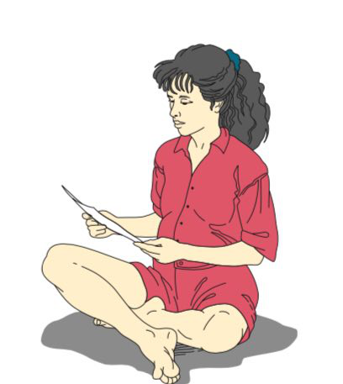
1-Tailor Sitting
Tailor sitting stretches perineal muscles to make
them more supple.
Notice that the legs are parallel so that one
does not compress the other.
A woman could use this position
for television watching,
telephone conversations,
playing with an older child

Slide 12
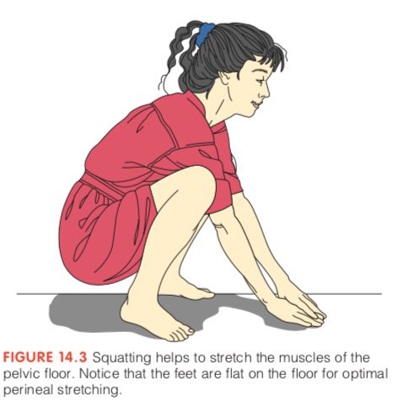
2-Squatting
Squatting helps to stretch the muscles of the
pelvic floor.
Can be a useful position for second-stage labor
so a woman should also practice this position for about 15 minutes a day.

Slide 13
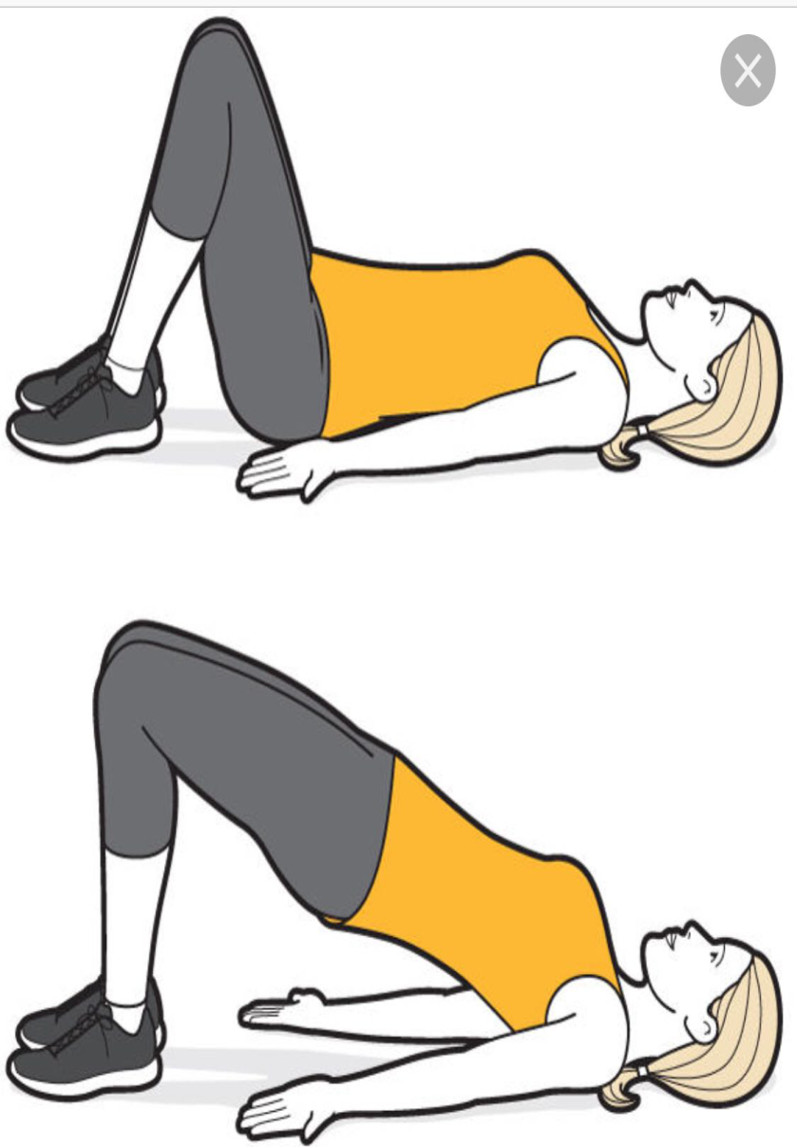
3-Pelvic Floor Contractions (Kegel Exercises)
Pelvic floor contractions can be done easily during daily activities.
helpful in the postpartum period to reduce pain
promote perineal healing.
They have long term effects of increasing sexual responsiveness
helping prevent stress incontinence

Slide 14
4-Abdominal Muscle Contractions
help strengthen abdominal muscles during pregnancy
help prevent constipation
help restore abdominal tone after pregnancy.
She can repeat the exercise as
Oftenas she wishes during
the day.

Slide 15
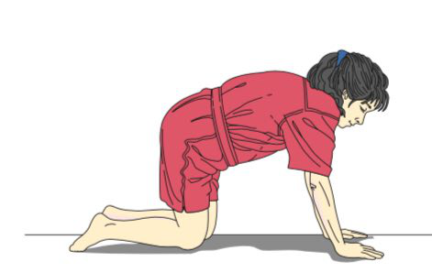
5-Pelvic Rocking
To do this, a woman first hollows her
back and then arches it.
helps relieve backache during pregnancy and early labor
making the lumbar spine more flexible.
Make her more comfortable for the night.

Slide 16
How can the pregnent women be sure the exercises that doing to be ready for birth won’t hurt her or her baby?”
fatigue.
Always rise from the floor slowly, to prevent feeling dizzy from orthostatic hypotension.
To prevent leg cramps when doing leg exercises, never point the toes.
To prevent back pain, do not attempt exercises that hyperextend the lower back.
Do not hold her breath while exercising, because this increases intra-abdominal and intrauterine pressure.
Do not continue with exercises if any danger signal of pregnancy occurs.

Slide 17
Methods for Managing Pain in Childbirth
The Bradley (Partner-Coached) Method
The Psychosexual Method
The Dick-Read Method
The Lamaze Philosophy

Slide 18
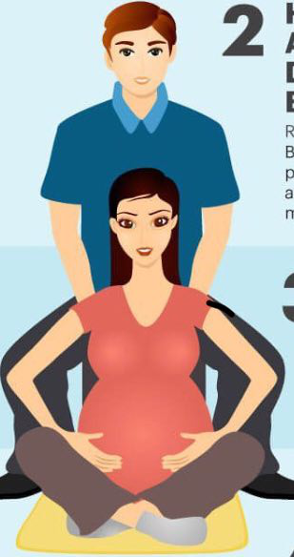
1-The Bradley method
emphasizes that birth is a natural process:
mothers are encouraged to trust their body and focus on:-
diet
exercise throughout pregnancy;
it teaches couples to manage labor through deep breathing and the support of a partner or labor coach.

Slide 19
Methods for Managing Pain in Childbirth
2-The Psychosexual Method
The method includes a program :-
of conscious relaxation
levels of progressive breathing
that encourage a woman to “flow with” rather than struggle against contractions

Slide 20
3-The Dick-Read Method
The premise is that fear leads to tension, which leads to pain.
If a woman can prevent fear from occurring, or break the chain between fear and tension or tension and pain, then she can reduce the
pain of labor contractions.
A woman achieves lack of fear
through education about childbirth and relaxation and reduced pain by focusing on abdominal breathing during contractions

Slide 21
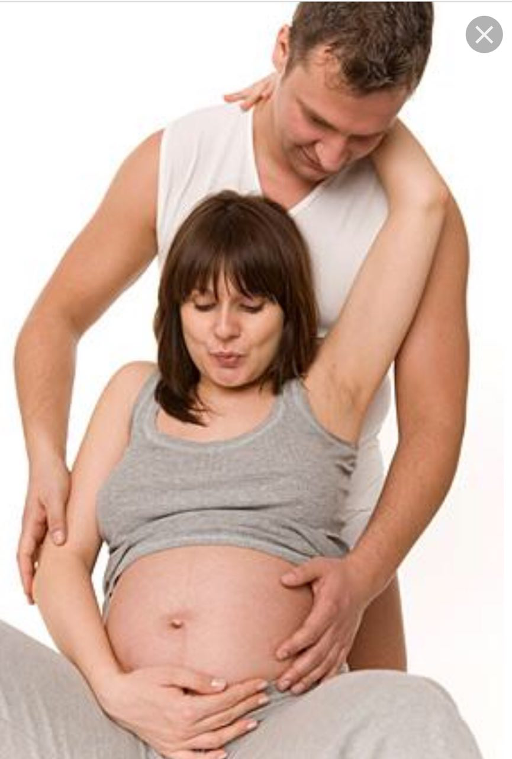
4-The Lamaze Philosophy
The method is based on the theory that through stimulus-response conditioning, women can learn to use controlled
breathing to reduce pain during labor
Or Psychoprophylactic method
use controlled breathing to reduce pain during labor
it focuses on preventing pain in labor (prophylaxis) by use of the mind (psyche).

Slide 22
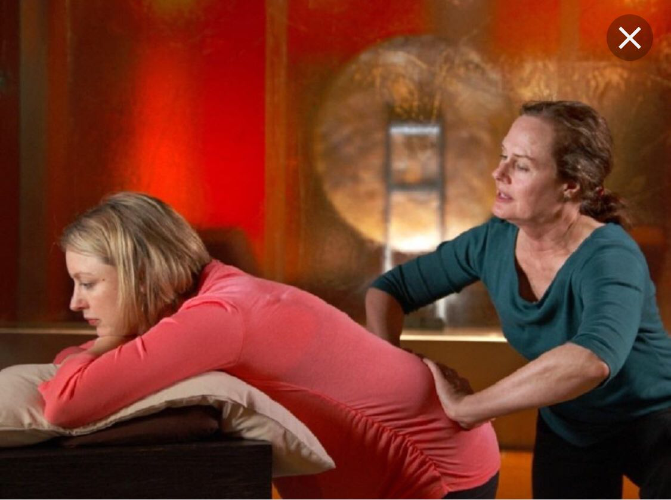
Non medication techniques to pain relive include
1-Conscious Relaxation
is learning to relax body parts
She practices this during pregnancy by deliberately relaxing one set of muscles,
then another and another until her body is completely relaxed.

Slide 23
2-The Cleansing Breath
To begin all breathing exercises, a woman breathes in deeply and then exhales deeply (a cleansing breath).
so it helps ensure an adequate fetal oxygen supply.

Slide 24
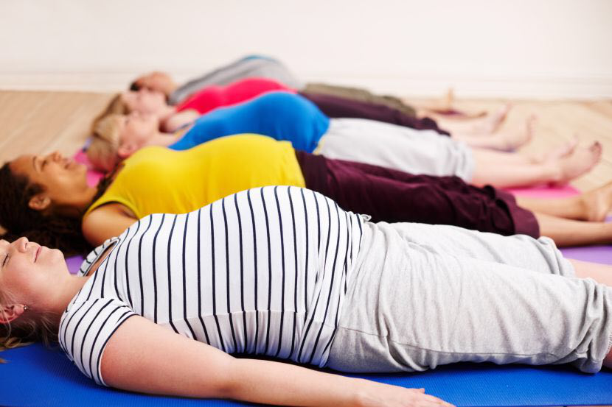
3-Consciously Controlled Breathing.
To practice, a woman inhales comfortably but
fully, then exhales, with her exhalation a little stronger than her inhalation (to help prevent hypoventilation).

Slide 25
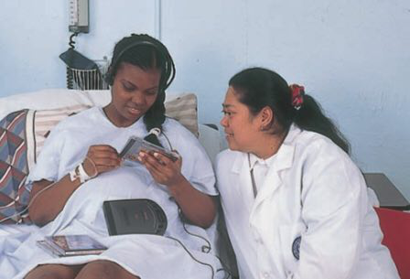
4-Imagery
Focusing intently on an object
is another method of keeping sensory input from reaching the cortex of the brain.
She concentrates on it during contractions.

Slide 26
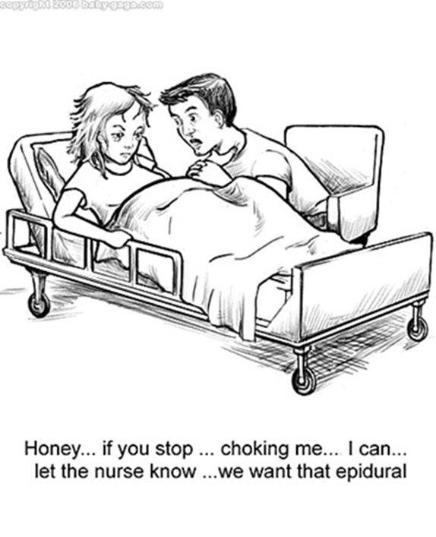
The birth setting
Choosing the Appropriate Setting
Choosing a Birth Attendant & Support Person
Hospital Birth
Alternative Birthing Centers
Home Birth

Slide 27
References
Adele Pillitteri . Maternal & Child Health Nursing : Care of the Childbearing & Childrearing Family, Sixth Edition,Chapter14 preparing a family for childbirth and parenting
patricia A.Wieland Ladewing ,Marcia L.London,Michele .R.Davidson. Contemporary Maternal-Newborn Nursing Care, Sixth Edition, chapter8 preparation for parenthood.

Slide 28
Thank you for your listening

