Slide 1
Maternal And Neonate Nursing Dept. First Simister Health Assessment
Postnatal Assessment
اشراف
أ.د. ربيعة محسن

Slide 2
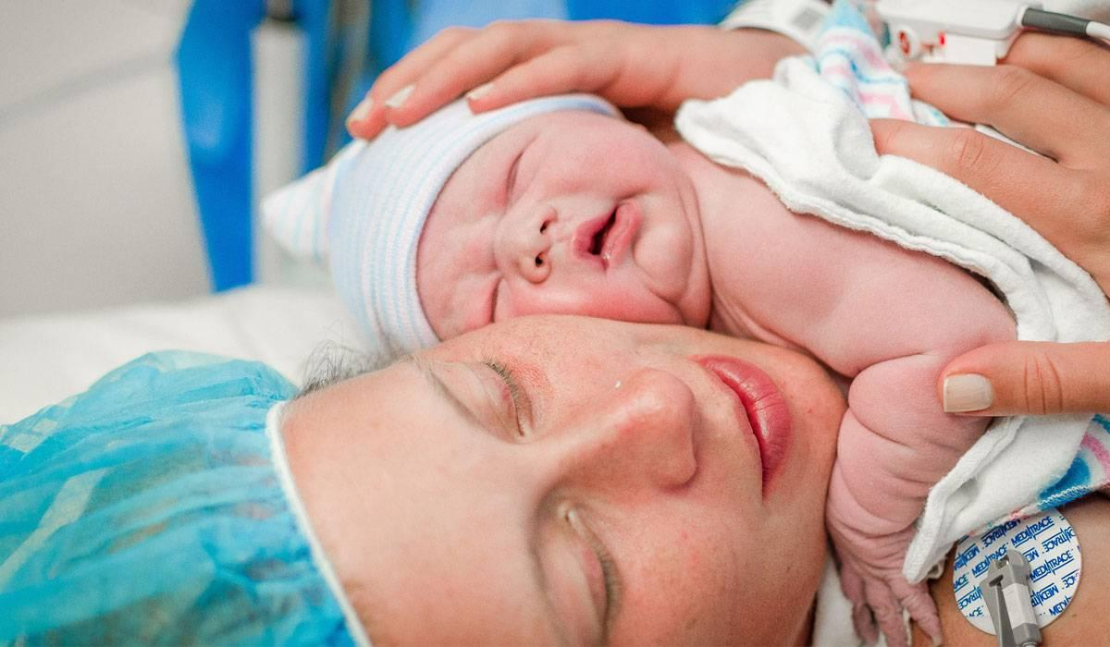

Slide 3
Meaning postnatal period
Is The period following delivery of baby &placenta to about six weeks postpartum.
It is a time in which the mother’s body ,including hormone levels and uterus size returns to a non-pregnant state.

Slide 4
Postnatal care
hospital
first 24 hou
Immediate care
first 2weeks
home
Early care
6 weeks after birth
Helth center
Follow-up care

Slide 5
Assessment Of The Mother
First 24 hours after birth
All postpartum women should have regular assessment of vaginal bleeding ,uterine contraction ,fundal height ,temperature and heart rate(pulse) routinely during the first 24 hours starting from the first hour after birth.
Blood pressure should be measured after birth.if normal,the second blood pressure measurement should be taken within six hours.
Urine void should be documented within six hours.

Slide 6
Beyond 24 hours after birth
Urinary tract function assessment.
Bowel function assessment.
Healing of any perineal or c/s wound .
Back pain
Perineal pain.
Perineal hygiene.
Breast pain.
Uterine tenderness.
Lochia.

Slide 7
Physical Assessment When assessing a maternity patient ,it complete from head to –toe Assessment Of The Breast
inspect for redness &engorgement .
Palpate breasts to determine if they are soft or filling ,warm,engorged or tender
Teach to promote milk production .
Nipple should be soft ,pliable,intact&everted.
*if mother is not brast feeding _do not palpate breasts or assess nipples
Abnormal findings(breast)
Redness,heat,pain,cracked,and fissured nipples ,inverted nipples ,palpable mass,painful,bleeding,bruised,blistered,cracked nipples.

Slide 8
Assessment of uterine fundus
It should be firm ,if not ,massage prior palpation &assess for any blood discharged during massage.
Assess its location and the dgree of uterine contraction ,any tenderness or pain should be noted.
Normal findings:normal size and shape ,firm mobile ,in the midlin,below the umbilicus&non tender.

Slide 9
Uterine fundus..........
Abnormal findings:immobile ,soft ,tender,deviated away from the midline or above the umbilicus after 24 hours.
Fundul height is measured in cm above or below the umbilicus
note:*fundus is 2 cm below the level of umbilicus immediately after birth ;fundus descendes approximately 1 cm per day ;by the 10 th day the fundus should no longer be palpated.

Slide 10
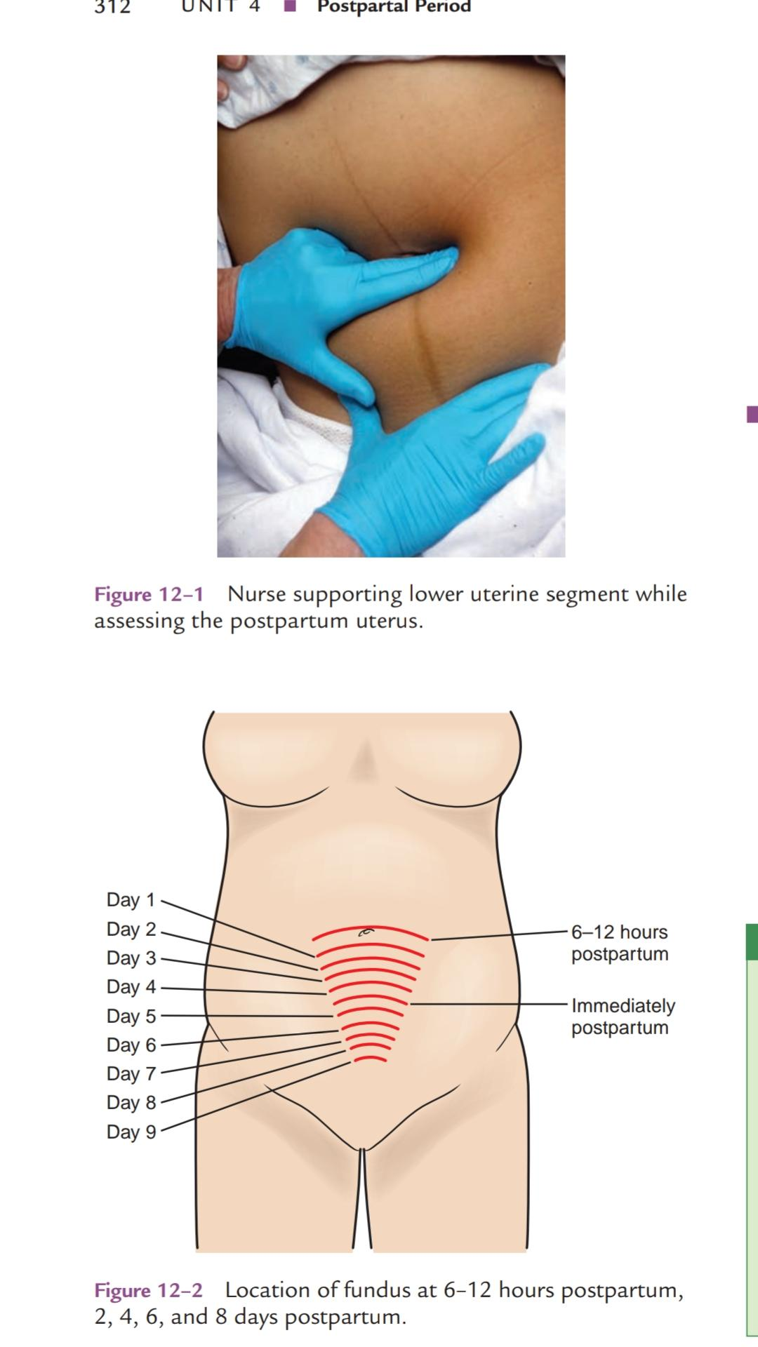

Slide 11
Assessment of the bladder
Able to void spontaneously within 6-8 hours of vaginal birth .
Epidurals commonly cause urinary retention
Assess frequency ,burning,or urgency.
Bladder distention
A full bladder displaces the uterus,prevents involution (contraction of the uterus) and puts the patient at great risk for hemorrage.

Slide 12
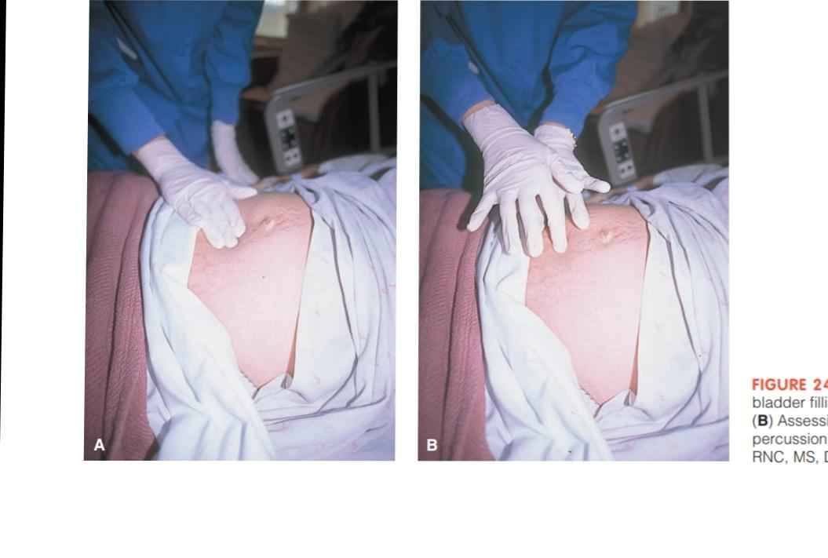

Slide 13
Assess of the bowels
Active bowel sounds in all four quadrants.
Bowel movment
Flatus in c-section patients.
Assess c- section incision site:
REEDA
Redness
Edema or swelling
Ecchymosis orbruising
Drainage
Approximation of wound edges

Slide 14
Assessment of the lochia
Lochia Is postpartum vaginal discharge, It contains blood from the placenta site.
Color (lochia rubra ,serosa, alba)
Odor
Amount

Slide 15
Stages of lochia
Triats | Lochia rubra | Lochia serosa | Lochia alba
colour | red | Pink or brown | Creamy ,yellowish
Composition | MAINLY RBC Leucocytes ,decidua Mucus. | Serum ,few rbc and leucocytes. | Mucus.serous, epithelial cell,leucocytes
Duration | 1-4 days | 5-9 days | 10-15 days

Slide 16
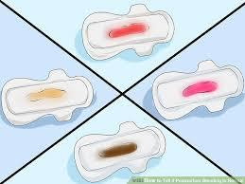

Slide 17
Assessment of episiotomy
Assess entire perineum (area from the opening of vagina to the rectum)
Assess the episiotomy using:
*REEDA

Slide 18
Proper technique for assessing the perineum
Wear gloves
Have patient lie on her side ;have her turn away from you and have her lift her top leg .
This will provide an unobstructed view of the entir perineum (vagina to rectum)
Be sure to assess for hemorrhoids also commonly develop as a result of pushing in L&D

Slide 19
Assessment of emotional status
Determine emotional status.
Sleep deprivation
Ablity to rest
Energy level
Comfort level
Anxiety
Appetite
Bonding behaviors
Support system (family ,husband, self supported)
Providing infant care

Slide 20
Vital signs and general health
pulse rate ,respiratory rate ,body temperature ,any outward odour,skin condition and the woman’s overall color
Chest should be clear with good air entry bilaterally .

Slide 21
Postnatal care include
counseling
Family planning
advice
immunization
Services on breastfeeding
Maternal nutrition

Slide 22
Postnatal nursing care
Encourage patient taken prescribed medications and supplementation :e.g iron tablets ,vitamin a,vitamin c.
Introduce exercises (e.g :kegel exercises).
Encourage and provide family planning counseling .
Examine the infant for normal weight gain .
Answer both mother’s and family’s questions.
Counsel mother about infant immunization schedule and ensure the mother can get access to immunization center.
Assess and advise on breastfeeding.
Personal hygiene
Rest.
Diet (eat protein and energy rich food ,minaral and fluids).

Slide 23
Neonate care instructions to the parents
Cord care.
Circumcised penis.
Elimination.
Bathing.
Clothing .
Breastfeeding.
Health promotion.

Slide 24
Postnatal complications
Hemorrhage.
Pueperial infection.
Mastitis.
Subinvolution.
Cystitis.
Postpartum depression.

Slide 25
References
1. (Stephens and Brighton 2015)
2. https://www.nurse.com/2017
3. https://www.nursingworld.org/
4. ©American Nurses Association
5. www.anmc.org.au. Accessed:19 March 2008.

