Slide 1
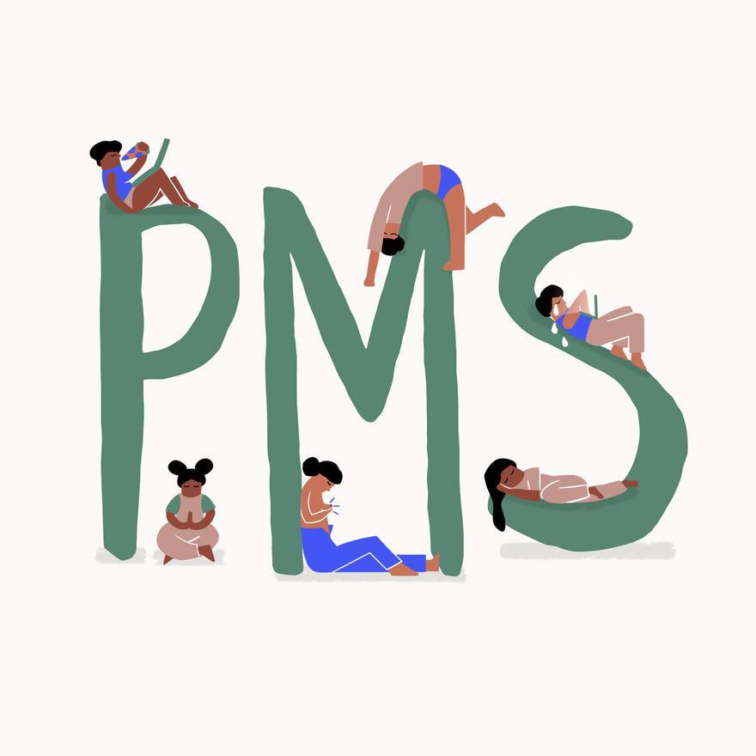
Premenstrual syndrome and premenstrual dysphoric disorder
prof. DR. RABEA M. ALI

Slide 2
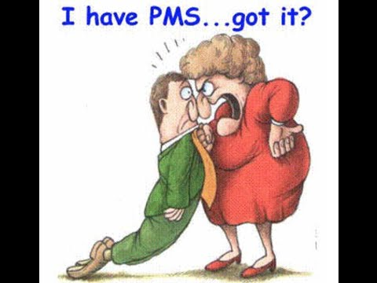
Premenstrual syndrome (PMS) is a combination of symptoms that many women get about a week or two before their period. Most women, over 90%, say they get some premenstrual symptoms, such as bloating, headaches, and moodiness.

Slide 3
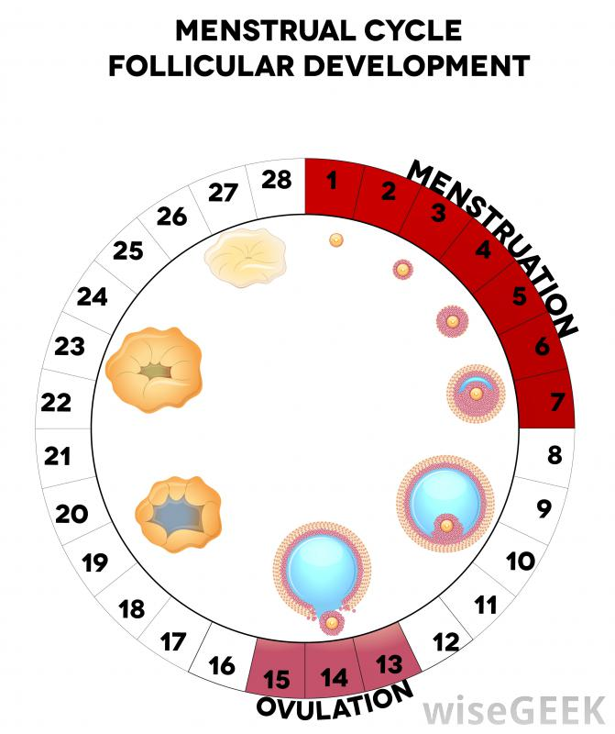
Menstruation : is the monthly shedding of the lining of a woman’s uterus (more commonly known as the womb). Menstruation is also known by the terms menses, menstrual period, cycle or period

Slide 4
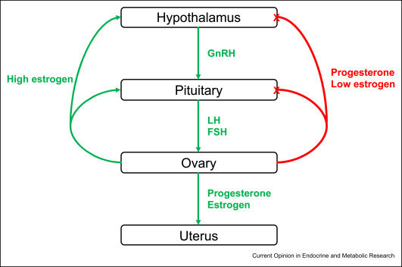

Slide 5
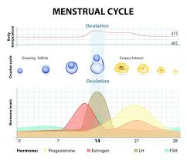

Slide 6
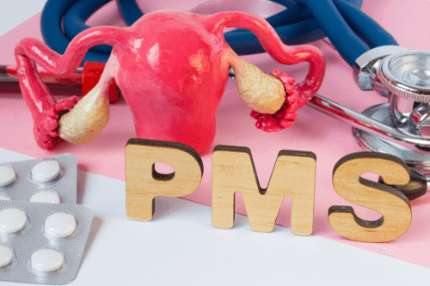
PMS is also sometimes known as Premenstrual Tension (PMT). One in three women suffers discomforting symptoms in the days before their period.
Epidemiology: Up to 80% of women of child-bearing age report having some symptoms prior to menstruation. These symptoms qualify as PMS in 20 to 30% of women and in three to eight percent are severe

Slide 8
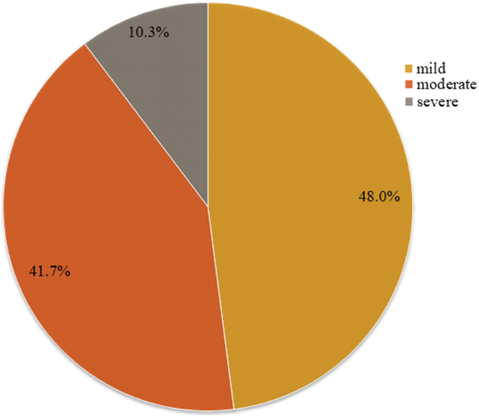

Slide 9
Causes
Cyclic changes in hormones. Signs and symptoms of premenstrual syndrome change with hormonal fluctuations and disappear with pregnancy and menopause.
Chemical changes: Chemicals in the brain, such as serotonin, fluctuate during the menstrual cycle. Serotonin contributes to feelings of happiness and regulates mood. It is possible that women with low levels of serotonin are more sensitive to PMS symptoms.

Slide 10
Weight and exercise Research undertaken has shown that women are more likely to have PMS symptoms if they are obese (body mass index over 30) and if they exercise very little. Stress
Stress can aggravate the symptoms of PMS, although it is not a direct cause
Diet: Low levels of vitamins and minerals may also worsen PMS symptoms.

Slide 11
Symptoms
Physical signs and symptoms
Joint or muscle pain
Headache
Fatigue
Weight gain related to fluid retention
Abdominal bloating
Breast tenderness
Acne flare-ups
Constipation or diarrhea

Slide 12
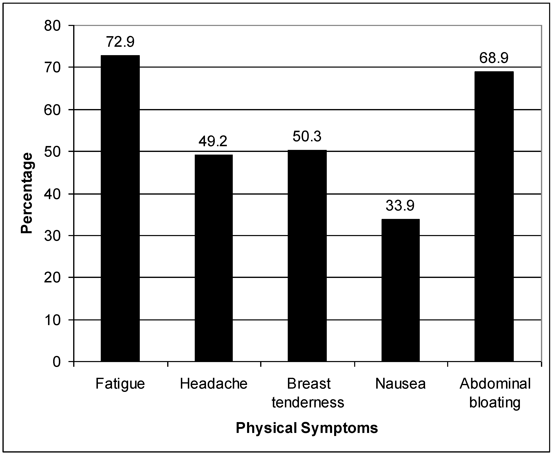

Slide 13
Emotional and behavioral signs and symptoms
Tension or anxiety
Depressed mood
Crying spells
Mood swings and irritability or anger
Appetite changes and food cravings
Trouble falling asleep (insomnia)
Social withdrawal
Poor concentration

Slide 14
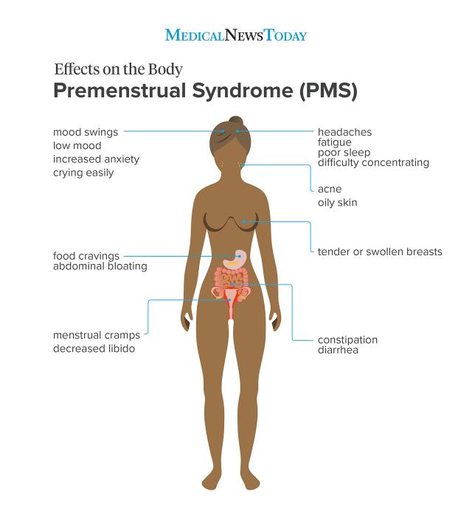

Slide 15
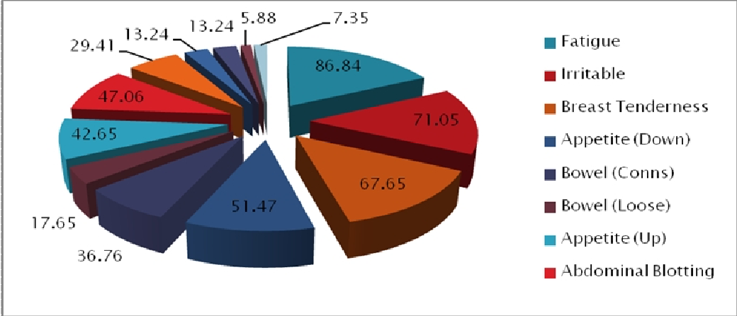

Slide 16
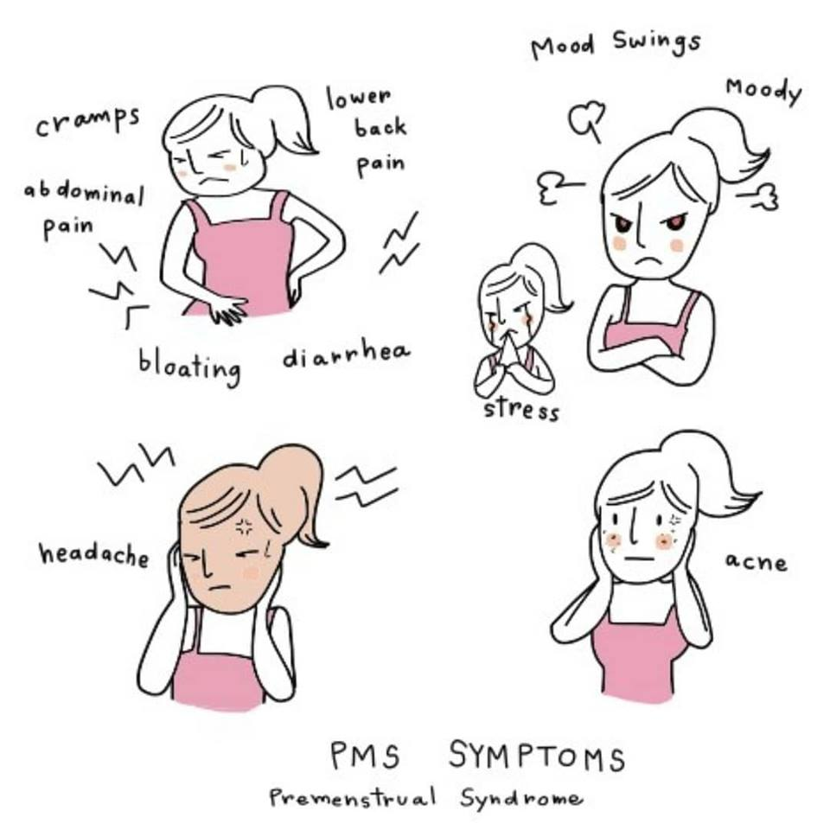

Slide 17
Risk factors for premenstrual syndrome include:
a history of depression or mood disorders, such as postpartum depression or bipolar disorder
a family history of PMS
a family history of depression
domestic violence
substance abuse
physical trauma
emotional trauma

Slide 20
Treatment options for PMS vary depending on a person’s specific symptoms.
Medication that people take to treat PMS include:
Pain relievers such as acetaminophen, which can help relieve muscle pain, cramps, and headaches
Non-steroidal anti-inflammatory drugs, which can reduce cramp pain, headaches, and muscle aches
Diuretics, which can help relieve bloating and breast soreness
For severe PMS symptoms, a doctor may recommend that a person starts taking hormonal birth control pills to reduce PMS symptoms.

Slide 21
Hormone treatments
Combined oral contraceptive pill: thought to alleviate PMS by stopping ovulation and reducing hormonal fluctuations.
Estrogen patches and implants: there is scientific evidence that extra estrogen given this way can relieve PMS symptoms

Slide 22
Mirena intra-uterine system (IUS): this is a contraceptive coil which releases a small dose of a progestogen. Some women say it improves PMS, as well as reducing the heaviness and duration of their period
Gonadotropin-releasing hormone analogues are drugs that prevent ovulation and should only be used for the treatment of severe PMS.

Slide 23
Relaxation technique
relaxation techniques include:
yoga
tai chi
stretching
taking a bath
going for a walk
journaling
speaking with a close friend or loved one
meeting with a mental health counselor or therapist

Slide 25
Reduce PMS-related bloating by:
Not eating salty foods, which make bloating worse
Eating potassium-rich foods, such as bananas
Staying hydrated
Doing gentle exercise

Slide 26
Eat certain nutrients
Making some dietary changes may reduce mild to moderate PMS symptoms.
Magnesium may help relieve migraine episodes related to PMS.
Fatty acids may help reduce abdominal cramps related to PMS.
Calcium supports bone strength and density. Having adequate calcium levels also helps regulate mood, sleep, and food cravings.

Slide 27
Surgery A hysterectomy with removal of both ovaries to prevent ovulation may be necessary for a few women who suffer from severe PMS.

Slide 28
Premenstrual dysphoric disorder (PMDD) is a health problem that is similar to premenstrual syndrome (PMS) but is more serious.
PMDD causes severe irritability, depression, or anxiety in the week or two before the period starts. Symptoms usually go away two to three days after the period starts. may need medicine or other treatment to help with symptoms.

Slide 29
When does PMDD begin?
Premenstrual symptoms can begin at any age after a woman begins to menstruate. Some women report that symptoms worsen when they are in their 30s; others associate the onset of symptoms with a reproductive event, such as a baby’s birth or surgery for tubal ligation.

Slide 30
causes
We don’t know for sure what causes PMDD, but researchers believe that, like other mood disorders, PMDD may involve an underlying vulnerability in brain chemistry. Because of this vulnerability, monthly fluctuations in hormones (estrogen and progesterone) have a negative effect on the way nerve cells in the brain function, leading to premenstrual symptoms.

Slide 31
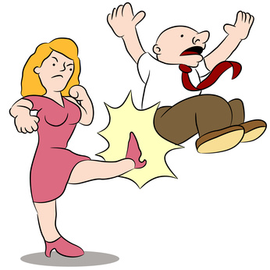
The symptoms of PMDD may include:
depression
thoughts of suicide
panic attacks
extreme anxiety
anger with severe mood swings
crying spells
a lack of interest in daily activities
insomnia
trouble thinking or focusing
binge eating

Slide 32
For PMDD to be diagnosed:
women must have ≥ 5 of the following symptoms for most of the week before menses, and symptoms must become minimal or absent during the week after menstruation. Symptoms must include ≥ 1 of the following:
Marked mood swings (eg, sudden sadness)
Marked irritability or anger or increased interpersonal conflicts

Slide 33
Marked depressed mood, feelings of hopelessness, or self-deprecating thoughts
Marked anxiety, tension, or an on-edge feeling

Slide 35
Treatments for PMDD include:
Antidepressants
Birth control pills to treat PMDD.
Over-the-counter pain relievers may help relieve physical symptoms, such as cramps, joint pain, headaches, backaches, and breast tenderness. These include: Ibuprofen, Naproxen, Aspirin

Slide 36
What nutritional approaches are used to treat PMDD?
Include
Limiting consumption of alcohol, caffeine, and salt.
Some experts also advise avoiding sugar and eating more complex carbohydrates.
The experts give little support to vitamins, herbal preparations, and other dietary supplements for PMDD

Slide 38
Potter, J., Bouyer, J., Trussell, J., Moreau, C. (2009). Premenstrual Syndrome Prevalence and Fluctuation over Time: Results from a French Population-Based Survey: Journal of Women’s Health; 18(1): 31–39.
Pearlstein, T., Steiner, M. (2008). Premenstrual dysphoric disorder: burden of illness and treatment update. Journal of Psychiatry & Neuroscience; 33(4): 291–301.
American Psychiatric Association. (2013). Diagnostic and statistical manual of mental disorders (5th ed.). Washington, DC: The American Psychiatric Association.
The Medical Letter. (2003). Which SSRI?(link is external) Med Lett Drugs Ther; 45(1170):93-5.
Goodale, I.L., Domar, A.D., Benson, H. (1990). Alleviation of premenstrual syndrome symptoms with the relaxation response(link is external). Obstet Gynecol; 75(4):649-55
WWW.Womens -health-concern.org
Office on Women's Health. December 23, 2014. Archived from the original on 28 June 2015. Retrieved 23 June 2015.

