Slide 1
New trend in maternity nursing
prof.Dr. Rabea M. Ali

Slide 2
Philosophy of Maternal and Child Health Nursing
Maternal and child health nursing is family centered; assessment data must include a family and individual assessment.
Maternal and child health nursing is community centered; the health of families depends on and influences the health of communities.
Maternal and child health nursing is research oriented, because research is the means whereby critical knowledge increases.
Both nursing theory and evidence-based practice provide a foundation for nursing care

Slide 3
Cont.…
A maternal and child health nurse serves as an advocate to protect the rights of all family members, including the fetus.
Maternal and child health nursing includes a high degree of independent nursing functions, because teaching and counseling are so frequently required.
Promoting health is an important nursing role, because this protects the health of the next generation.
Pregnancy or childhood illness can be stressful and can alter family life in both subtle and extensive ways.

Slide 4
Cont.
Personal, cultural, and religious attitudes and beliefs influence the meaning of illness and its impact on the family.
Maternal and child health nursing is a challenging role for a nurse and is a major factor in promoting high-level wellness in families

Slide 5
Common Measures to Ensure Family-Centered Maternal and Child Health Care Principle
The family is the basic unit of society.
Families represent racial, ethnic, cultural, and socioeconomic diversity.
Children grow both individually and as part of a family.

Slide 6
Nursing Interventions
Consider the family as a whole as well as its individual members.
Encourage families to reach out to their community so that family members are not isolated from their community or from each other.
Encourage family bonding through rooming-in in both maternal and child health hospital settings.
Participate in early hospital discharge programs to reunite families as soon as possible.
Encourage family and sibling visits in the hospital to promote family contacts.

Slide 7
Cont.
Assess families for strengths as well as specific needs or challenges.
Respect diversity in families as a unique quality of that family.
Encourage families to give care to a newborn or ill child.
Include developmental stimulation in nursing care.
Share or initiate information on health planning with family members so that care is family oriented.

Slide 8
family-centered care and the nursing process
American Nurses Association/Society of Pediatric Nurses
Standards of Care and Professional Performance Standards of Care Comprehensive pediatric nursing care focuses on helping children and their families and communities achieve their optimum health potentials
This is best achieved within the framework of family-centered care and the nursing process, including primary, secondary, and tertiary care coordinated across health care and community settings.

Slide 9
Standard I: Assessment The pediatric nurse collects patient health data.
Standard II: Diagnosis The pediatric nurse analyzes the assessment data in determining diagnoses.
Standard III: Outcome Identification The pediatric nurse identifies expected outcomes individualized to the child and the family.
Standard IV: Planning The pediatric nurse develops a plan of care that prescribes interventions to obtain expected outcomes.
Standard V: Implementation The pediatric nurse implements the interventions identified in the plan of care.
Standard VI: Evaluation The pediatric nurse evaluates the child’s and family’s progress toward attainment of outcomes.

Slide 11
Association of Women’s Health, Obstetric, and Neonatal Nurses Standards and Guidelines Standards of Professional Performance
Standard I: Quality of Care The nurse systematically evaluates the quality and effectiveness of nursing practice.
Standard II: Performance Appraisal The nurse evaluates his/her own nursing practice in relation to professional practice standards and relevant statutes and regulations.
Standard III: Education The nurse acquires and maintains current knowledge in nursing practice.
Standard IV: Collegiality The nurse contributes to the professional development of peers, colleagues, and others.
Standard V: Ethics The nurse’s decisions and actions on behalf of patients are determined in an ethical manner.

Slide 12
Standard VI: Collaboration The nurse collaborates with the patient, significant others, and health care providers in providing patient care.
Standard VII: Research The nurse uses research findings in practice.
Standard VIII: Resource Utilization The nurse considers factors related to safety, effectiveness, and cost in planning and delivering patient care.
Standard IX: Practice Environment The nurse contributes to the environment of care delivery within the practice settings.
Standard X: Accountability The nurse is professionally and legally accountable for his/her practice. The professional registered nurse may delegate to and supervise qualified personnel who provide patient care.

Slide 14
Trend
In the changing scenario of health care system of today’s world, the trends in maternal and newborn health nursing are also changing.(Radhika,2016)
New Trends in Maternity's & Midwifery Nursing is rapidly changing the world, that required professionals to remain up-to-date in order to react to new any developments as they occur

Slide 16
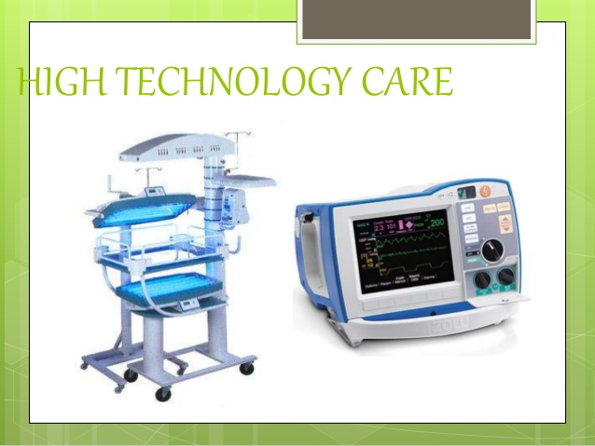

Slide 19
Technological Advances
Today fetal monitoring has progressed from the use of Feto-scope to electronic fetal monitor such as:
Bella beat Shell
Bloom life

Slide 20
Bella beat's Shell : app It works to amplify the sound of baby's heartbeat when pressed to the mother's body, as well as to let to record the audio and even share it with friends and family via the app. to regular appointments.

Slide 21
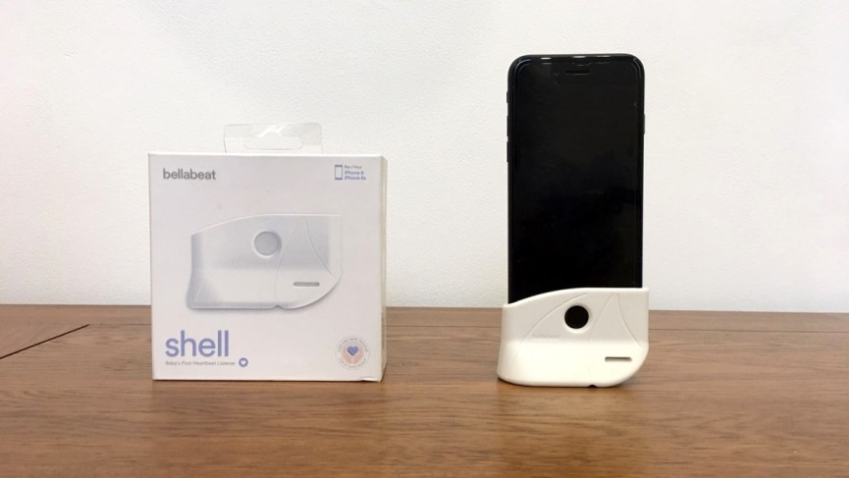

Slide 22
Bloom life
woman not supposed to wear it the whole time but for one, two or three months of third trimester. It sticks onto the belly and measures the count and timing of contractions (both Braxton Hicks and labor) via electrical signals from the uterine muscle.

Slide 23
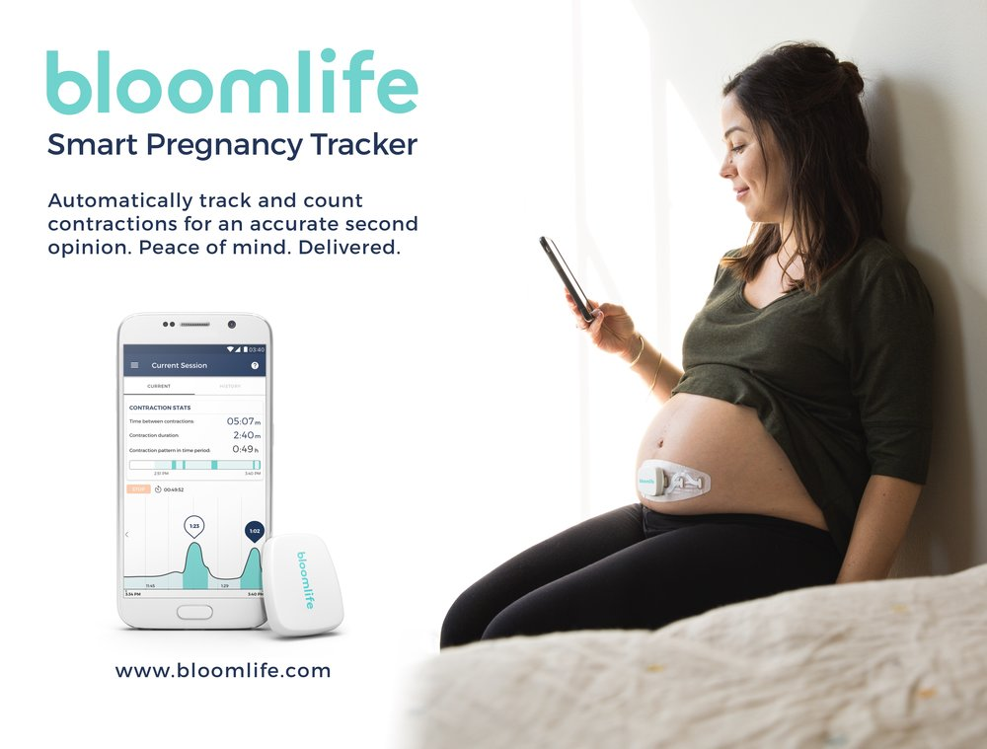

Slide 24
Noninvasive prenatal testing or NIPT (2000s)
a blood test, can be done as early as the 9th week of pregnancy and can screen for chromosomal abnormalities in baby. Unlike amniocentesis, NIPT carries no risk of miscarriage. Early diagnosis of chromosomal disorders, including microdeletions ensures that affected babies receive the care they need as soon as possible.

Slide 25
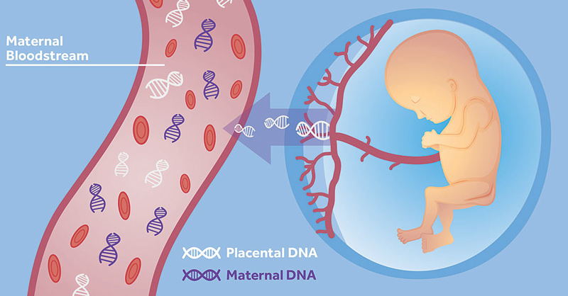
Cell-free DNA genetic screening
Cell-free DNA screening is the newest way to screen for genetic problems in the baby. This is a simple blood test that can detect pieces of the baby's DNA in mom's blood to determine if there may be a problem with the pregnancy.

Slide 26
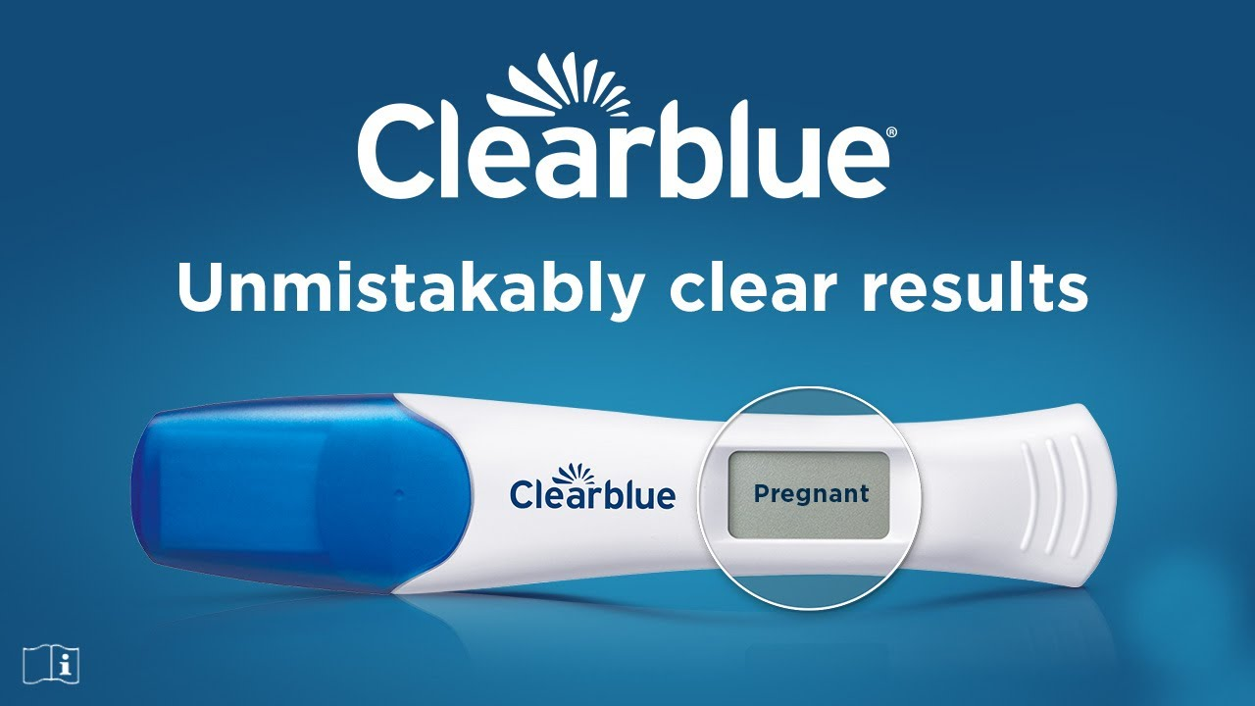
Clearblue Digital pregnancy test.
Description
Unmistakably clear results
Over 99% accurate
Results 5 days sooner
The pregnancy hormone increases rapidly in early pregnancy and Clearblue Digital can be used to test up to 4 days before the expect period (5 days sooner than missed period).
**99% accurate at detecting typical pregnancy hormone levels.

Slide 27
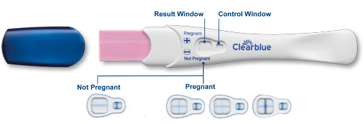
tests can be used either ‘in-stream’ simply by holding the tip directly in the urine stream for 5 seconds; or by dipping the test into a collected urine sample for between 5 - 20 seconds, depending on the product used. Keep in mind you should always read the instruction leaflet before testing

Slide 28
Trends in Maternal and Child Health Care and Implications for Nurses
Implications for Nursing | Trend
Fewer family members are present as support in a time of crisis. Nurses must fulfill this role more than ever before. | Families are smaller than in previous decades.
A single parent may have fewer financial resources; this is more likely if the parent is a woman. | Single parents are increasing in number
Good interviewing is necessary with mobile families so a health database can be established; education for health monitoring is important. | Families are more mobile than previously; there is an increase in the number of homeless women and children.

Slide 29
Screening for child or intimate partner abuse should be included in family contacts. Be aware of the legal responsibilities for reporting abuse. | Abuse is more common than ever before
Families are ripe for health education; providing this can be a major nursing role.` | Families are more health-conscious than previously.
Comprehensive care is necessary in primary care settings because referral to specialists may no longer be an option | Health care must respect cost containment

