Slide 1
Menopause
Prof. Dr. Rabea M. Ali

Slide 2
Overview of Menopause
Menopause is a stage of a woman's life remarkable by the end of her menstrual cycle, and it marks the end of her reproductive years. As a result of these biological changes, women are often exposed to a number of different symptoms for a period of time, though they finally subside

Slide 3
Definition
The permanent cessation of menstruation for 12 months caused by the termination of ovarian follicular recruitment, selection and development in presence of elevated pituitary gonadotropin

Slide 4
Female sex hormones
Gonadotropin releasing hormone (GnRH) of hypothalamus induces the release of follicle stimulating hormone (FSH) and luteinizing hormone (LH), FSH each month initiates the development of several ovarian follicles and stimulates follicular cells to secrete estrogen, LH induces ovulation and the production of corpus luteum and progesterone secretion by corpus luteum

Slide 5
Estrogen and progesterone are hormones made by the ovaries they are known as female sex hormones (sex steroids) the ovaries also produce some of the male hormones, testosterone. During puberty, estrogen stimulates breast growth and causes the vagina, uterus and fallopian tube to mature. It also plays a role in the growth of spurt and changes the distribution of fat on the girl`s body, typically resulting in more being deposited around the hip, buttocks and thighs. Testosterone helps promote muscle and bone growth

Slide 6
Normal menstruation Physiology
Hypothalamus:
The release of GnRH by the hypothalamus initiates the menstrual cycle. GnRH is transmitted from the hypothalamus to the anterior pituitary gland and signals the gland to start production of the gonadotropic hormones FSH and LH

Slide 7
Pituitary gland: The anterior pituitary gland secretes two hormones which are called gonadotropins in order to stimulate the gonads, these hormones are essential for reproduction, they contain follicle-stimulating hormone stimulates the maturation of ovarian follicle sand and the luteinizing hormone (LH) responsible for ovulation of mature follicles in the ovary. The stander regulator of LH and FSH secretion is gonadotropin-releasing hormone (GnRH), also known as LH-releasing hormone

Slide 8
The ovary:
Ovaries produce and release two sets of sex hormones—progesterone and estrogen. There are actually three main estrogens, known as estradiol, estrone, and estriol. These materials work together to enhance the healthy growth of female sex characteristics through puberty and to ensure fertility. Progesterone and estrogen are needed to prepare the uterus for menstrual cycle, and their release is triggered by the hypothalamus

Slide 9
The Uterus:
The endometrium is shed and the discharge occurs because low levels of hormones, especially progesterone, inducing the release of prostaglandins that lead to the uterine spiral arterioles to constrict

Slide 10
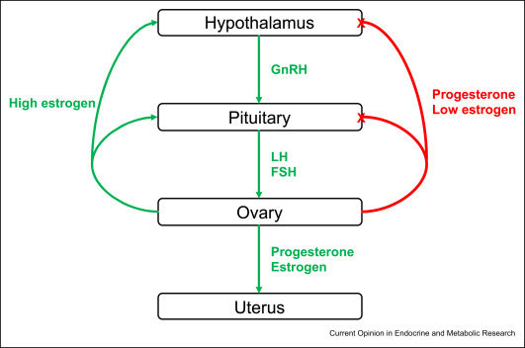

Slide 11
Menopausal stages
Pre-menopause stage is the time before menopause when a woman has regular monthly menstrual cycles (‘periods’).
Peri-menopause stage is the time that ovarian function begins to change, commonly preceding final menses by approximately 2 to 8 years.

Slide 12
Menopause stage is the time of life when menstrual cycles stop, resulting in decline in the secretion of hormones estrogen and progesterone. Natural menopause is diagnosed after 12 months of amenorrhea not associated with a satisfactory reason

Slide 13
Post-menopause stage: It is the period of time after the menopause. The post menopause is formally known as the time after which a woman suffers twelve (12) consecutive months of amenorrhea (absence of menstruation) without a period.

Slide 14
Premature menopause:
also described as premature ovarian failure (POF), is characterized by stopping of menstrual cycle before the age of 40 years. Little information is available on the overall prevalence of POF or on the prevalence by racial group. There is also a lack of information on the association of POF with health indicators

Slide 15
Secondary POF is caused by some interventions (oophorectomy or chemotherapy and radiotherapy, infections); bilateral surgical removal of one or both ovary or surgical menopause, hysterectomy without oophorectomy/uterine artery embolization. Uterine artery embolization also has a chance to result in POF by exposing the vascular supply to the ovary

Slide 16
Late menopause:
A woman who is 55 or older and still has not reached menopause, would be considered late

Slide 17
Hormonal changes during menopause
It is nearly five years before menopause occurs that a woman will begin to experience changes in menstrual cycle. These changes assign that a woman's production of hormones is changing. Hormones are chemicals produced by different areas of body. Hormones will both stimulate and exert control over many important functions of body

Slide 18
Short and long terms consequences of menopause
Short term consequences
Vasomotor symptoms (VMS):
are a form of temperature imbalance that occurs due to changes in gonadal hormones. (VMS), usually called hot flashes or flushes (HFs) and night sweats. It has seen mostly around the head, neck, chest and upper back

Slide 19
Genitourinary and Sexual Symptoms
vaginal dryness
pain during sexual intercourse
itching
Burning
pain during urination
frequent urination
Nocturia
Urinary incontinence
Urogenital atrophy
Irritation
Decreased libido

Slide 20
Psychological Symptoms
Depression
Irritability
Anxiety
fatigue,
Nervousness
Headaches
insomnia
palpitations.

Slide 21
Dermatological symptoms
changes in the skin collagen lead to lowering flexibility and skin strength
Itchy skin
Dryness
Thinner
more prone to sun damage due to number of melanocytes in the skin reduces during the perimenopause and menopause

Slide 22
Long term consequences
Osteoporosis
A main cause of illness and death in the elderly. The condition is characterized by a decreased bone mass which increases the risk of fracture, especially of the spine, hip, and wrist. All over the world it is estimates that 200 million women suffer from osteoporosis. In the United States, more than 53 million people either they have previously osteoporosis or are at a high risk because of low bone mass

Slide 23
Estrogen plays a big role in maintaining bone strength. Starting around the age 30 during the onset of menopause, women lose a small amount of bone each year as a normal part of the aging process.
The early assessment of skeletal health and then the perform of proper calcium and vitamin D supplementation and an exercise program are substantial in the prevention and treatment of osteoporosis.

Slide 24
The diagnosis of osteoporosis can be made using conventional radiography and by measuring the bone mineral density (BMD). The most popular method of measuring BMD is dual-energy X-ray absorptiometry(DEXA).

Slide 25
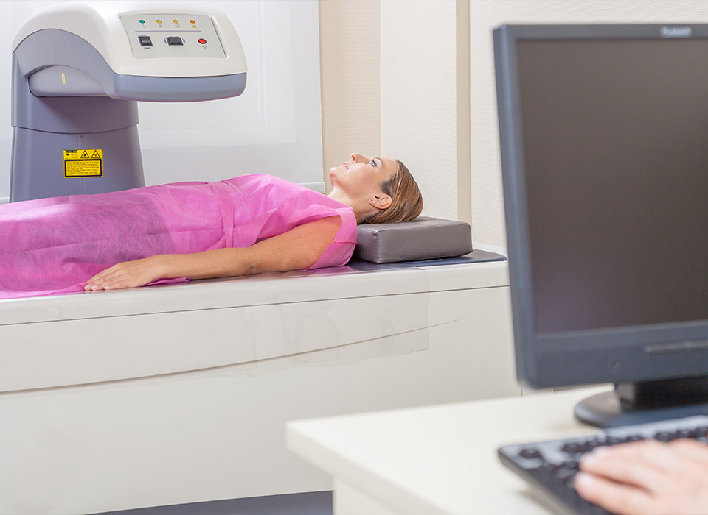

Slide 26
Cardiovascular disease
The cardiovascular disease (CVD) is the main cause of dying for American women. Women share many of the same risk factors (RFs) for cardiovascular disease (CVD) as men, and in both, women and men, these RFs are associated with the biology of aging. Additionally, the prevalence of multiple RFs increases with age, although menopause has been believed to increase CVD risk in women

Slide 27
The cardiovascular disease is a condition that affects the heart and circulatory system. It contains thickening of the arteries (atherosclerosis) that supply the heart and limbs, HT, angina and stroke. According to American Heart Association report (2002), after menopause 70% of women finally develop cardiovascular disease and 30% develop osteoporosis in United States

Slide 28
Management of Menopause
1. Hormone Replacement Therapy(HRT)
Hormone Replacement Therapy (HRT) is now used for three key indications: avoiding osteoporosis, prevention of coronary artery disease (CAD), and reduction of menopausal symptoms.

Slide 29
Hot flashes and night sweats are common, and respond effectively to hormone replacement therapy doses of estrogen. Hormone replacement therapy (HRT) in which the estrogen is similar to natural ovarian production should not be confused with the strong ethinyl estradiol used in combined oral contraceptive regimens.

Slide 30
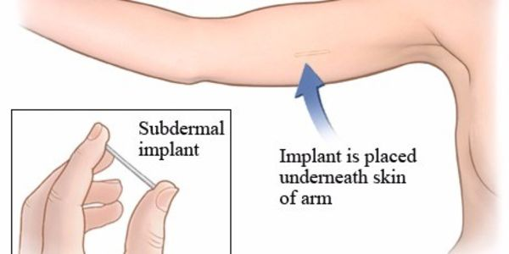
Type of HRT
Implants
Tablets
skin patches
gels and vaginal creams
pessaries or rings

Slide 31
2. Life style changes
Diet: healthy diet can reduce some of conditions that may develop during and after menopause, including obesity, diabetes (type 2), cardiovascular disease, specific type of cancer and osteoporosis. All women in perimenopause should be aware of healthy eating and should use menopause as chance to make healthy changes

Slide 32
Eat a heart healthy diet, including at least five portions of different coloured fruit and vegetables, plenty of fibre rich cereal foods, and more fish, nuts (unsalted), peas and beans
Aim for two to three portions of calcium-rich foods every day
Reduce caffeine and alcohol intakes to help manage hot flushes
Maintain or take steps to achieve a healthy body weight

Slide 33
Food Avoided
Spicy Foods
Fast Food
Alcohol
Caffeine
Fatty Meats

Slide 35
Exercise
Regular exercise is an excellent way to stave off weight gain and loss of muscle mass, which are two frequent symptoms of menopause.

Slide 36
Cardio
Aerobic activity that makes use of the large muscle groups while keeping up the heart rate is a good thing. Your options for cardio are limitless. Almost any activity counts, for example:
walking
jogging
biking
swimming

Slide 37
Yoga and meditation
They can also help alleviate symptoms such as:
hot flashes
irritability
Fatigue

Slide 38
Dancing and Zumba

Slide 39
3. Life habit
Healthy life style habits such as stop smoking, balance diet, good sleep pattern and exercise are the best ways to do during menopause. Smoking increases development heart disease and osteoporosis, and the worsening of hot flashes. Smoking can also lead to complications if women choose to take menopause medications, such as hormone therapy.

Slide 40
Thank you

