Slide 1
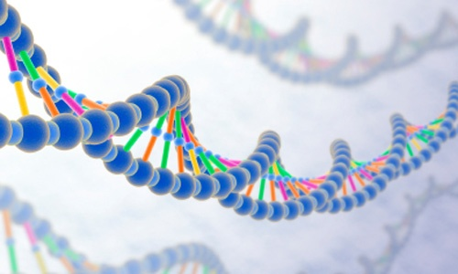
Genetics
Prof. Dr. Rabea M. ALI

Slide 2
Objectives:
On completion of this seminar, the students will be able to:
Explore how recent advances in genetics have changed the field of health care.
Describe expanded roles for nurses in genetics and genetic counseling.
Identify genetic disorders commonly tested for in maternity and newborn nursing.

Slide 3

What is Genetics
Genetics is the study of individual genes and their role in heritance. Genomics, a relatively new science, is the study of all genes and includes interactions among genes as well as interactions between genes and the environment. Genomics plays a role in complex conditions such as heart disease and diabetes.

Slide 4
Why it is important study of genetics
Genetic disorders affect people of all ages, from all socioeconomic levels, and from all racial and ethnic backgrounds. Genetic disorders affect not only individuals but also families, communities, and society. Advances in genetic testing and genetically based treatments have altered the care provided to affected individuals

Slide 5

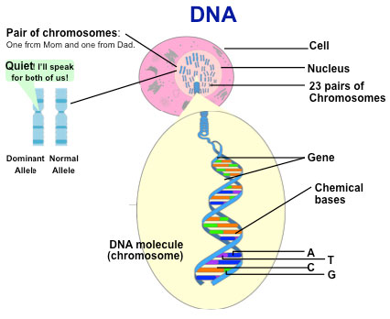

Slide 6
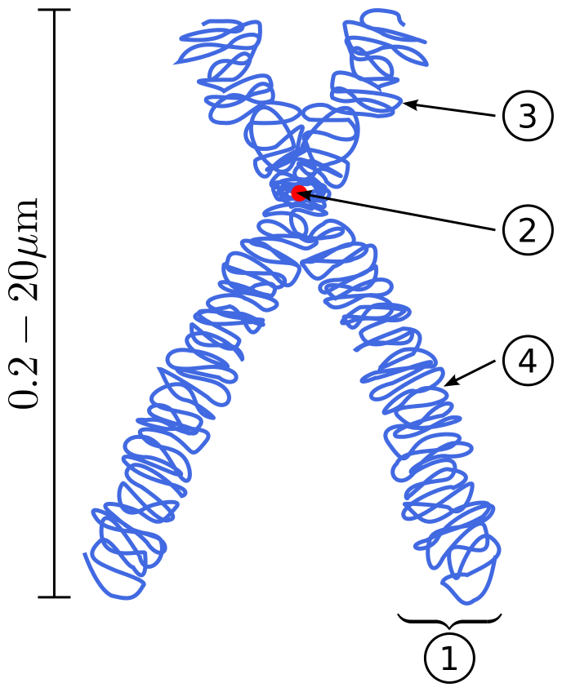
مخطط للكروموسوم فيه يظهر(1) الكروماتيد centromere (2) قطعة مركزية (3) الذراع القصير للكروماتيد (4) الذراع الطويل للكروماتيد

Slide 7
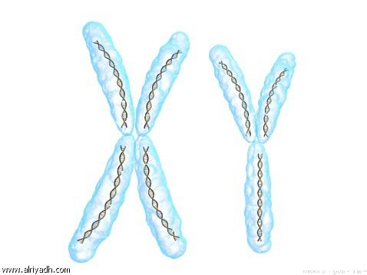

Slide 8
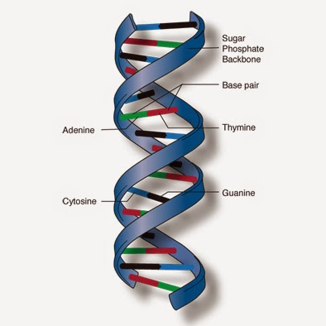

Slide 9
Nature of inheritance
The hereditary material carried in the nucleus of each of the somatic cells determines an individual’s characteristics. This material, called DNA (deoxyribonucleic acid), forms threadlike strands known as chromosomes.
Each chromosome is composed of many smaller segments of DNA referred to as genes.
Genes or combinations of genes contain coded information that determines an individual’s unique characteristics.
The code is found in the specific linear order of the molecules that combine to form the strands of DNA. Genes control both the types of proteins that are made and the rate at which they are produced. Genes never act in isolation; they always interact with other genes and the environment.

Slide 10
Terms used in genetics
Homozygous : An individual having two copies of the same allele for a given trait
Heterozygous :With two different alleles, the person is for the trait.
Allele: one of several alternative form of a gene at a given gene locus.
Locus: The position of a gene on a chromosome.
Pheno type: refers to the observable expression of an individual’s genotype, such as physical features, a biochemical or molecular trait, and even a psychological trait.
Genotype: is used to an individual’s entire genetic makeup or all the genes that the individual can pass on to future generations

Slide 11
Multifactorial Inheritance
Most common congenital malformations result from multifactorial inheritance, a combination of genetic and environmental factors. Examples are cleft lip, cleft palate, congenital heart disease, and neural tube defects. Each malformation can range from mild to severe, depending on the number of genes for the defect present or the amount of environmental influence

Slide 12
Uni factorial Inheritance
If a single gene controls a particular trait or disorder, its pattern of inheritance is referred to as unifactorial or single-gene inheritance. The number of single-gene disorders far exceeds the number of chromosomal abnormalities. Potential patterns of inheritance for single-gene disorders include autosomal dominant, autosomal recessive, and X-linked dominant and recessive modes of inheritance.

Slide 13
Patterns or Modes of Inheritance for Genetic Disorders
Patterns of inheritance demonstrate how a genetic disorder can be passed on to offspring. A genetic disorder is a disease caused by an abnormality in an individual’s genetic material. Diagnosis of a genetic disorder is usually based on clinical signs and symptoms or on laboratory confirmation of the presence of an altered gene associated with the disorder. Accurate diagnosis can be aided by recognition of the pattern of inheritance within a family.

Slide 14
Monogenic Disorders
The principles of genetic disease inheritance of single gene disorders are the same principles that govern the inheritance of other traits, such as eye and hair color. These are known as Mendel’s laws of inheritance, named for the genetic work of Gregor Mendel, an Austrian naturalist. These patterns occur due to a single gene being defective and are referred to as monogenic or sometimes Mendelian disorders.

Slide 15
If the defect occurs on the autosome, the genetic disorder is termed autosomal which can be classified as
autosomal dominant. 2. autosomal recessive
If the defect is on the X chromosome, the genetic disorder is termed X linked which can be classified as
1. X-linked dominant. 2.X-linked recessive

Slide 16
Auto somal dominant inherited disorders :
occur when a single gene in the heterozygous state is capable of producing the phenotype. In other words, the abnormal or mutant gene overshadows the normal gene and the individual will demonstrate signs and symptoms of the disorder. The affected person generally has an affected parent, and an affected person has a 50% chance of passing the abnormal gene to each of his or her children

Slide 17
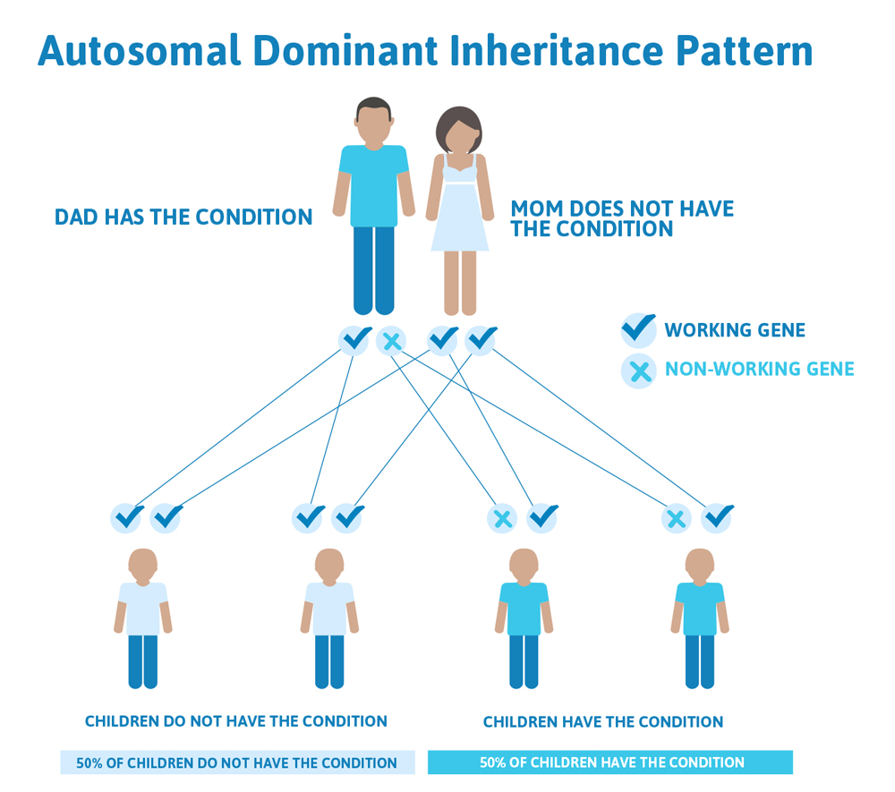

Slide 18
pattern of inheritance include
*Neurofibromatosis (genetic disorders affecting the development and growth of neural cells and tissues)
*Huntington’s disease (a genetic disorder affecting the nervous system characterized by abnormal involuntary movements and progressive dementia)
*Achondro plasia (a genetic disorder resulting in disordered growth and abnormal body proportion)
* polycystic kidney disease (a genetic disorder involving the growth of multiple, bilateral, grape-like clusters of fluid-filled cysts in the kidneys that eventually compress and replace functioning renal tissue).

Slide 19
Auto-somal recessive inherited disorders
occur when two copies of abnormal gene in the homozygous متماثلstate are necessary to produce the phenotypeالنمط الظاهري. In other words, two abnormal genes are needed for the individual to demonstrate signs and symptoms of the disorder. Both parents of the affected person must be heterozygous carriers of the gene (clinically normal but carry the gene), and their offspring have a 25% chance of being homozygous (a 50% chance of getting the mutant متحولةgene from each parent and therefore a 25% chance of inheriting two mutant genes). If the child is clinically normal, there is a 50% chance that he or she is a carrier .

Slide 20
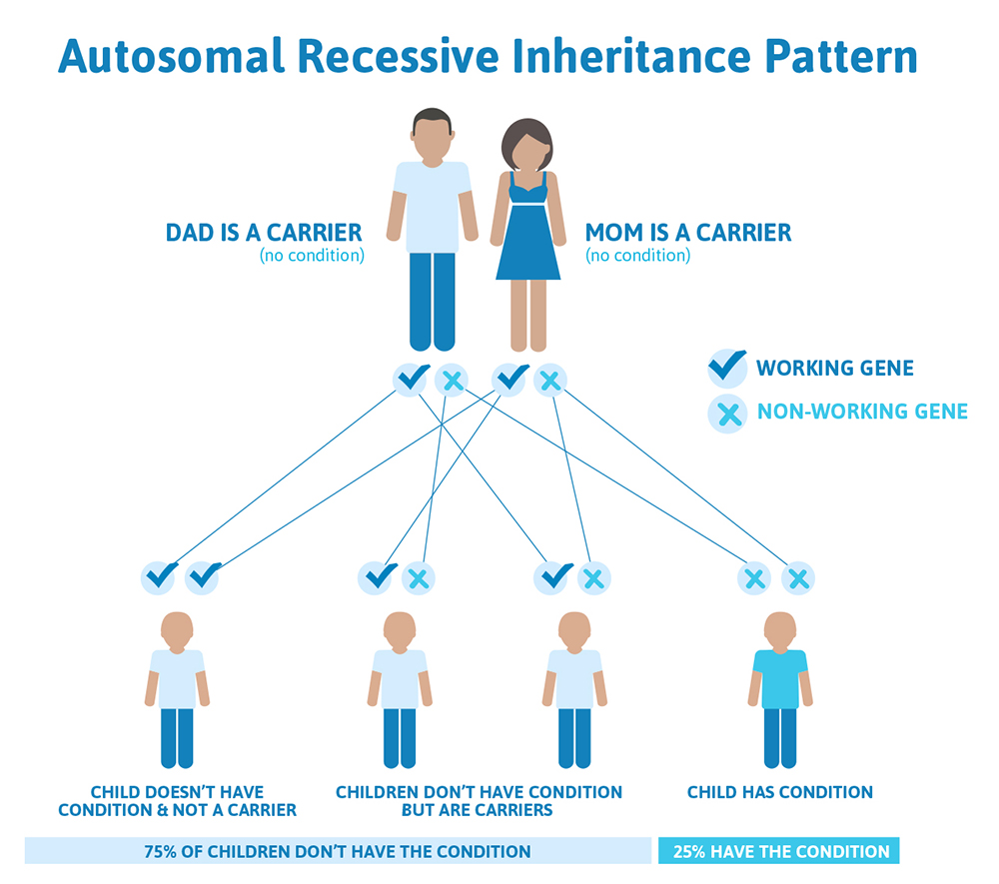

Slide 21
Common types of genetic disorders that follow the auto-somal recessive inheritance pattern include
Cystic fibrosis (a genetic disorder involving generalized dysfunction of the exocrine glands)
Phenyl ketonuria (a disorder involving a deficiency in a liver enzyme that leads to the inability to process the essential amino acid phenylalanine)
Tay-Sachs disease (a disorder due to insufficient activity of the enzyme Hexooraminidase, which is necessary for the breakdown of certain fatty substances in the brain and nerve cells)
Sickle cell disease (a genetic disorder in which the red blood cells carry an ineffective type of hemoglobin instead of the normal adult hemoglobin).

Slide 22
X-Linked Recessive Inheritance
X-linked, or sex-linked, disorders are those for which the abnormal gene is carried on the X chromosome. Thus an X-linked disorder is manifested in a male who carries the abnormal gene on his only X chromosome and is considered hemo-zygous for the condition, the mother of a male with an X-linked disorder will be a carrier. Most carrier females (known as heterozygous females) do not have symptoms of the condition.
Common X-linked recessive disorders are hemophilia, and some forms of color blindness.

Slide 23
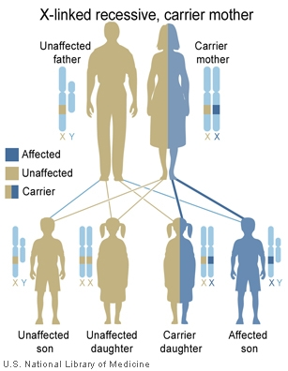

Slide 24
X-Linked Dominant Inheritance
X-linked dominant disorders are rare, the most common being vitamin D–resistant rickets. When X-linked dominance does occur, the pattern is similar to X-linked recessive inheritance except that heterozygous females can also be affected. In X-linked dominant inheritance. Affected fathers will have affected daughters but no affected sons. Some types of X-linked dominant disorders are so severe that they can be lethal in utero or in the newborn period.

Slide 25
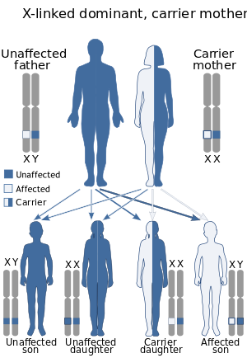

Slide 26
Chromosome abnormalities
can occur in either the autosomes or the sex chromosomes and can be divided into two categories

Slide 27
Abnormalities of number
The abnormality is most often caused by non disjunction, a failure of paired chromosomes to separate during cell division. If non disjunction occurs in either the sperm or the egg before fertilization, the resulting zygote (fertilized egg) will have an abnormal chromosome makeup in all of the cells. If non disjunction occurs after fertilization, the developing zygote will have cells with two or more different chromosome make ups, evolving into two or more different cell lines

Slide 28
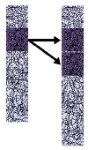
b. Abnormalities of structure:
Types of structural abnormalities include
duplication: there is an extra chromosomal segment within the same homologous or another non-homologous chromosome

Slide 29

Deletions :حذفresult in the loss of chromosomal material and partial monosomyاحادي for the chromosome involved.

Slide 30
Micro deletions: are deletions too small to be detected by standard cytogenetic خلوي techniques. Whenever a portion of a chromosome is deleted from one chromosome and added to another, the gamete produced may have either extra copies of genes or too few copies

Slide 31
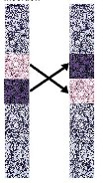
4. Inversions :عكس
Are deviations in which a portion of the chromosome has been rearranged in reverse order

Slide 32
Chromosome abnormalities
Altered Chromosome تغيير : 21
Genetic defect: trisomy 21 (Down syndrome)
Incidence: average 1 in 700 live births

Slide 33
Chromosome abnormalities
Altered Chromosome: 18
Genetic defect: trisomy 18
Incidence: 1 in 3000 live births

Slide 34
Chromosome abnormalities
Altered Chromosome: 13
Genetic defect: trisomy 13
Incidence: 1 in 5000 live births
Characteristics
CNS: intellectual disability; severe hypotonia نقص التوتر; seizures; anatomic defects of the brain
Head : microcephaly; malformed ears; aplasia of external auditory canal; abnormally small lower jaw; cleft lip and palate
Hands: abnormal posturing of fingers.

Slide 35
Chromosome abnormalities
Altered Chromosome: 5p
Genetic defect: deletion of short arm of chromosome 5 (cri du chat, or cat cry, syndrome)
Incidence: 1 in 20,000 live births

Slide 36
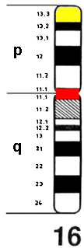
Short arm
centromere
Longer arm

Slide 37
Chromosome abnormalities
Altered Chromosome: X (sex chromosome)
Genetic defect: only one X chromosome in female (Turner syndrome)
Incidence: 1 in 5000 live female births

Slide 38
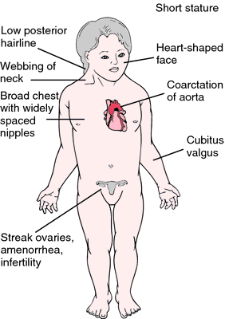

Slide 39
Chromosome abnormalities
Altered Chromosome: XXY (sex chromosome)
Genetic defect extra X chromosome in male (Klinefelter syndrome)
Incidence: 1 in 1000 live male births
Characteristics
CNS: mild intellectual disability
Trunk: occasional gynecomastia (abnormally large male breasts);
abnormal body proportions (long legs, short trunk, shoulder equal to hip size)
Other: small firm testes; underdeveloped secondary sex characteristics; reducedFertility

Slide 40
Prenatal Diagnostic Tests

Slide 41
Prenatal Diagnostic Tests

Slide 42
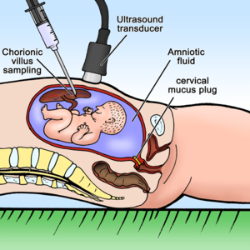

Slide 43
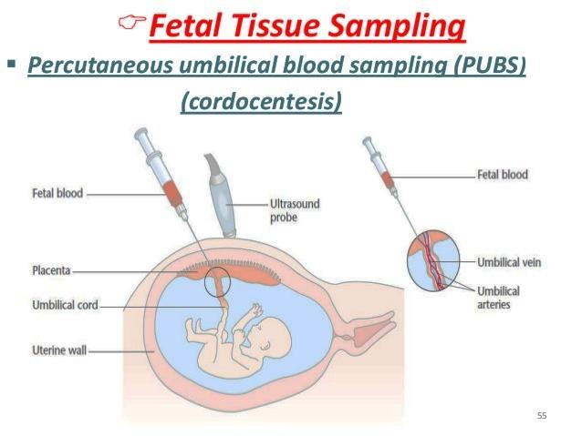
Prenatal Diagnostic Tests
Percutaneous umbilical blood sampling (PUBS) also know (Cordocentesis) | Insertion of a needle directly into a fetal umbilical vessel under ultrasound guidance; two potential complications: fetal hemorrhage and risk of infection | Used for prenatal diagnosis of inherited blood disorders such as hemophiliaA detectionof fetal infection assessment and treatment of isoimmunization | performed after 16 weeks’ gestation

Slide 44
Prenatal Diagnostic Tests

Slide 45
Prenatal Diagnostic Tests

Slide 46
Genetic Counseling
Genetic counseling is a professional service can serve the following purposes:
Provide concrete, accurate information about inherited disorder.
Reassure people who are concerned that their child may inherit a particular disorder will not occur.

Slide 47
Allow people who are affected by inherited disorders to make inform choices about future reproduction.
Educate people about inherited disorders and the process of inherence.
Offer support to people who are affected by genetic disorders.

Slide 48
Multiple Roles for Nurses in Genetics
Nurses play many roles in genetics:
Nurses play important roles in assessing for signs and symptoms of genetics disorders, in offering support to individuals who seek genetics counseling, and in helping with reproductive genetic testing procedures.
Alerting a couple to what procedures they can expect to undergo.
Explain how different genetic screening tests are done and when they are usually offered
Supporting a couple during thee wait test results
Assessing couple in values clarification, planning, and decision making based on test results.

Slide 49
Thank you for listening

