Slide 1
Effect of nutrition on the Product of conception
Prof. Dr. Rabia M. Ali

Slide 2
Introduction:
A –woman's nutritional status before and during pregnancy can significantly influence her own health and that of her unborn child. Many factors influence a woman’s ability to achieve good

Slide 4
Pre pregnancy Weight
Pre pregnancy weight is an important factor for both mothers and their babies
Women who are underweight before pregnancy, especially younger adolescents, have a higher risk of giving birth to a low-birth-weight infant than women who begin pregnancy at normal weight for height.

Slide 5
Obesity during pregnancy is associated with many complications, including:
1.gestational diabetes
2. gestational hypertension, preeclampsia.
3. birth defects
4.cesarean birth.
5.fetal Macrosomia
6.Perinatal deaths
7. postpartum anemia

Slide 6
Weight gain during pregnancy
The recommended weight gain during pregnancy:
10–16 kg for those with a normal BMI
13–18 kg for those who are underweight
7–11 for those who are overweight
5–9 kg for those who are obese.
Both excessive and insufficient weight gain during pregnancy have negative impacts. With every additional kilogram that a mother gains over that recommended, the risk of the child for being obese during adulthood increases by 8%.

Slide 7
Effects of Poor Nutrition During Pregnancy
In adequate nutrition during pregnancy can lead to a difficult pregnancy, labor difficulties, and a slower recovery.
Poor nutrition can lead to preterm labor.
Pregnant women who are overweight or obese have a greater risk for developing gestational diabetes, hypertension, preeclampsia or needing a Cesarean section, low birth weight, miscarriage

Slide 8
critical nutrient needed during pregnancy
folic acid
Protein
vitamin B 12 B6
Zinc
Iron
Calcium and vitamin D
Minerals (Magnesium, Sodium)
Omega 3 fatty acid
Calorie
Carbohydrate
Fiber
Vitamin C
Vitamin A
Minerals
Iodine
Water
Caffeine

Slide 9
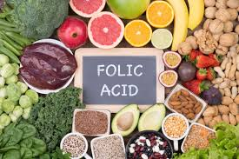
folic acid
Vitamin B (water soluble) important for growth of the placenta and the development of the fetal spinal cord during the first month of pregnancy. to prevent serious birth defect
Pregnant women should take a folic acid supplement of 400μg per day during the first 12 weeks of pregnancy , Inadequate in take cause neutral tube defect, cleft lip and palate and congenital heart disease, premature birth and low birth weight.
diet rich in folic acid: eggs, leafy green, beets, broccoli , banana, avocado etc…

Slide 10
Protein :
1. Requirement during pregnancy 30 g/ day .
2. During pregnancy additional protein is required for
Growth of fetus
Development of placenta
Enlargement of maternal tissues
Increased maternal blood volume
Formation of amniotic fluid
Protein reserves prepares the mother for labor, delivery and lactation
Additional 15g of protein is required 2nd & 3rd trimester of pregnancy
Diet : meats , beef, chicken, duck, birds, fish and seafood , eggs, dairy products – milk, cheese.

Slide 11
Vitamin B12
Vitamin B12 supplementation during pregnancy helps in brain & nervous system development of the fetus. Need : 2.6 mcg per day
Deficiency of vit B12 cause: miscarriage , stillbirth.

Slide 12
Vitamin B6 (pyridoxine)
Vitamin B6 helps to reduce nausea and vomiting. The main dietary sources are meat (beef, pork and chicken), fish (tuna, salmon), legumes, oats, bananas, plums, avocado and potatoes. No supplementation is required during pregnancy.

Slide 13
Zinc.
Zinc is necessary for the synthesis of DNA and RNA, and important in reproduction.
zinc deficiency may cause poor pregnancy outcomes and abnormal deliveries including preterm birth, congenital malformation
The needs for zinc during pregnancy is 12 mg, or an increase of 3 mg over pre pregnancy needs.

Slide 14
Iron
Pregnancy causes a surge in the volume of blood in the body; the expanded volume may go up by 50%
Iron is also required for the normal development of the growing baby and the Placenta.
Iron requirements in pregnancy go up from 18 to 27 mg per day.
Because iron is not easily absorbed from the diet, it is recommended to take an iron supplement
Not getting enough iron could cause anemia
Essential for normal infant brain development
Iron helps create blood that is necessary for fetal demands and blood loss during delivery.

Slide 15
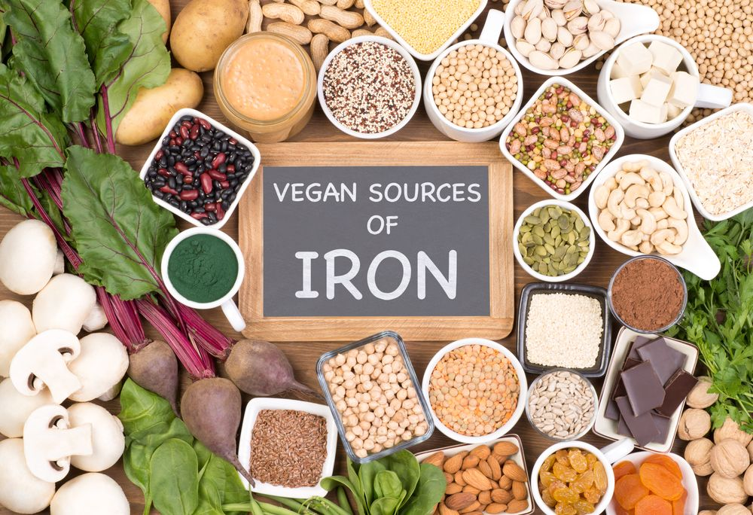
Anemia before conception and during the early stages of pregnancy is associated with impaired fetal development, premature birth and low birth weight. An important means of reducing anemia in newborns is to delay cord clamping.

Slide 16
1- Calcium
During pregnancy additional calcium is needed for:
Growth and development of bones as well as teeth of the fetus.
Calcium intake decreases risk of hypertension, pre-eclampsia in mothers and low birth weights and chronic hypertension in newborns.
Maintaining bone strength
Proper muscle contraction
Blood clotting

Slide 17
If calcium intake is inadequate during pregnancy then calcium is mobilized from maternal bones to meet the fetal calcium needs and this demineralization of maternal bones leading to easy fractures.
Recommended daily allowance ( RDA) for calcium during pregnancy is 1g.

Slide 18
Importance of calcium during pregnancy
Calcium is necessary to protect the bone health of the mother and to provide the developing fetus with the calcium needed for the healthy development of their skeleton.
Although the requirement for calcium does not increase during pregnancy. Pregnant adult women require 1,000mg calcium every day. Pregnant teenage girls require 1,300mg

Slide 19
Vitamin D
vitamin D is required for the development of the fetal skeletomuscular system, brain and immune system.
Vitamin D deficiency may have a negative effect on the development of the child’s bone tissue and cause long-term skeletal disorders, such as osteoporosis, Vitamin D deficiency also increases the risks for fetal growth impairment, low birth weight, neonatal tetanus, hypokalemia, cardiovascular disease and diabetes mellitus type I and incurs a lifelong risk for cancer. For the mother, vitamin D deficiency is associated with risks for pre-eclampsia, premature delivery, insulin resistance, gestational diabetes, dysfunction of the immune system and bacterial vaginosis.
Recommended 10 micrograms of Vitamin D per day

Slide 21
Magnesium
During gestation, the fetus accumulates 1 g/day of magnesium, and pregnant women should have sufficient quantities of magnesium to prevent leg cramps and preeclampsia. Nuts, wholegrain products and dark-green leafy vegetables are sources of magnesium.
For pregnant women, the German Nutrition Society recommends a daily magnesium intake of 310 mg

Slide 22
Sodium
During pregnancy, the maternal blood volume increases, resulting in a higher glomerular filtration rate, in which the water and electrolyte balance is maintained by compensatory mechanisms.
Strict reduction of sodium in the diet during pregnancy is not recommended, nor is use of diuretic agents. It is advisable to cut down on salt in the diet and to use iodized salt.
The recommended quantity is 1.5–2.3 g of sodium per day, equivalent to 4–5 g of cooking salt. This quantity of salt and an adequate volume of liquids ensure a sufficient blood volume for preventing dehydration and premature contractions.

Slide 24
Omega fatty acids during pregnancy
Omega-3 Fatty Acids
Important for brain development and preventing preterm birth
Essential for visual development
Reduces the incidence of heart disease and heart related death of the infant
Recommended 300 milligrams per day

Slide 25
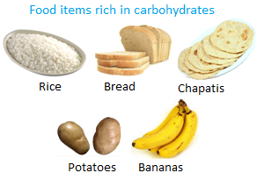
Carbohydrates
Carbohydrates are a source of energy for both the mother and the fetus. During pregnancy additional energy is required to support
The growth of fetus, Development of placenta & maternal tissues, meet the needs for increased basal metabolic rate
The amounts required are the same as those recommended for the general population (50–60% of energy). Appropriate amounts of suitable carbohydrates help to control blood glucose levels and provide protection against ketosis. 340 additional calories recommended per day during the second trimester
450 additional calories recommended per day during the third trimester

Slide 26
Fibre
The required intake of fibre 30–35 g. Fibre is required to prevent constipation and thus reduce the risk for haemorrhoidal vein disease; it also reduces the risks for gestational diabetes and preeclampsia. Furthermore, fibre-rich products contain minerals, vitamins and other biologically active substances.
The main sources of fibre are wholegrain products (e.g. wholegrain bread, pasta), legumes, dried and fresh fruit, vegetables, nuts and seeds.

Slide 27
A. calories:
1. Requirement during pregnancy needs by 300 calories / day.
2. extra calories are needed to
support maternal _ fetal tissue synthesis
provide optimal use of protein and tissue growth .

Slide 28
Vitamin C (ascorbic acid)
It increase iron absorption and also helps in fetal growth. Deficiency of vitamin C increases the chances of preterm delivery. Good sources of vitamin C are cabbage, tomatoes, paprika, broccoli, strawberries, pineapple, citrus fruit, blackcurrants and kiwi. Requirement (60mg/d):

Slide 29
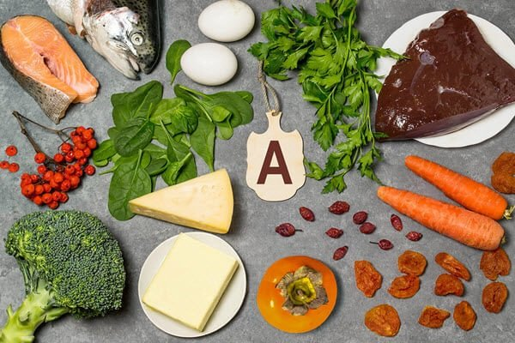
Vitamin A
Vitamin A is required for the development of the skin, mucous membranes (including those of the gastrointestinal and respiratory systems), skeletal system and teeth and for visual and immune functions. While vitamin A deficit is undesirable, excessive amounts (3000 µg or 10 000 IU of vitamin A) may be teratogenic. Women who take medicine or food supplements containing vitamin A or retinol, such as fish oil supplements, should discontinue them before 20 conception and throughout pregnancy. Vitamin A is found in foods of animal origin, e.g. fish, seafood, eggs, milk and dairy products, especially cheese. Liver contains particularly high quantities of vitamin A and is therefore not advised during pregnancy.

Slide 30
Iodine.
1. Iodine is essential for the formation of thyroxin.
2. If iodine deficiency occurs, it can cause hypothyroidism and thyroid enlargement (goiter) in a woman, it can cause the same symptoms in a fetus.
3. Thyroid enlargement in a fetus at birth is serious because the increased pressure of the enlarged gland on the airway could lead to early respiratory distress.
4. Deficiency of iodine during brain development can have permanent effect such as mental retardation.
5. The needs for iodine is 220 g daily during pregnancy.

Slide 31
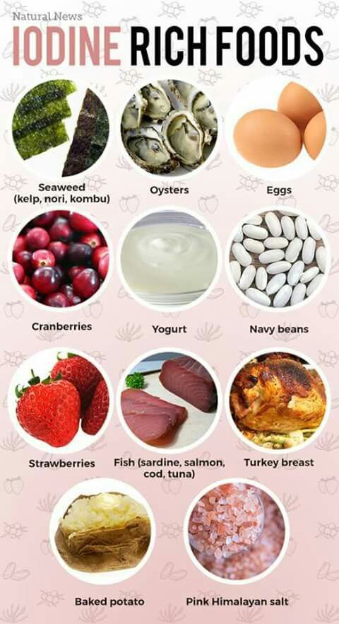

Slide 32
Water
The volume of liquid required per day is 2–2.5 L, mostly in the form of water. The volume should be increased gradually as the pregnancy progresses and the expectant mother gains weight. During the last months of pregnancy, the volume required increases by 300 mL/day. the recommended amount of water (from both food and drink) is 35 mL/kg body weight per day. An adequate volume of water not only ensures the vital functions but also reduces the risks for urinary infections, urinary calculi and constipation.

Slide 33
Caffeine
Large quantities of caffeine restrict fetal development, and it is recommended that pregnant women not exceed 200 mg/day. The amount of caffeine in foods and drinks varies; however, two cups of coffee or four small mugs of tea contain 200 mg caffeine. Caffeine-containing energy drinks should be avoided during pregnancy.

Slide 34
The 5 main food groups which provide the nutrients needed for a healthy pregnancy are:
Breads, cereals and potatoes – choose wholegrain and whole meal more often
Fruit and vegetables – choose at least 5 a day and vary the types chosen
Milk and milk products – choose low-fat milk and yoghurt more often than cheese
Meat, fish, chicken and alternatives – choose lean cuts of meat
Fats and oils – use sparingly

Slide 35
Foods to avoid or minimize when pregnant
Alcohol
Caffeine from coffee, tea, soft drinks, energy beverages, and other sources
Raw or undercooked food of animal origin

