Slide 1
Maternal and neonatal nursing nursing elective complications of third stage of labor
بأشراف: د. ربيعة علي

Slide 2
What the 3th stage of labor :
The third stage of labor is an unpredictable time. It ought to be a period of rest and rejoicing after the birth of the baby if all has gone well so far, but in thousands of women it can become very dangerous. This is because of the many complications that may occur during the third stage. The active management of the third stage is one approach which evolved in to prevent these complications in as many women as possible.

Slide 3
What happens during the third stage of labor?
The third stage of labor begins after the baby is born and ends when the placenta separates from the wall of the uterus and is passed through the vagina. This stage is often called delivery of the "afterbirth" and is the shortest stage of labor. It may last from a few minutes to 20 minutes. You will feel contractions but they won't be as painful. If you had an episiotomy or small tear, it will be stitched during this stage of labor.

Slide 7
1-postpartum hemorrhage (PPH)
primary postpartum bleeding is defined as blood loss in excess of 500 ml following vaginal delivery or 1000 ml following caesarean section in the first 24 hours following birth.[2]
Secondary postpartum bleeding is that which occurs after the first day and up to six weeks after childbirth.[7]

Slide 9
Signs and symptoms
Symptoms generally include heavy bleeding from the vagina that doesn't slow or stop over time. Initially there may be an increased heart rate, feeling faint upon standing, and an increased respiratory rate. As more blood is lost, the woman may feel cold, blood pressure may drop, and she may become unconscious.
Signs and symptoms of circulatory shock may also include blurry vision, cold and clammy skin, confusion, and feeling sleepy or weak.

Slide 10
Causes
uterine atony is the inability of the uterus to contract and may lead to continuous bleeding. Retained placental tissue and infection may contribute to uterine atony. Uterine atony is the most common cause of postpartum hemorrhage.
Trauma: Injury to the birth canal which includes the uterus, cervix, vagina and the perineum which can happen even if the delivery is monitored properly. The bleeding is substantial as all these organs become more vascular during pregnancy.

Slide 11
Tissue: retention of tissue from the placenta or fetus as well as placental abnormalities such as placenta accrete and peraccreta may lead to bleeding.
Thrombin: a bleeding disorder occurs when there is a failure of clotting, such as with diseases known as coagulopathies

Slide 13
Risk factors
Excessive and rapid loss of blood can cause a severe drop in the mother’s blood pressure and can cause shock and death if left untreated.

Slide 14
Diagnosis
Tests used to diagnose postpartum hemorrhage may include:
Estimation of blood loss
Measurement of pulse and blood pressure.
Hematocrit (red blood cell count)
Blood clotting factors.

Slide 15
2-Retained placenta
The retention of part or the whole of the placenta, including the membranes, for over 30 minutes after the delivery of the baby, is called retained placenta.
causes:
Premature closure of the cervix so that the separated placenta is trapped inside the uterine cavity
A full urinary bladder which prevents the placenta from passing through the birth canal by its pressure
Retention of a part of the membranes or placenta after placental expulsion

Slide 16
Symptoms
Foul smelling vaginal discharge
High fever
Painful cramping and contracting
Delay in milk production
Postpartum hemorrhage.

Slide 17
Manual placenta removal
is a procedure to remove a retained placenta from the uterus after childbirth.^{[1]}
It is usually carried out under anesthesia or more rarely, under sedation and analgesia.
A hand is inserted through the vagina into the uterine cavity and the placenta is detached from the uterine wall and then removed manually. If the placenta does not separate easily from the uterine surface, there may be a placenta accrete.

Slide 18
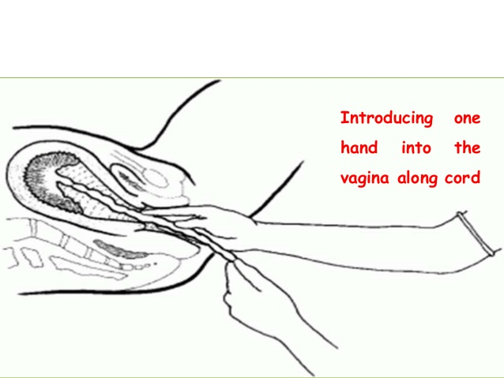

Slide 19
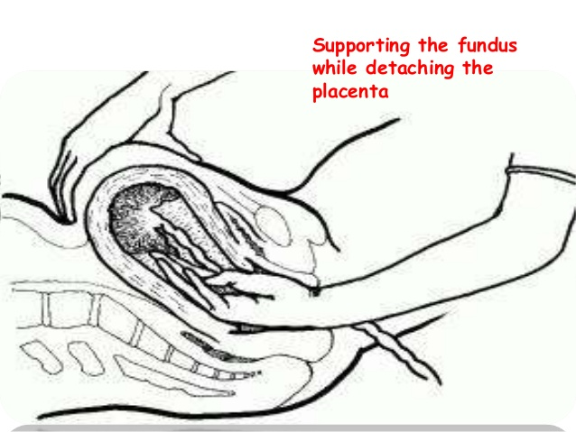

Slide 20
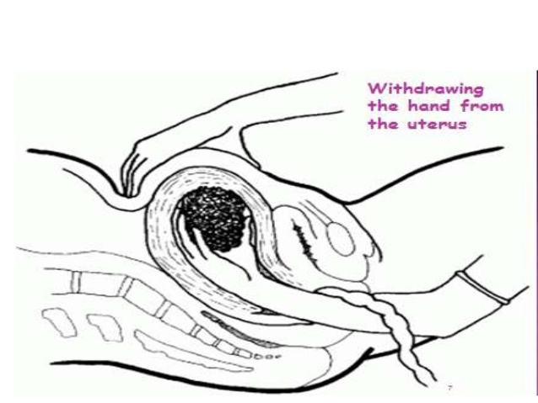

Slide 21
3-Shock
is the state of insufficient blood flow to the tissues of the body as a result of problems with the circulatory system.
Initial symptoms of shock may include weakness, fast heart rate, fast breathing, sweating, anxiety, and increased thirst.
This may be followed by confusion, unconsciousness, or cardiac arrest, as complications worsen.

Slide 22
Signs and symptoms
some people having only minimal symptoms such as confusion and weakness. While the general signs for all types of shock are low blood pressure, decreased urine output, and confusion, these may not always be present. While a fast heart rate is common, those on β-blockers, those who are athletic, and in 30% of cases of those with shock due to intra abdominal bleeding may have a normal or slow heart rate. Specific subtypes of shock may have additional symptoms.
Dry mucous membrane, reduced skin turgor, prolonged capillary refill time, weak peripheral pulses and cold extremities can be early signs of shock

Slide 23
Cause
Shock is a common end point of many medical conditions. Shock itself is a life-threatening condition as a result of compromised body circulation.
It can be divided into four main types based on the underlying cause: hypovolemic, distributive, cardiogenic, and obstructive.

Slide 24
4-Pulmonary embolism
air embolism, also known as a gas embolism, is a blood vessel blockage caused by one or more bubbles of air or other gas in the circulatory system.
Air embolisms may also occur in the xylem of vascular plants, especially when suffering from water stress. Air can be introduced into the circulation during surgical procedures, lung over-expansion injury, decompression

Slide 26
causes
It is mostly agreed that this condition results from amniotic fluid entering the uterine veins and in order for this to occur there are three prerequisites:
Ruptured membranes (a term used to define the rupture of the amniotic sac)
Ruptured uterine or cervical veins
A pressure gradient from uterus to vein
Although exposure to fetal tissue is common and thus finding fetal tissue within the maternal circulation is not significant, in a small percentage of women this exposure leads to a complex chain of events resulting in collapse and death.
Drugs causing amniotic fluid embolism
Dinoprostone

Slide 27
5-Uterine inversion
is when the uterus turns inside out, usually
following childbirth.^{[1]}
Symptoms
include postpartum bleeding, abdominal pain, a mass in the vagina, and low blood pressure.^{[1]} Rarely inversion may occur not in association with pregnancy

Slide 28
Risk factors
include pulling on the umbilical cord or pushing on the top of the uterus before the placenta has detached.^{[1]}
Other risk factors include uterine atony, placenta previa, and connective tissue disorders.^{[1]}

Slide 30
Management of 3th stage of labor :
Active management:
Oxytocin (10 units IV or IM) is preferred over other uterotonic drugs because it is effective 2-3 minutesafter injection, has minimal side effects and can be used in all women.
Syntometrine® is more effective than oxytocin (Syntocinon®) in reducing blood loss during the delivery of the placenta.

Slide 31
Physiological management.
Physiological Management The physiological third stage involves supporting the woman’s physiology during the third stage. This is delivery of the placenta without intervention. No oxytocic drug, no cord clamping, unless it has stopped pulsating, no controlled cord traction, no palpation of the uterus. Facilitated by: Lucy Griffiths, Midwife Last reviewed:
gravity and the baby suckling at the breast. Signs of separation and descent are seen (Baddock & Dixon, 2006).Providing that fresh blood loss is not excessive, the mother’s condition remains stable and her pulse rate normal, there need be no anxiety. This spontaneous process can take from 20 minutes to an hour. Eighty nine percent of women having physiological management of the third stage birthed their placenta within 40 minutes of birth (Dixon et al, 2006).

Slide 32
References
Bhalla, Rita; Wuntakal, Rekha; Odejinmi, Funlayo; Khan, Rehan U (January 2009). "Acute inversion of the uterus". The Obstetrician & Gynaecologist. 11 (1): 13–18. doi:10.1576/toag.11.1.13.27463.
https://www.ncbi.nlm.nih.gov/pubmed/27054942
https://www.slideshare.net/hanisahwarrior/complications-of-3rd-stage-of-labo r
Baddock, S. & Dixon, L. (2006). Physiological changes during labor and the postnatal period. Midwifery preparation for practice. (pp. 383-384). Elsevier, Australia.
Dixon, L., Fletcher, L., Tracy, S., Gilliland, K., Pair man, S. & Hendry, C. (2006). Midwives care during the Third Stage of Labor: An analysis of the New Zealand College of Midwives Midwifery Database 2004 – 2008. New Zealand College of Midwives. 41, October, 20 – 25.
Weeks, A (January 2015). "The prevention and treatment of postpartum hemorrhage: what do we know, and where do we go to next?". BJOG : An International Journal of Obstetrics and Gynecology. 122 (2): 202–10.
Lockhart, E (2015). "Postpartum hemorrhage: a continuing challenge". Hematology. American Society of Hematology. Education Program. 2015 (1): 132–7. doi:10.1182/asheducation-2015.1.132. PMID 26637712.
^ Pacagnella RC, Souza JP, Durocher J, Perel P, Blum J, Winikoff B, Gülmezoglu AM (2013). "A systematic review of the relationship between blood loss and clinical signs". PLOS ONE. 8 (3): e57594. Bibcode:2013PLoSO...857594P.

