Slide 1
Abnormalities of the fetal and newborn babies
Prof. Dr. Rabea M. Ali

Slide 2
Definitions:
A congenital disorder
is a medical condition that is present at or before birth. can be acquired during the fetal stage of development or from the genetic make up of the parents.
Birth defects are structural changes present at birth that can affect almost any part or parts of the body (e.g., heart, brain, foot). They may affect how the body looks, works, or both

Slide 3
Risk factors for birth defects
family history of birth defects or other genetic disorders.
drug use, alcohol, or smoking during pregnancy
maternal age of 35 years or older
inadequate prenatal care
untreated viral or bacterial infections, including sexually transmitted infections
use of certain high-risk medications
Women with pre-existing medical conditions, such as diabetes, are also at a higher risk of having a child with a birth defect.

Slide 4
Common Birth Defects
Neural tube defects (NTD)
Spina bifida
Anencephaly
Encephalocele
Cleft lip and cleft palate
IUGR
SGA
Macrosomia
Clubfoot
Tetralogy of Fallot
Down syndrome

Slide 5
Neural tube defects
Neural tube defects (NTDs) are birth defects of brain and spinal cord. The neural tube typical closes between the third and fourth weeks after conception, NTD’s result from failure of tube closure by the 6th week's gestational age (embryonic age 26 – 28 days)
Various NTD’s anomalies :
Anencephaly
Encephalocele
Spina Bifida

Slide 6
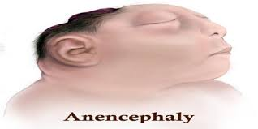
Anencephaly is a serious birth defect in which a baby is born without parts of the brain and skull. It is a type of neural tube defect (NTD).
A baby born with anencephaly is usually blind, deaf, unaware of its surroundings and unable to feel pain.

Slide 7
Causes
Lack of folic acid
Diabetes
High body temperature
Medications: Anti-seizure drugs
Obesity

Slide 8
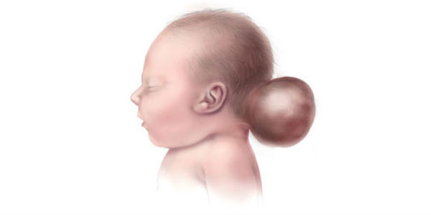
Encephalocele
Encephalocele is a neural tube defect characterized by sac-like protrusions of the brain and the membranes that cover it through openings in the skull. These defects are caused by failure of the neural tube to close completely during fetal development.

Slide 9
Symptoms
delays in reaching developmental milestones intellectual disability
learning disabilities
growth delays
seizures
vision impairment
uncoordinated voluntary movements (ataxia)

Slide 10
Causes
family history of neural tube defects such as spina bifida or anencephaly.
a genetic predisposition to developing a neural tube defect and may develop an encephalocele.
A person who is genetically predisposed to certain disorders may carry a gene (or genes)that activated” under certain circumstances, such as the exposure to particular environmental factors.

Slide 11
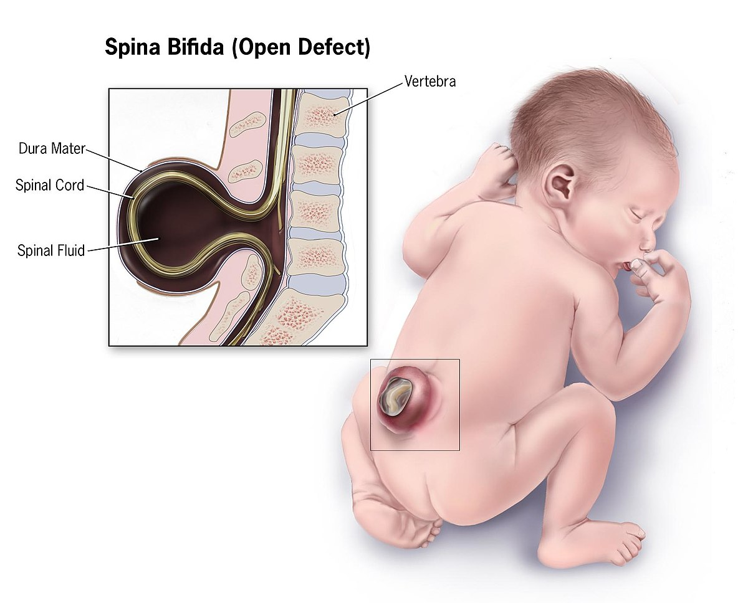
Spina bifida is a birth defect that occurs when the spine and spinal cord don't form properly. It's a type of neural tube defect. The neural tube is the structure in a developing embryo that eventually becomes the baby's brain, spinal cord and the tissues that enclose them.

Slide 12
Symptoms
Leg weakness and paralysis
Orthopedic abnormalities (i.e., club foot, hip dislocation, scoliosis)
Bladder and bowel control problems, including incontinence, urinary tract infections, and poor kidney function
Pressure sores and skin irritations
Abnormal eye movement

Slide 13
Diagnosis
Spina bifida can be diagnosed during pregnancy or after the baby is born.
Types
Spina Bifida Occulta: is the mildest type of spina bifida. It is sometimes called “hidden” spina bifida. With it, there is a small gap in the spine, but no opening or sac on the back
Meningocele :a sac of fluid comes through an opening in the baby’s back. But, the spinal cord is not in this sac.
Myelomeningocele: is the most serious type of spina bifida. With this condition, a sac of fluid comes through an opening in the baby’s back. Part of the spinal cord and nerves are in this sac and are damaged.

Slide 14
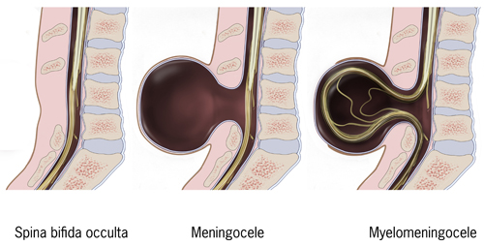

Slide 15
Cleft lip and cleft palate
Cleft lip and cleft palate are openings or splits in the upper lip, the roof of the mouth (palate) or both. Cleft lip and cleft palate result when facial structures that are developing in an unborn baby don't close completely.
Symptoms
Difficulty with feedings
Difficulty swallowing, with potential for liquids or foods to come out the nose
Nasal speaking voice
Chronic ear infections

Slide 16
Risk factors
Family history. Parents with a family history of cleft lip or cleft palate face a higher risk of having a baby with a cleft.
Exposure to certain substances during pregnancy. smoke cigarettes, drink alcohol or take certain medications.
Having diabetes.
Being obese during pregnancy.

Slide 17
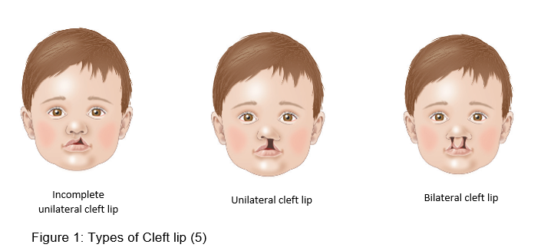
Types
Incomplete unilateral cleft lip. ...
Complete unilateral cleft lip. ...
Incomplete bilateral cleft lip. ...
Complete bilateral cleft lip

Slide 18
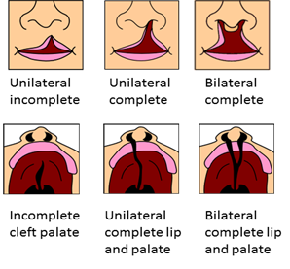
Types of Cleft Palate
Incomplete cleft palate.
Unilateral Complete cleft palate.
Bilateral complete

Slide 19
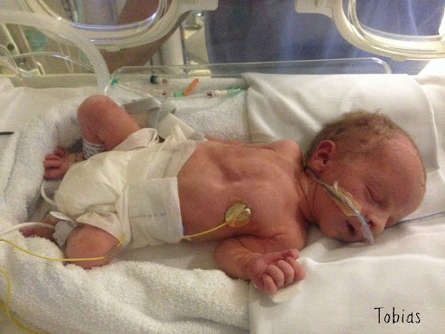
IUGR
Intrauterine growth restriction (IUGR) refers to poor growth of a fetus while in the mother's womb during pregnancy. Because of poor maternal nutrition or lack of adequate oxygen supply to the fetus

Slide 20
symptoms of IUGR are:
Baby is small all over or malnourished.
Thin, pale, loose and dry skin.
Umbilical cord is thin and often stained with meconium.

Slide 21
Causes
Maternal
pre-pregnancy weight and nutritional status
poor weight gain during pregnancy
poor nutrition
anemia
maternal smoking
gestational diabetes
cardiovascular disease
hypertension
celiac disease
Fetal
chromosomal abnormalities
Vertically transmitted infections
Erythroblastosis fetalis
Congenital abnormalities

Slide 22
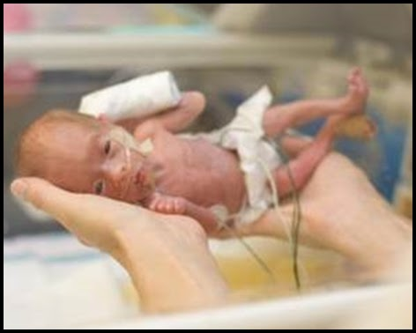
Small for Gestational Age (SGA
is a term used to describe a baby who is smaller than the usual amount for the number of weeks of pregnancy. SGA babies usually have birth weights below the 10th percentile for babies of the same gestational age

Slide 23
Signs and Symptoms
decreased muscle mass and subcutaneous fat tissue.
Facial features may appear sunken, resembling those of an elderly person ("wizened facies").
The umbilical cord can appear thin and small.

Slide 24
Medical disorders in the mother that increase the risk of having an SGA baby include
High blood pressure (hypertension)
Long-standing diabetes
Chronic kidney disease
Heart disease or lung disease
Lupus
Severe anemia
Sickle cell disease

Slide 25
Complications
Perinatal asphyxia
Meconium aspiration
Hypoglycemia
Polycythemia
Hypothermia

Slide 26
Macrosomia
Macrosomia is a term that describes a baby who is born much larger than average for their gestational age, which is the number of weeks in the uterus.
symptoms
Macrosomia weigh over 8 pounds, 13 ounces.
Large fundal height. During prenatal visits

Slide 27
Causes of this condition include:
diabetes in the mother
obesity in the mother
genetics
a medical condition in the baby

Slide 28
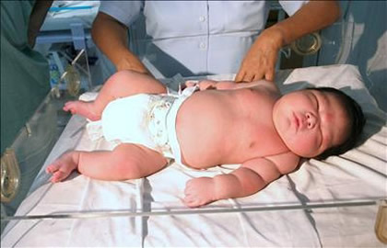

Slide 29
How is it diagnosed?
Measuring the height of the fundus. A larger than normal fundal height could be a sign of Macrosomia.
Ultrasound.
Check the amniotic fluid level. Too much amniotic fluid is a sign that the baby is producing excess urine. Larger babies produce more urine.
Biophysical profile.

Slide 30
Complications
Injury to the vagina.
Bleeding after delivery. A large baby can prevent the muscles of the uterus from contracting like they should after delivery.
Uterine rupture.

Slide 31
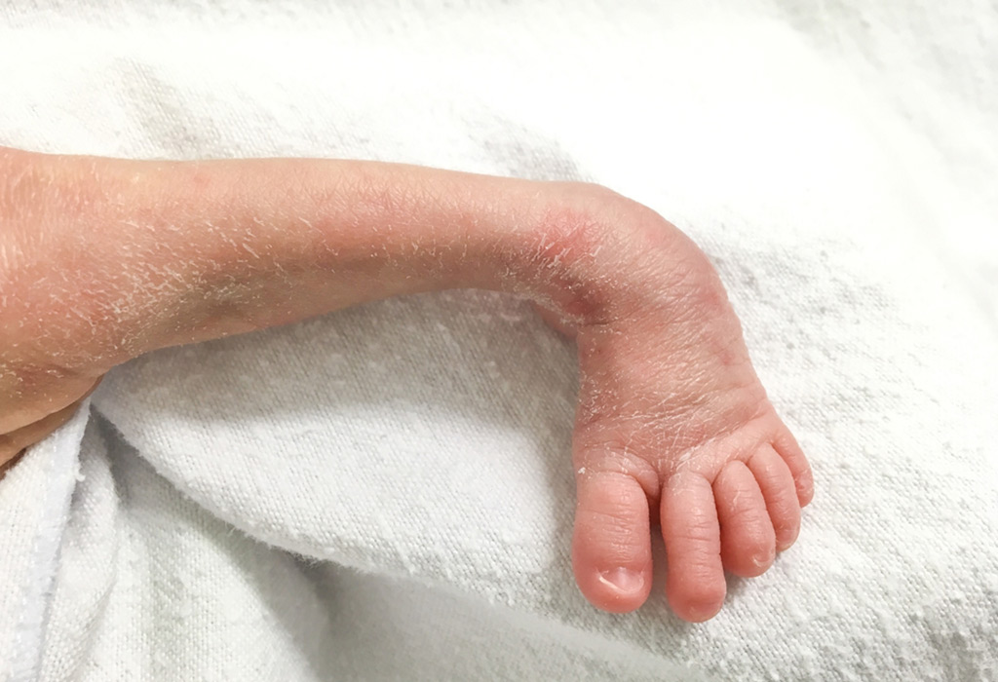
Club Foot
Clubfoot describes a range of foot abnormalities usually present at birth (congenital) in which the baby's foot is twisted out of shape or position.

Slide 32
Symptoms
The top of the foot is usually twisted downward and inward, increasing the arch and turning the heel inward.
The foot may be turned so severely that it actually looks as if it's upside down.
The affected leg or foot may be slightly shorter.
The calf muscles in the affected leg are usually underdeveloped.

Slide 33
Risk factors
Family history.
Congenital conditions. In some cases, clubfoot can be associated with other abnormalities of the skeleton that are present at birth (congenital), such as spina bifida, a birth defect that occurs when the spine and spinal cord don't develop or close properly.
Environment. Smoking during pregnancy can significantly increase the baby's risk of clubfoot.
Not enough amniotic fluid during pregnancy. may increase the risk of clubfoot.

Slide 34
Complications
Movement. The affected foot may be slightly less flexible.
Leg length. The affected leg may be slightly shorter, but generally does not cause significant problems with mobility.
Shoe size. The affected foot may be up to 1 1/2 shoe sizes smaller than the unaffected foot.
Calf size. The muscles of the calf on the affected side may always be smaller than those on the other side.

Slide 35
Tetralogy of Fallot
Tetralogy of Fallot (TOF) is a cardiac anomaly that refers to a combination of four related heart defects that commonly occur together. The four defects are:
Ventricular septal defect (VSD) − a hole between the right and left pumping chambers of the heart
Overriding aorta − the aortic valve is enlarged and appears to arise from both the left and right ventricles instead of the left ventricle as in normal hearts

Slide 36
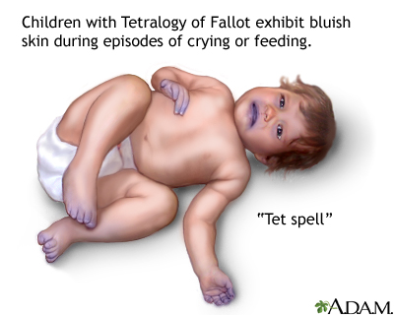
3. Pulmonary stenosis − narrowing of the pulmonary valve and outflow tract or area below the valve that creates an obstruction (blockage) of blood flow from the right ventricle to the pulmonary artery
4. Right ventricular hypertrophy − thickening of the muscular walls of the right ventricle, which occurs because the right ventricle is pumping at high pressure

Slide 37
Signs and Symptoms of Tetralogy of Fallot
heart murmur
tiring easily
difficulty breathing
rapid heartbeat (palpitations)
fainting
"clubbing," where the skin or bones around the tips of fingers are widened or rounded

Slide 38
Diagnosis:
pulse oximeter: a small sensor that clips onto the fingertip, toe, or ear and measures how much oxygen is in the blood.
electrocardiogram (EKG):
echocardiogram (echo):
chest X-ray
cardiac catheterization: a thin, flexible tube called a catheter is inserted into the heart, usually through a vein in the leg or arm, and provides information about the heart as well as blood pressure and blood oxygen levels.

Slide 39
Treatment
Complete repair: The surgeon widens the passageway between the right ventricle and the pulmonary artery to improve blood flow to the lungs. ventricles.
Temporary or palliative surgery: Minor repairs can improve blood flow to the lungs. This usually is done only when a baby is too weak or small to have full surgery.

Slide 40
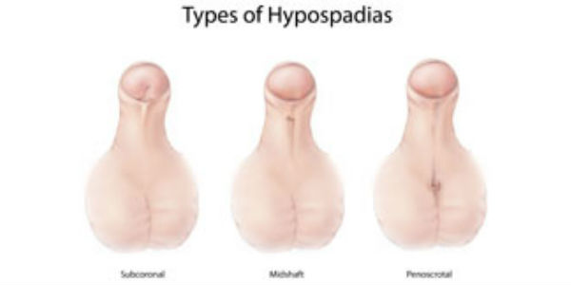
Hypospadias
Is a common congenital disease of the penis with an abnormal ventral opening of the meatus of the urethra.

Slide 41
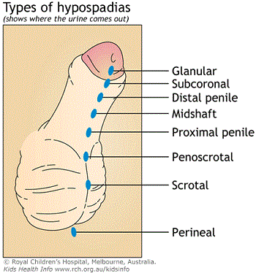
Types of Hypospadias
Sub coronal: The opening of the urethra is located somewhere near the head of the penis.
Midshaft: The opening of the urethra is located along the shaft of the penis.
Penoscrotal: The opening of the urethra is located where the penis and scrotum meet.

Slide 42
Causes
Family history: about 7% of patients with hypospadias have children with hypospadias
Further risk factors:
increased maternal age,
low birth weight,
in-vitro fertilization

Slide 43
Signs and symptoms of hypospadias may include:
Opening of the urethra at a location other than the tip of the penis
Downward curve of the penis
Hooded appearance of the penis because only the top half of the penis is covered by foreskin
Abnormal spraying during urination

Slide 44
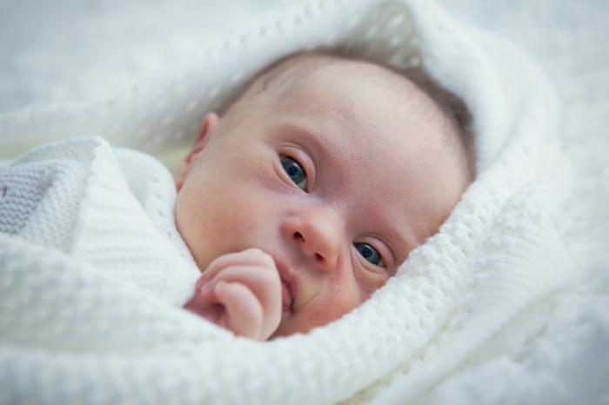
Down syndrome (sometimes called Down's syndrome) is a condition in which a child is born with an extra copy of their 21st chromosome — hence its other name, trisomy 21. This causes physical and mental developmental delays and disabilities.

Slide 45
Symptoms
Flattened face
Small head
Short neck
Protruding tongue
Upward slanting eye lids (palpebral fissures)
Unusually shaped or small ears

Slide 47
Risk factors
Advancing maternal age. A woman's chances of giving birth to a child with Down syndrome increase with age because older eggs have a greater risk of improper chromosome division.
Being carriers of the genetic translocation for Down syndrome.
Having had one child with Down syndrome. Parents who have one child with Down syndrome and parents who have a translocation themselves are at an increased risk of having another child with Down syndrome.

Slide 48
Prevention of fetal abnormalities
Ensuring adolescent girls and mothers have a healthy diet including a wide variety of vegetables and fruit, and maintain a healthy weight.
Ensuring mothers avoid harmful substances, particularly alcohol and tobacco.
Reducing or eliminating environmental exposure to hazardous substances (such as heavy metals or pesticides) during pregnancy.
Controlling diabetes prior to and during pregnancy through counseling, weight management, diet and administration of insulin when required.
Ensuring that any exposure of pregnant women to medications or medical radiation (such as imaging rays) is justified and based on careful health risk–benefit analysis.

Slide 49
Vaccination, especially against the rubella virus, for children and women.
Increasing and strengthening education of health staff and others involved in promoting prevention of congenital anomalies.
Screening for infections, especially rubella, varicella, and syphilis, and consideration of treatment.

